Slide 1
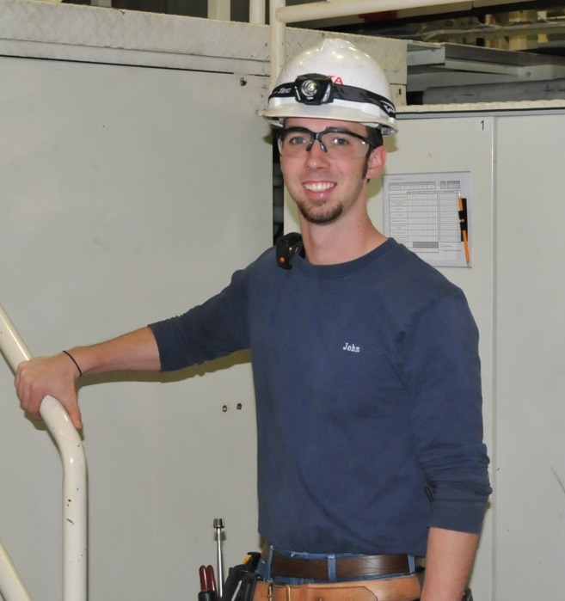
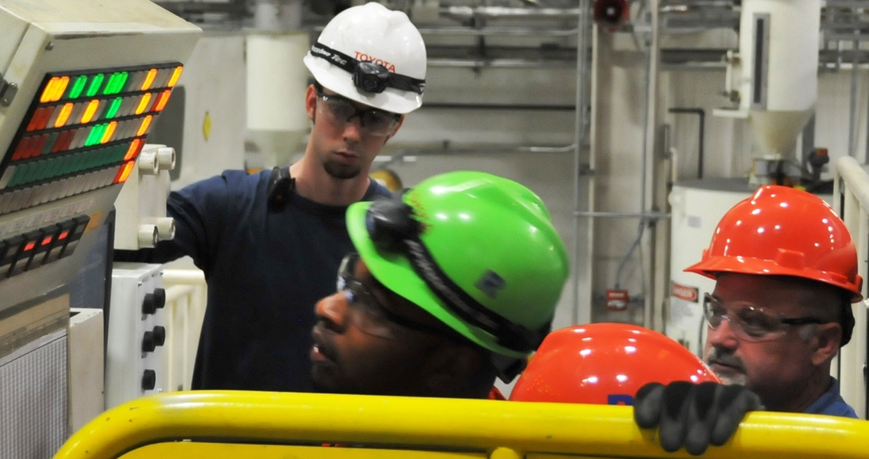
2015 Advanced Manufacturing Technician Program Conference
Motor Engineering & Manufacturing North America, Inc.
Norm Bafunno
President Toyota Motor Manufacturing, Indiana

Slide 2
Motor Engineering & Manufacturing North America, Inc.
U.S. Manufacturing Strong
PM
Purchasing Managers Index trending positive and projected to continue

Slide 3
Motor Engineering & Manufacturing North America, Inc.
Deloitte & Mfg. Institute
February 2015

Slide 4
Motor Engineering & Manufacturing North America, Inc.
Source : U.S. Census Bureau

Slide 5
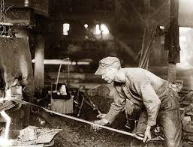
Perception
Motor Engineering & Manufacturing North America, Inc.
Reality

Slide 6
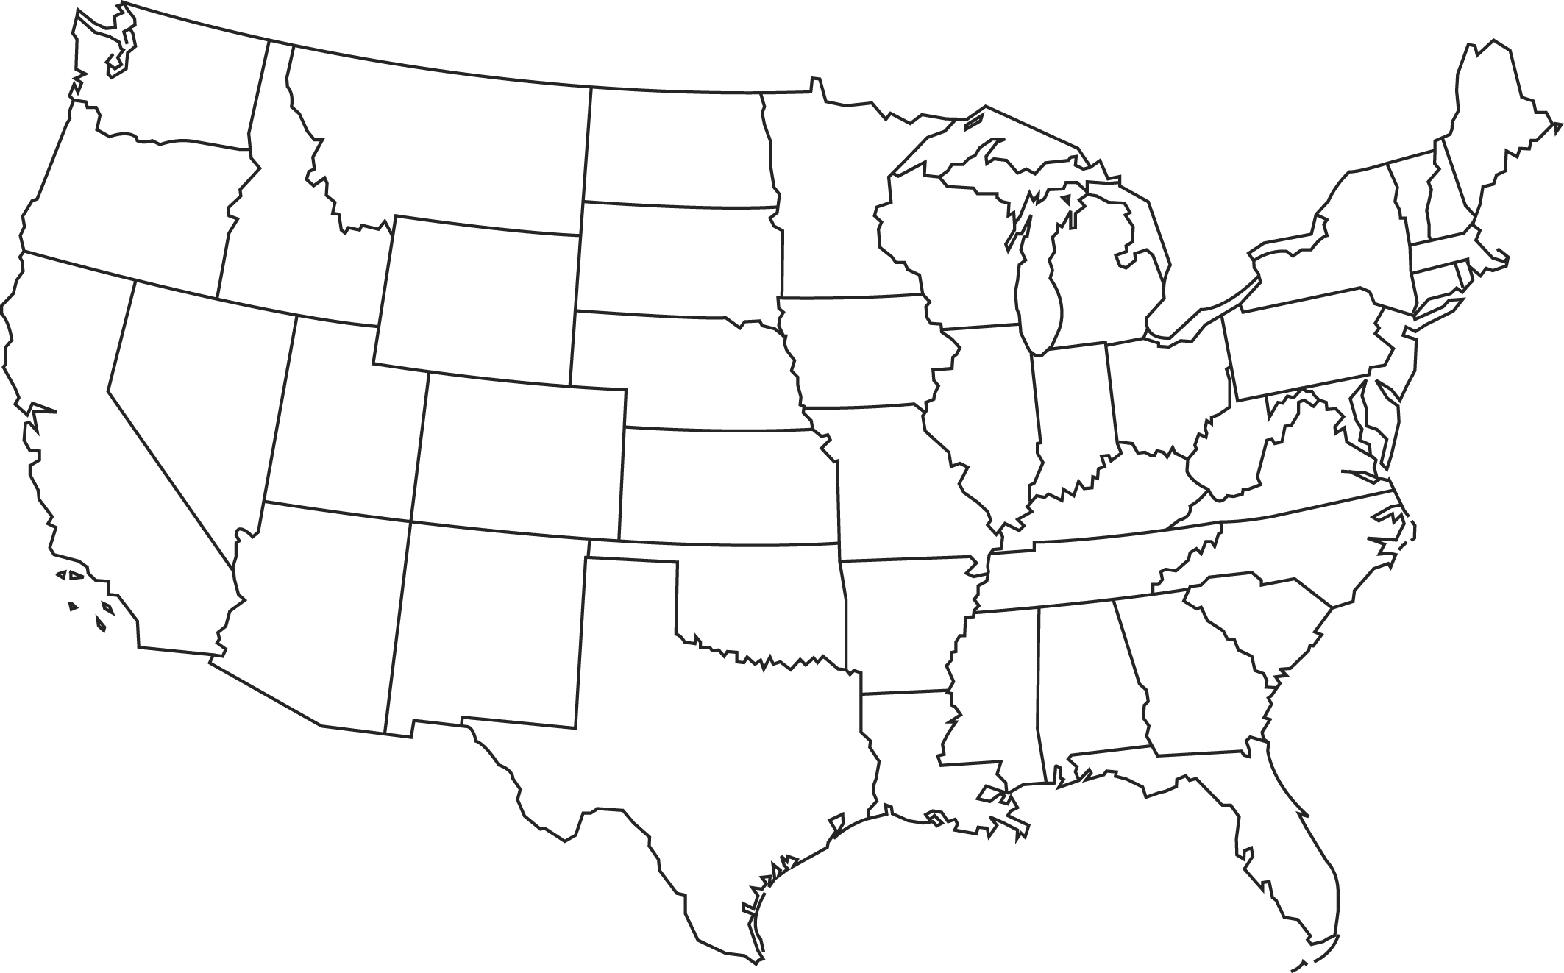
Motor Engineering & Manufacturing North America, Inc.
AMT Program Map
Alabama: Toyota Alabama
Indiana: Toyota Indiana & Jasper - IN Fame
Kentucky: Toyota Kentucky
Kentucky Fame - Greater Louisville
Kentucky Fame - Lincoln Trail
Kentucky Fame - Northern Kentucky
Tennessee: Bodine, Jackson – TN Fame
Missouri: Bodine, Troy – MO Fame
Mississippi: Toyota Mississippi
West Virginia: Toyota West Virginia
Texas: Toyota Texas
Notes:
.

Slide 7
Motor Engineering & Manufacturing North America, Inc.

Slide 8
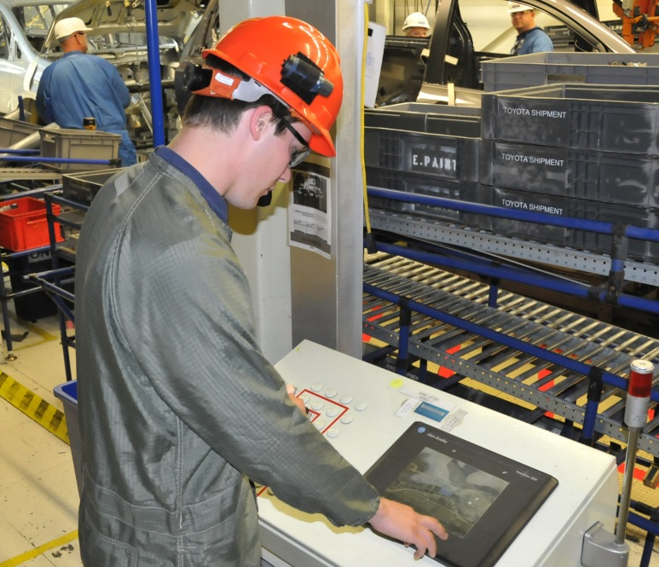
Motor Engineering & Manufacturing North America, Inc.

Slide 9
Motor Engineering & Manufacturing North America, Inc.
Q&A
Notes:
Text

