Slide 1
Welcome
Welcome
Welcome!

Slide 2
Safety First!

Slide 3
Safety First!
IN CASE OF EMERGENCY
Inform the Receptionist in the Lobby
and/or
Call: 911
ADDRESS IS: 1201 Science Park Drive, South Charleston, WV
CAMPUS SECURITY Chief “Boz:” 216.571.3969

Slide 4
Safety First!
Building Emergency
(Tornado, Fire, etc.)
Follow Conference Leaders
Shelter-in-Place: Upstairs Hallway
Outside Rally Point: Far west parking lot

Slide 5
About the South Central West Virginia Advanced Technology Center
Capstone achievement of retirinng WVCTCS Chancellor James Skidmore
First 2 regional centers for West Virginia
$15M state-of-the-art facility
Home of the West Virginia AMT Program The No. 1 Career Pathway program in the U.S.!

Slide 6
Introductions
AMT Students It’s what we’re all about, after all.
AMT Sponsoring companies
AMT College Partners
AMT University Partners
Other Manufacturing Companies
Other colleges & universities
Education/Research/Advocacy/Private
Government
NAPSC Staff

Slide 7
Restrooms
Straight across the lobby
Upstairs toward the building main entrance

Slide 8
Conference Bag
Conference “Program Guide”
Conference “Speakers & Presenters” guide.
Project Lead the Way (PLTW) Overview
Pen: Project Lead the Way
West Virginia education and manufacturing information package
Brief AMT History
Globally Competitive Technical Worker Summary

Slide 9
Name Badges
Green – AMT Student
White/Green Letters – AMT Sponsoring Co.
White/Blue Letters – AMT College Partner

Slide 10
Schedule
Schedule is on the back cover of the Program Guide.
Conference Hand-Outs/Power Points
Will be provided by .pdf after conference

Slide 11
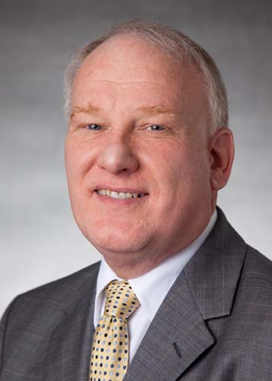
Opening Speaker
First chancellor of the West Virginia Community & Technical College System
State-level education administration for 29 years
133 new technical programs. 35% increase in infrastructure budgets.
Led the AMT Program to West Virginia.
JAMES SKIDMORE

