Slide 1
TMMWV Advanced Manufacturing Technician Program
Presented by
Jacob Hill
Dennis Gibson
Kain Ramey
Shane Hager

Slide 2
When was the AMT program started in West Virginia?
The AMT program at TMMWV started in 2012
TMMWV was the 2nd Toyota plant to implement the AMT program

Slide 3
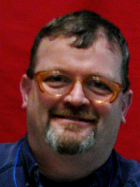
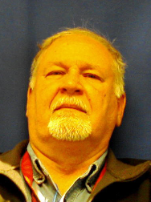
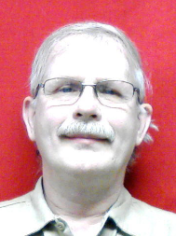
Fame and AMT leaders of WV
West Virginia currently does not have a FAME organization.
AMT leaders at WV are Mike Howard, Butch Smith, and Dennis Dunbar.
Mike Howard
Butch Smith
Dennis Dunbar

Slide 4
Current Students
10 first year students (Freshman)
9 second year students (Graduated)
4 graduates are interns at TMMWV
Currently no AMT graduates have been hired by TMMWV

Slide 5
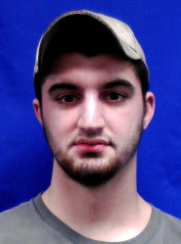
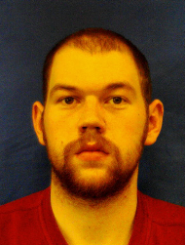
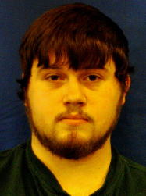
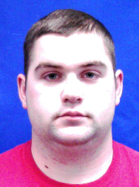
Current Interns
Trent
Surface
Cole
McLane
Adam
Haynes
Jordan
McCarty

Slide 6
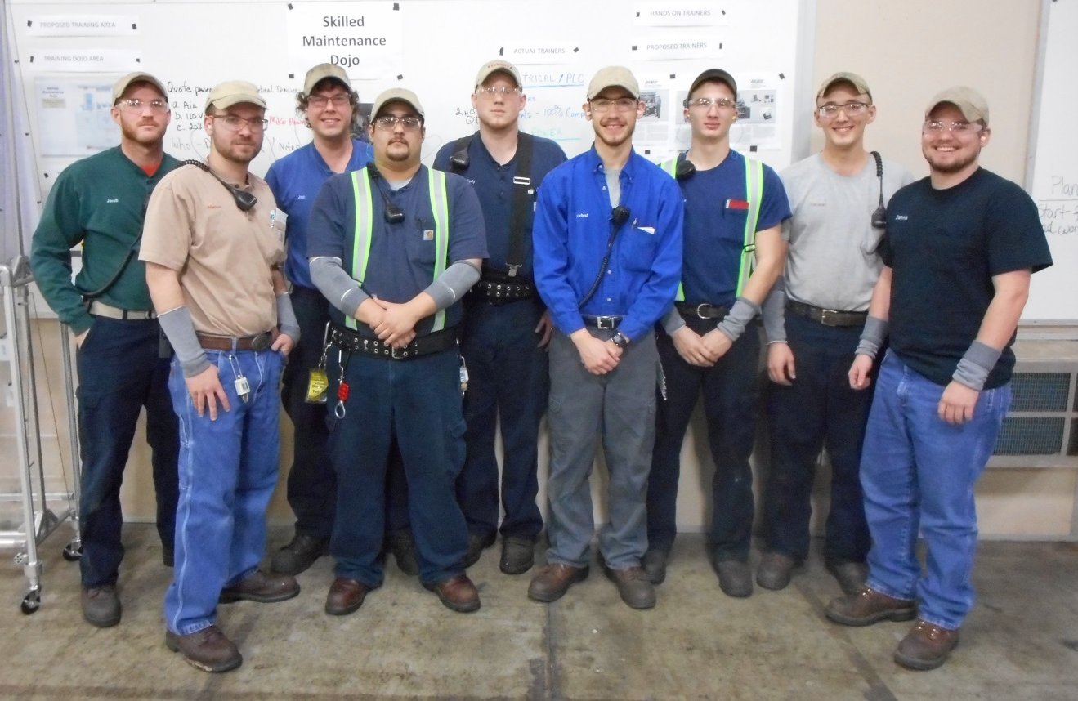
Graduated Sophomores

Slide 7
Freshmen

Slide 8
Educational Partner
TMMWV’s educational partner is BridgeValley Community and Technical College
Located in South Charleston, WV
BridgeValley is home to a brand new state of the art Advanced Technology Center
Opened Fall of 2014

Slide 9
Advanced Manufacturing Center
AMC

Slide 10
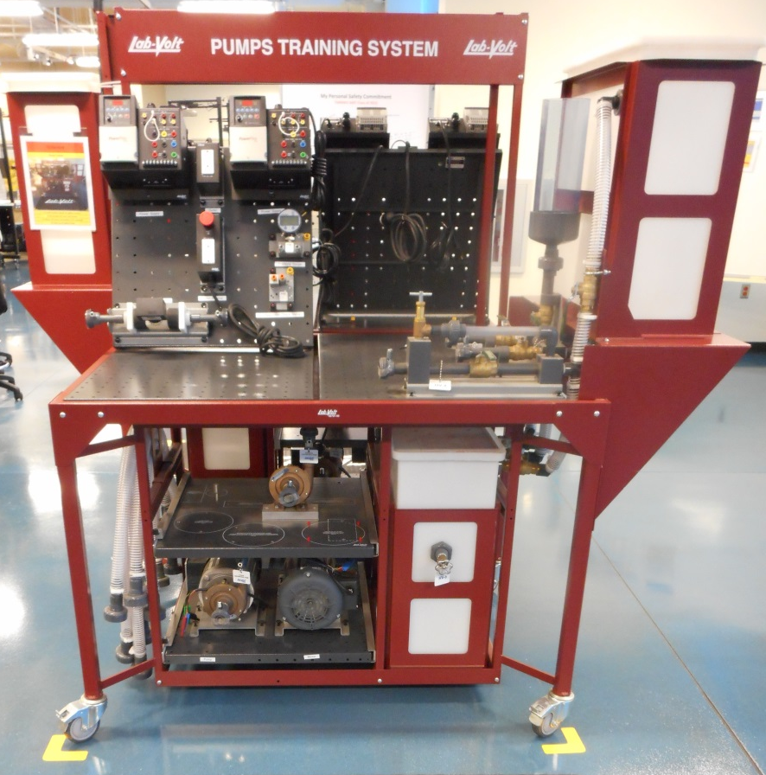
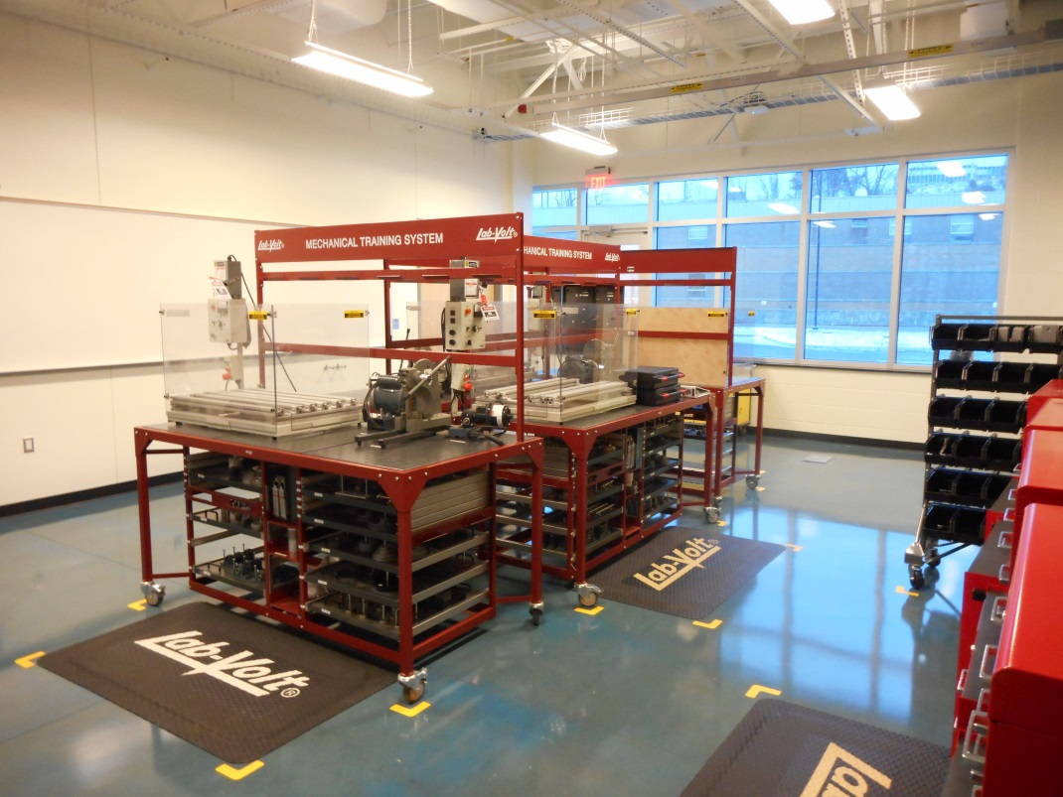
LabVolt Trainers

Slide 11
LabVolt Trainers Continued

Slide 12
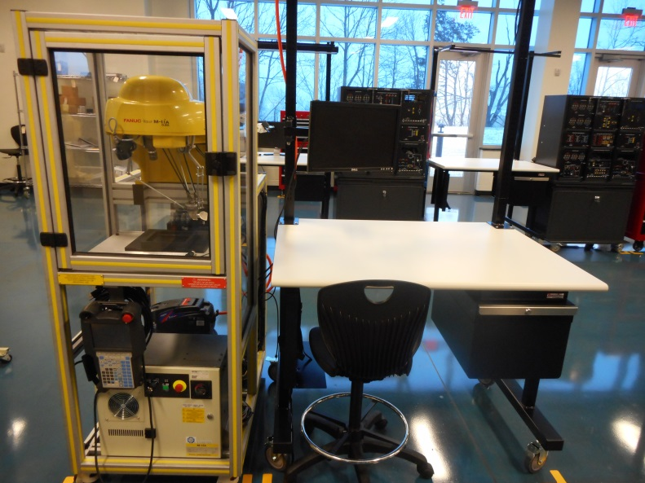
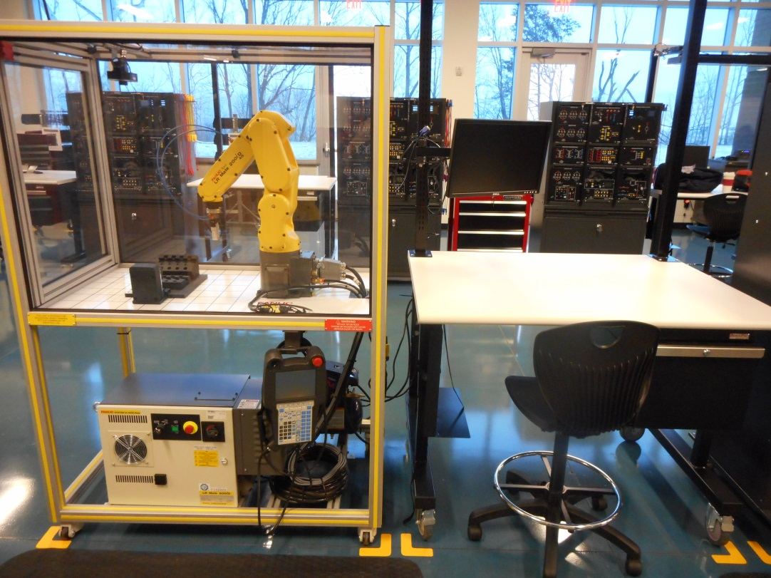
Robotics

Slide 13
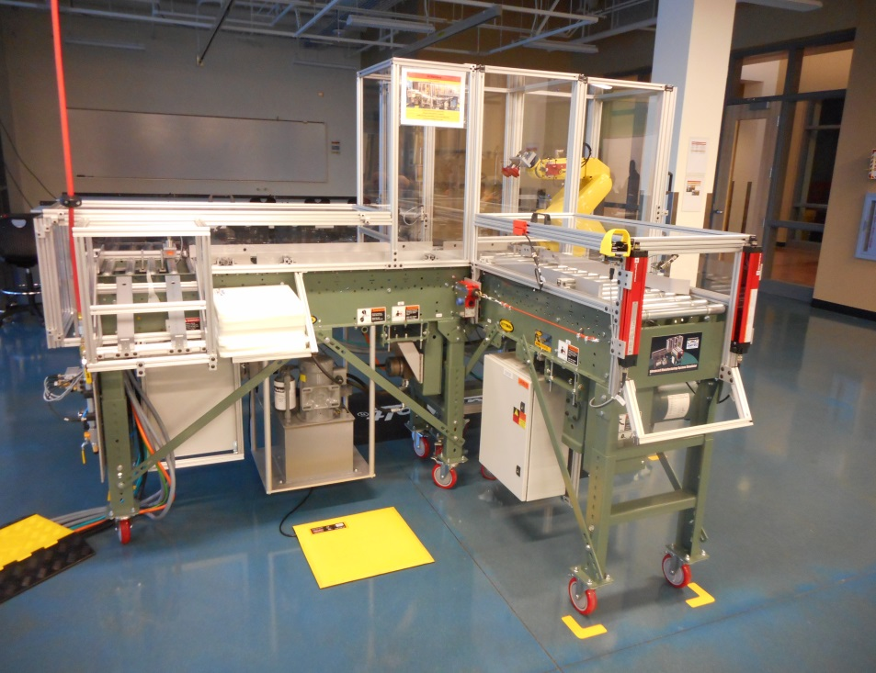
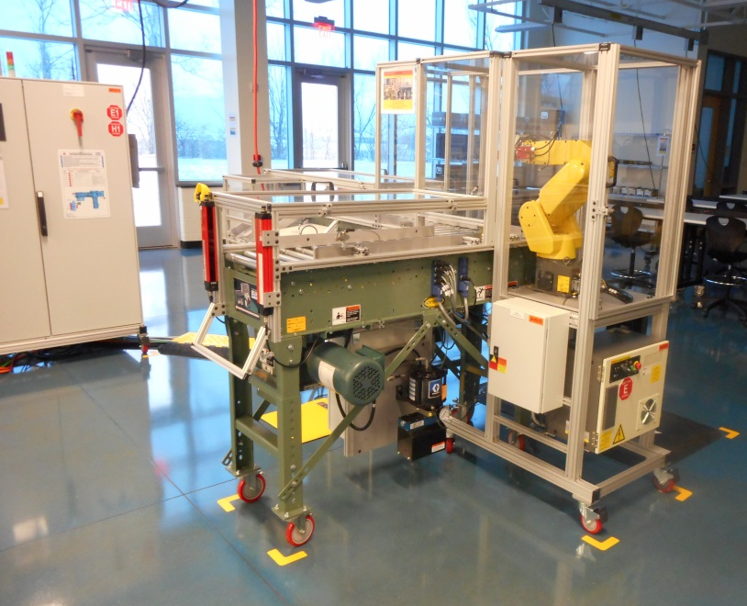
Troubleshooting Simulator

Slide 14
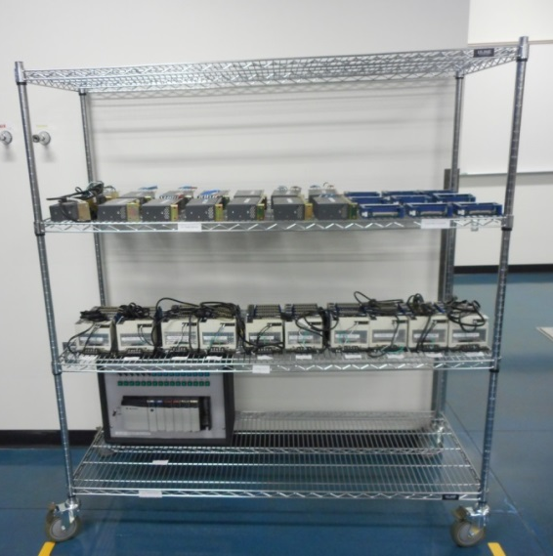
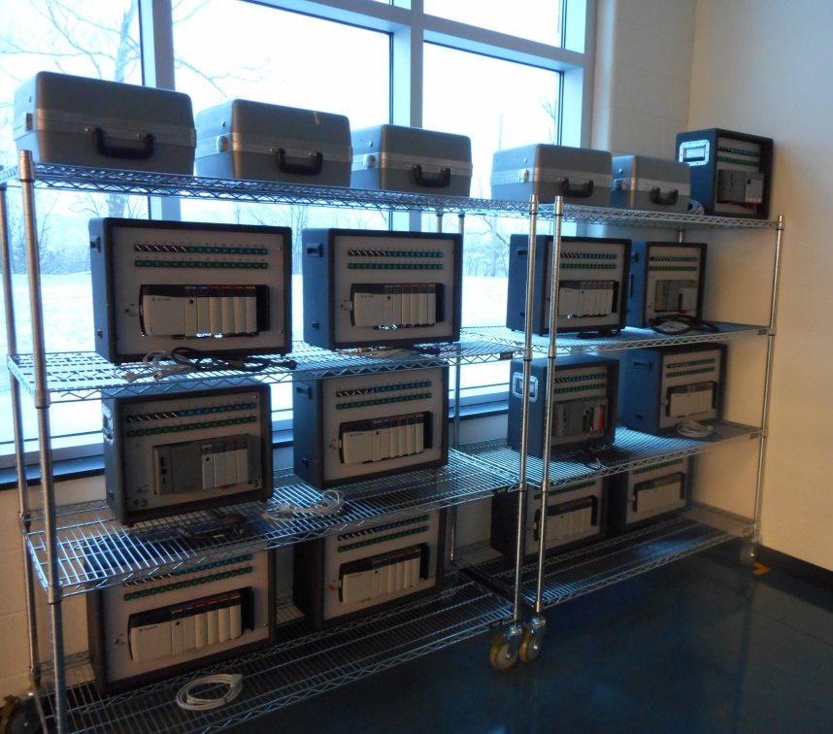
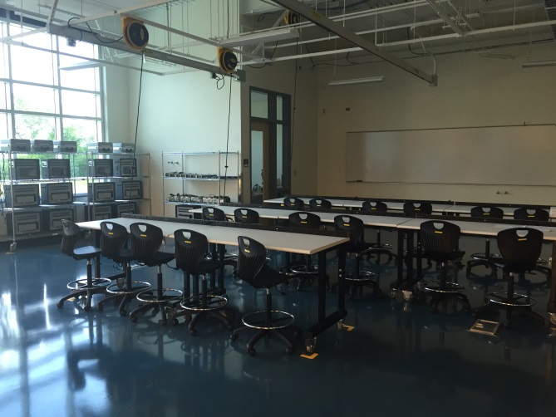
PLC Training Area

Slide 15
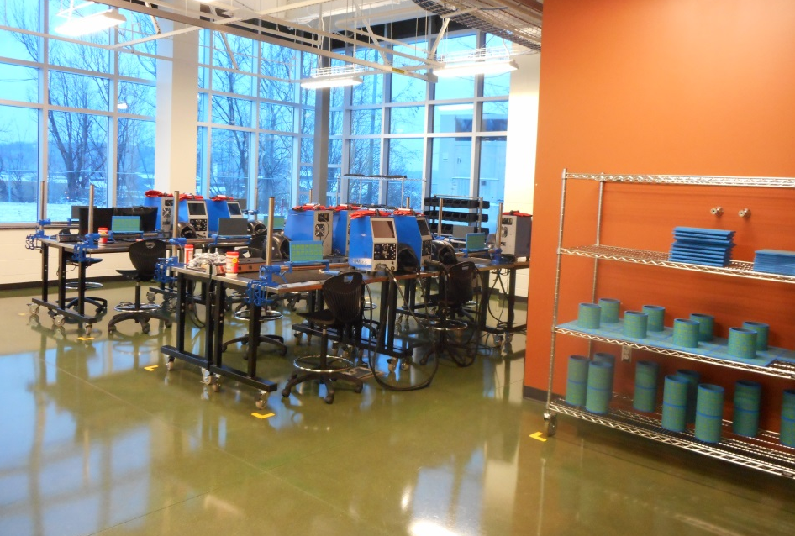
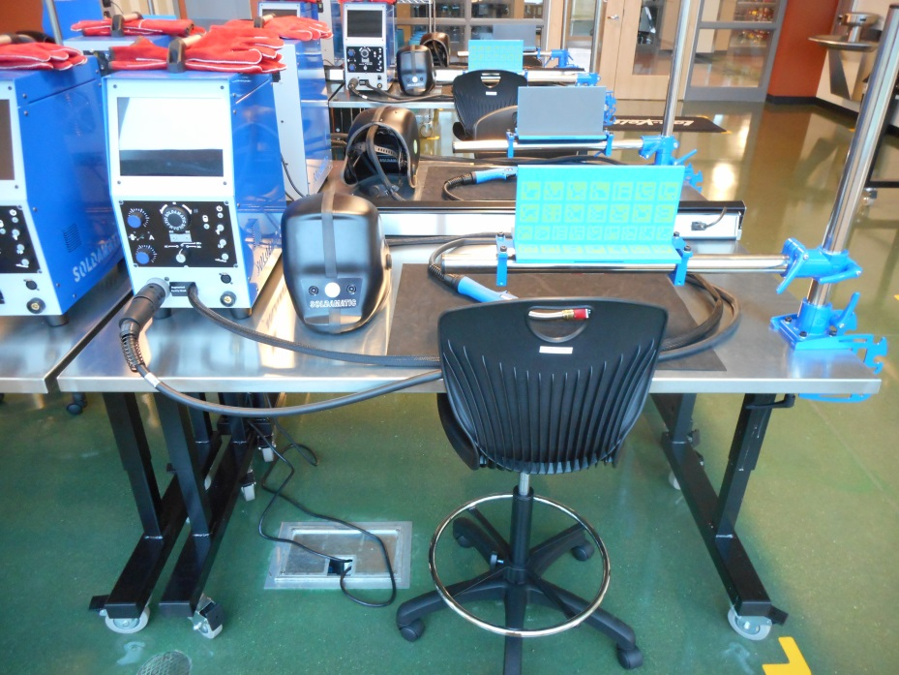
Virtual Welding Lab

Slide 16
AMT Events & Projects
Implementing 5S
Kentucky FAME
Fence Project
Lego Competition
Discover Manufacturing Day
Founders Day
AMT Training Classroom
Maintenance DOJO development
Hydraulic Hose Station
Confined Space Cart
Recruiting

Slide 17
School 5S Project
Implemented the 5S system at school
Divided classrooms into 7 zones
Sifted, Sorted, Swept and Set a standard for each zone
Developed a schedule and rotation for who is responsible for their zone
Helped to teach the school faculty how to sustain a good 5S condition

Slide 18
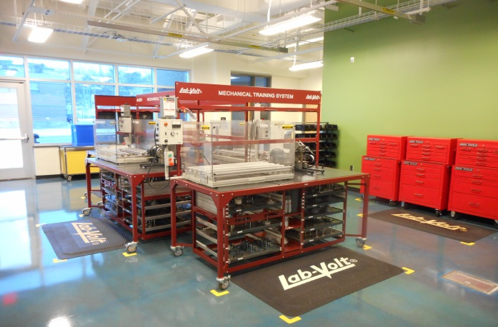
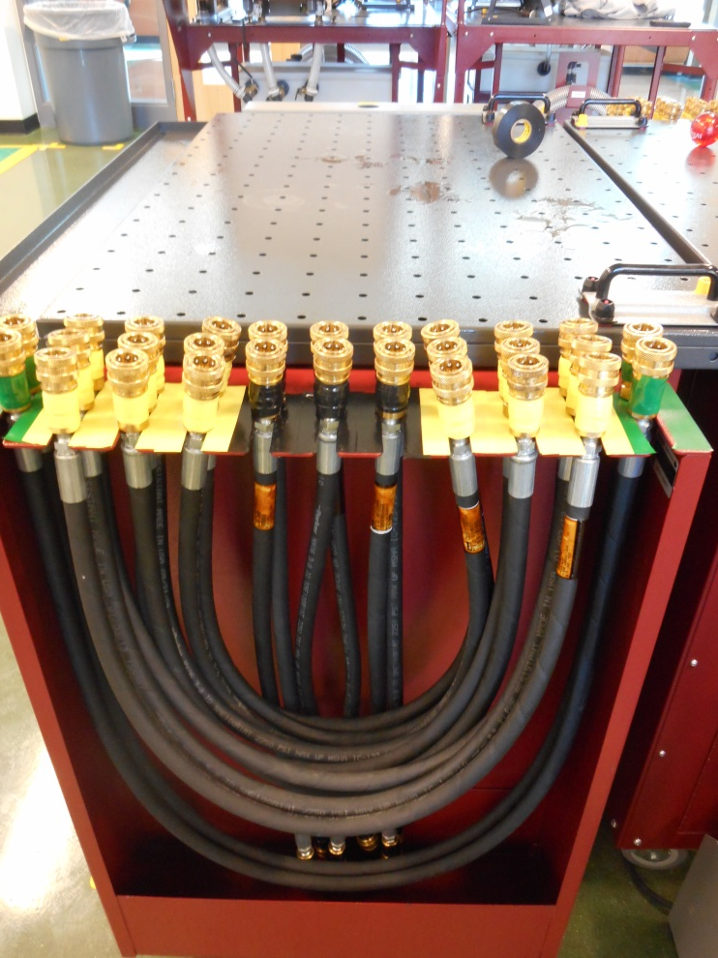
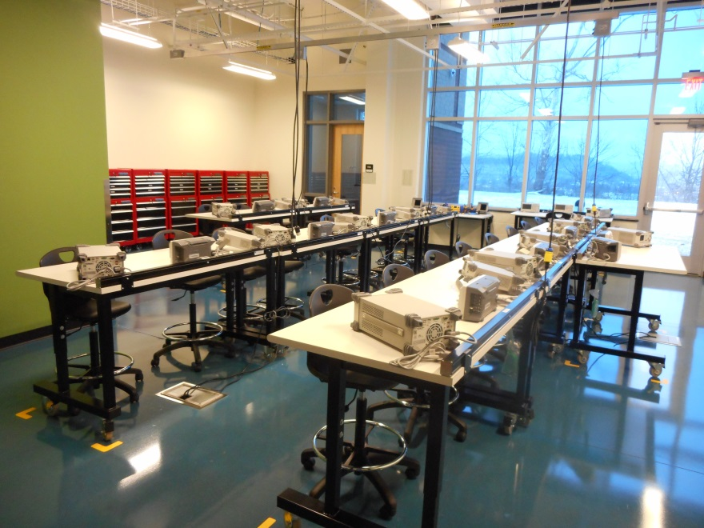
5S Project

Slide 19
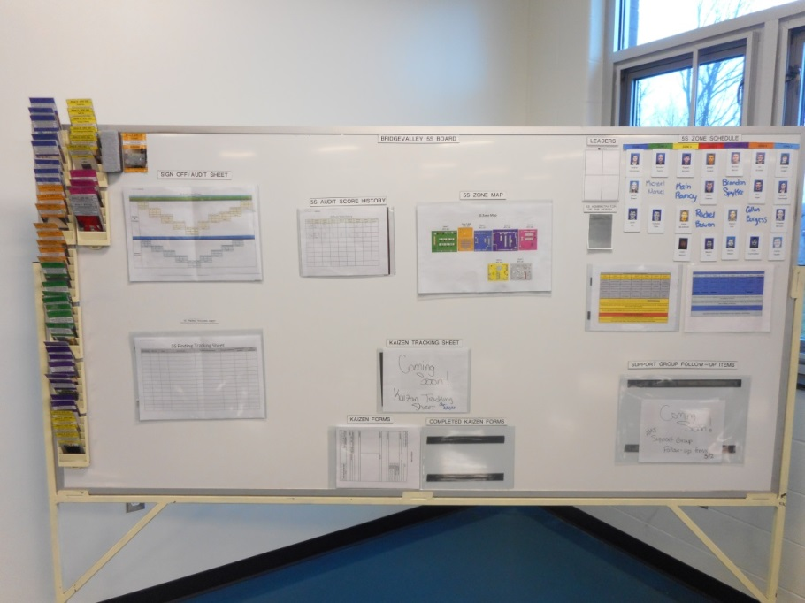
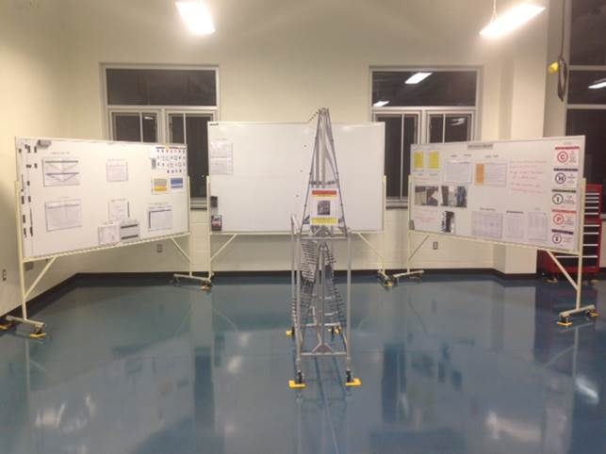
5S Communication Boards

Slide 20
Kentucky Fame Visit
AMT class gave tours of each lab area: electrical, pneumatic, mechanical, and welding labs
Explained how 5S of each lab was implemented and how each room is maintained
PowerPoint presentation on our overall 5S project at the ATC Toyota Hall

Slide 21
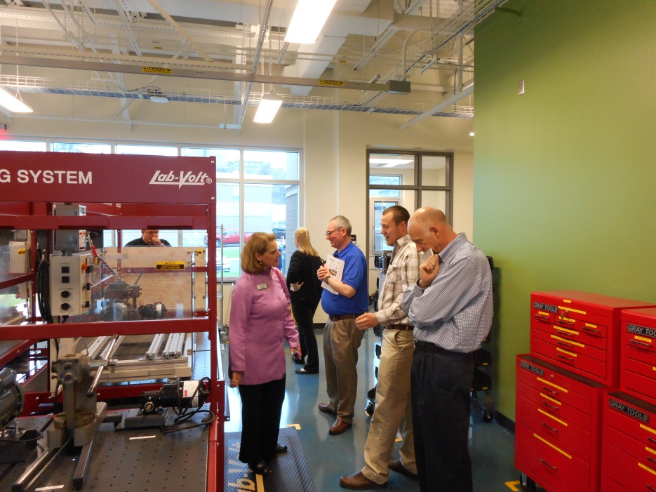
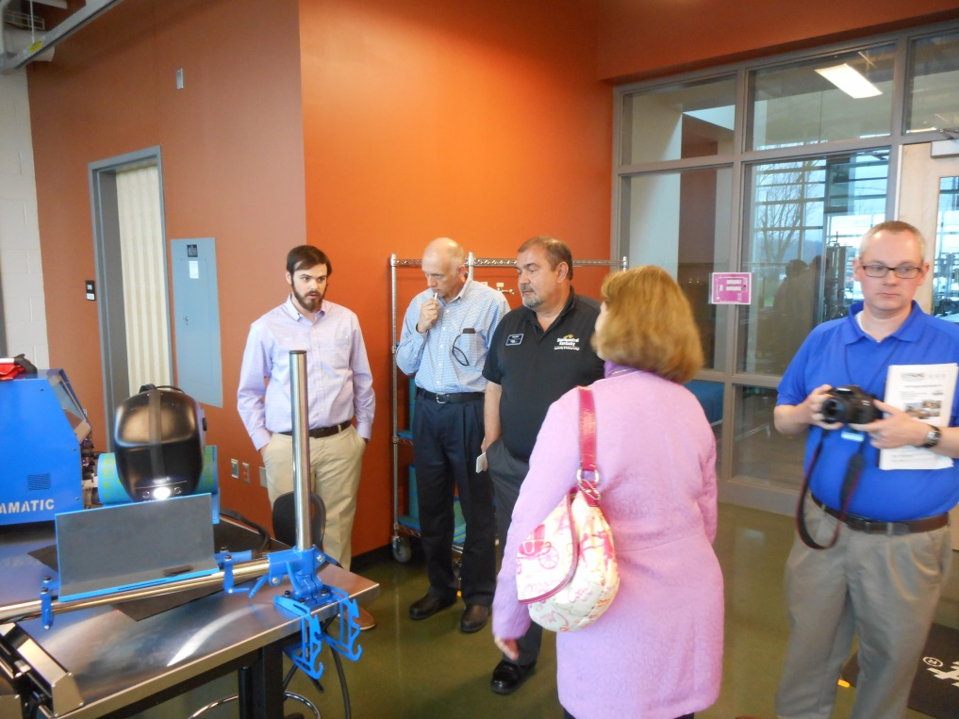
Kentucky Fame Visit

Slide 22
Fence Project
Group project to plan and construct a fence around the skilled maintenance dojo
Based on:
Safety
Teamwork
Leadership
Highest quality

Slide 23
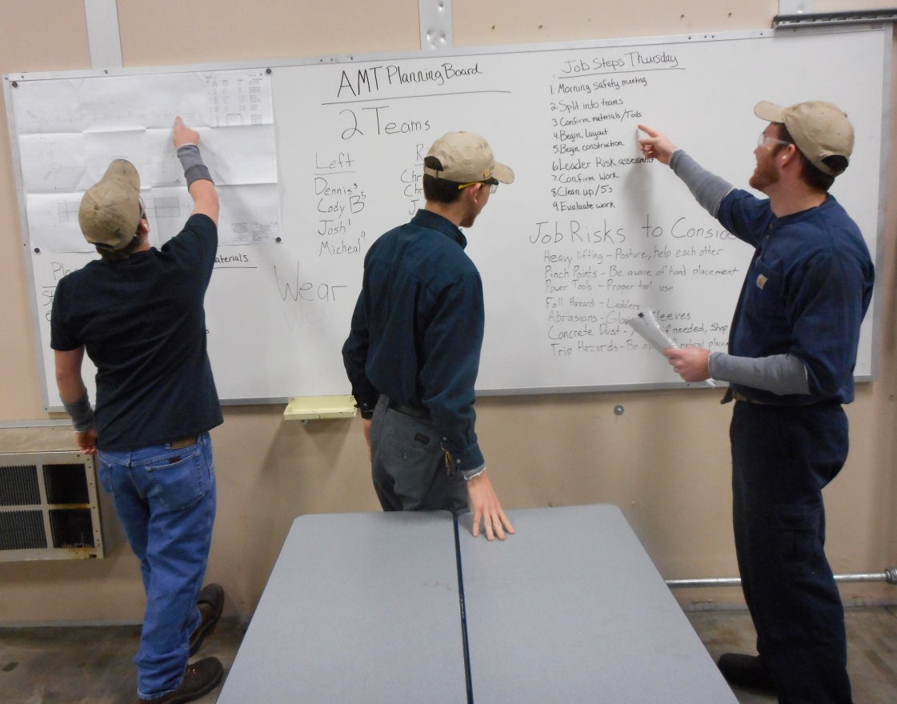
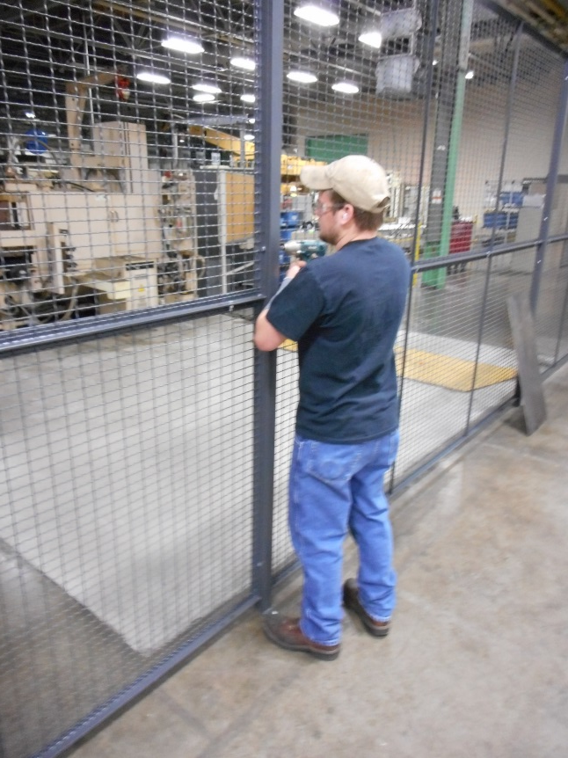
Fence Project

Slide 24
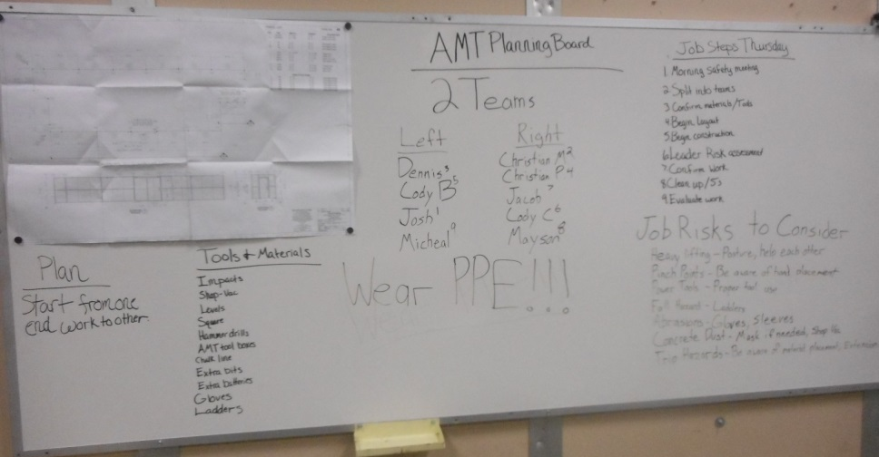
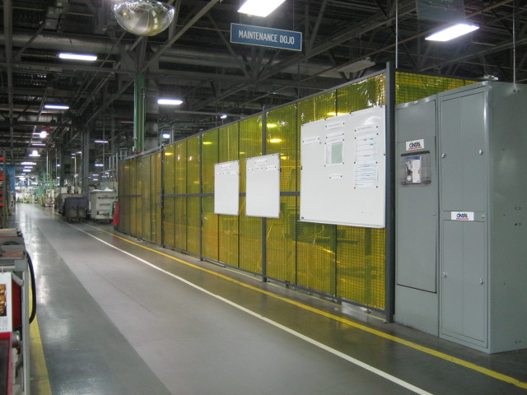
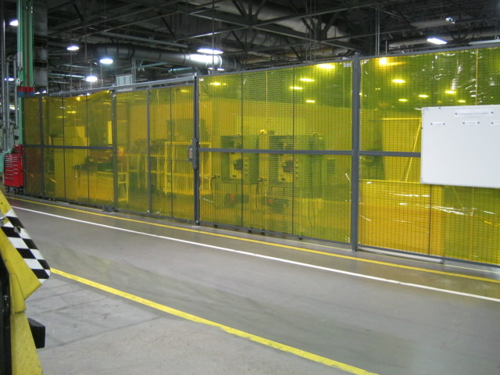
Fence Project

Slide 25
Lego Competition
AMT students attended the LEGO Robotics Competition at Ashland Community and Technical College
Intended to spread awareness of the STEM educational process and the AMT program.
AMTs played a large role in setting up for the competition, as well as presenting their AMT program.

Slide 26
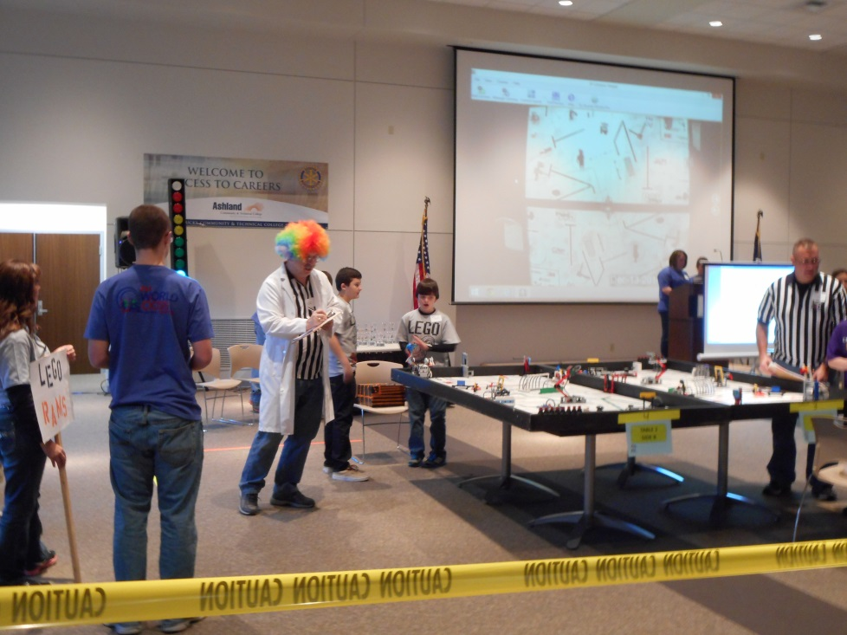
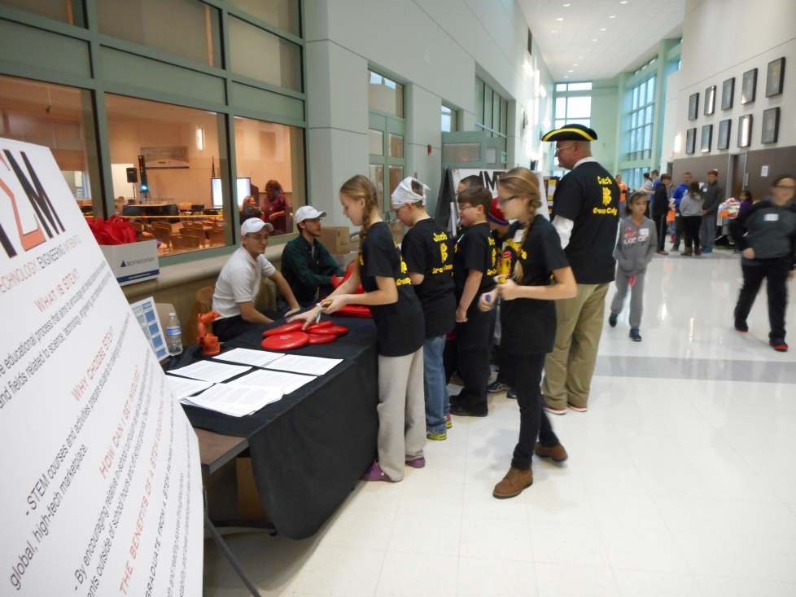
Lego Competition

Slide 27
Discover Manufacturing Day
A group of middle school students from the Putnam and Kanawha County areas came to visit the Advanced Technology Center.
The AMTs were tour guides for the middle school students.
The visit was intended to teach students about manufacturing and how it has changed over recent decades.

Slide 28
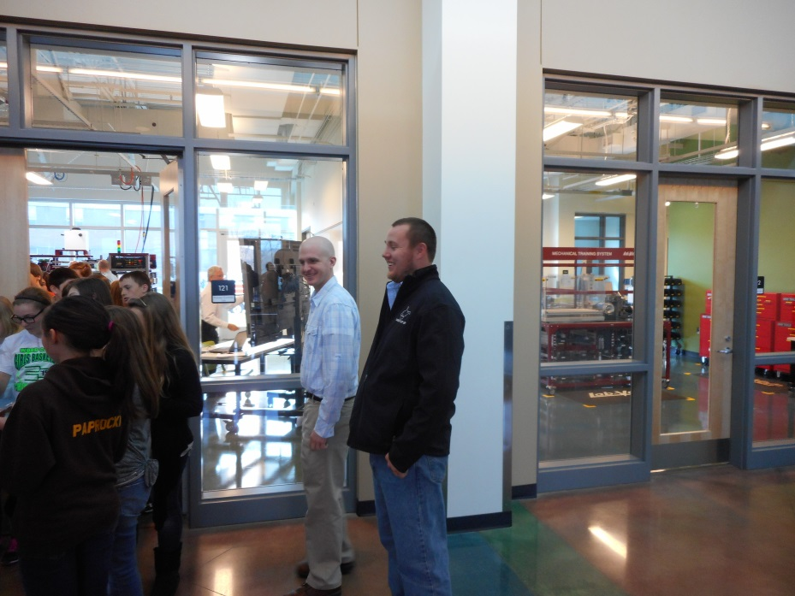
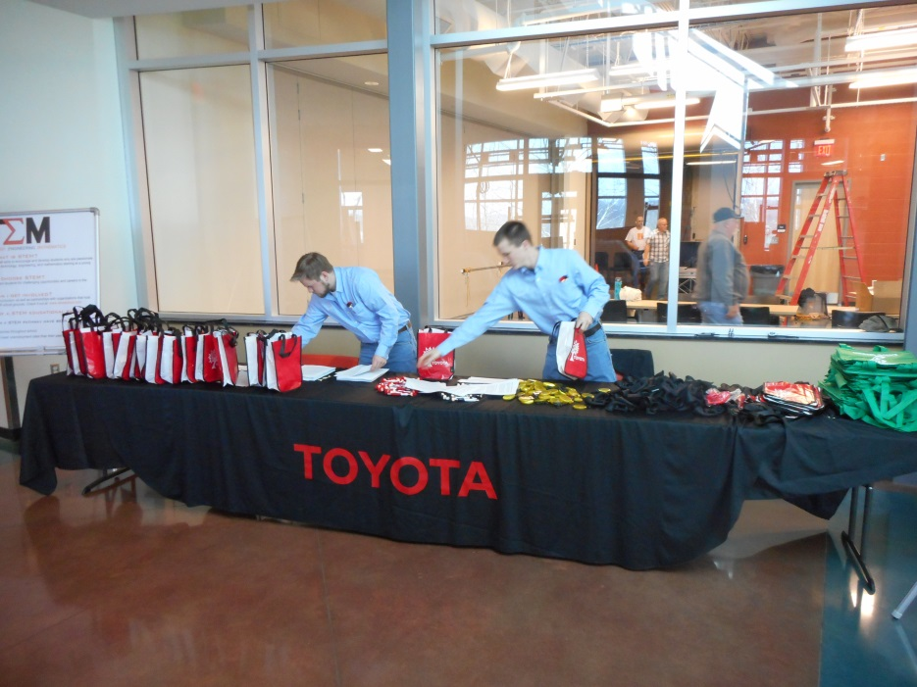
Discover Manufacturing Day

Slide 29
Founders Day
Founder’s Day unveiled Toyota Hall at the BridgeValley Advanced Technology Center
Millie Marshall, the president of TMMWV, WV Senator Joe Manchin III, and WV Governor Earl Ray Tomblin were present

Slide 30
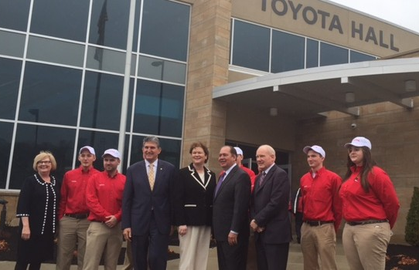
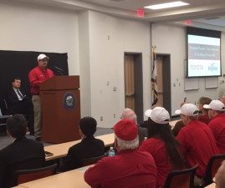
Founders Day

Slide 31
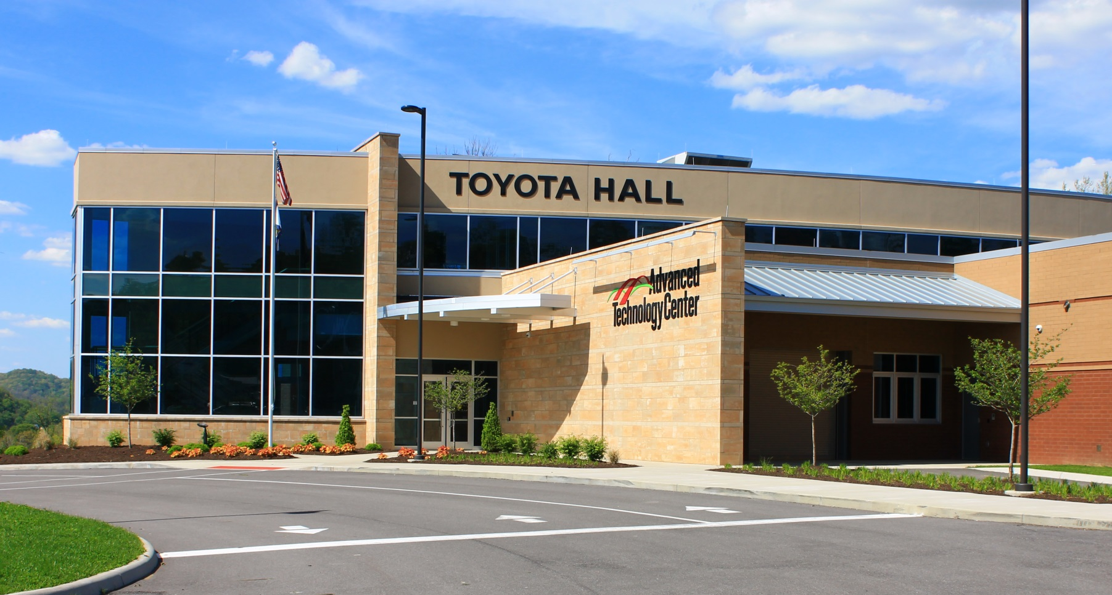
Founders Day

Slide 32
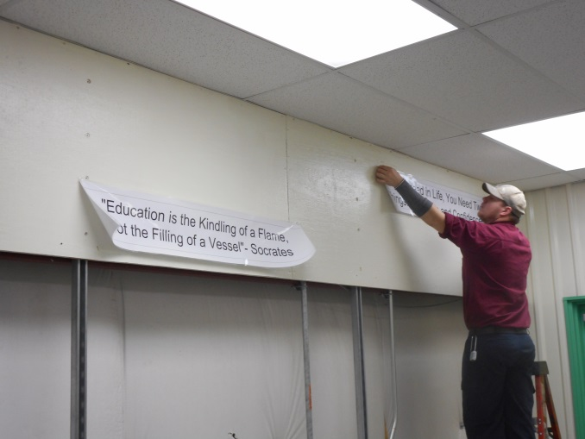
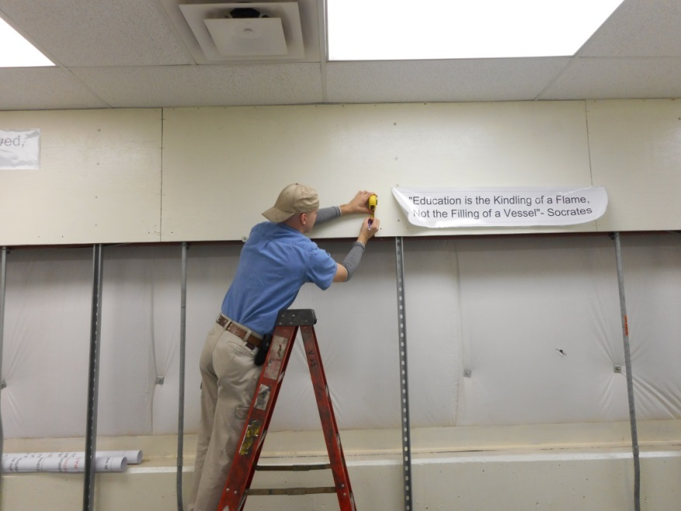
AMT Training Classroom
Developed a training classroom at TMMWV
Fulfill AMT meetings and training needs

Slide 33
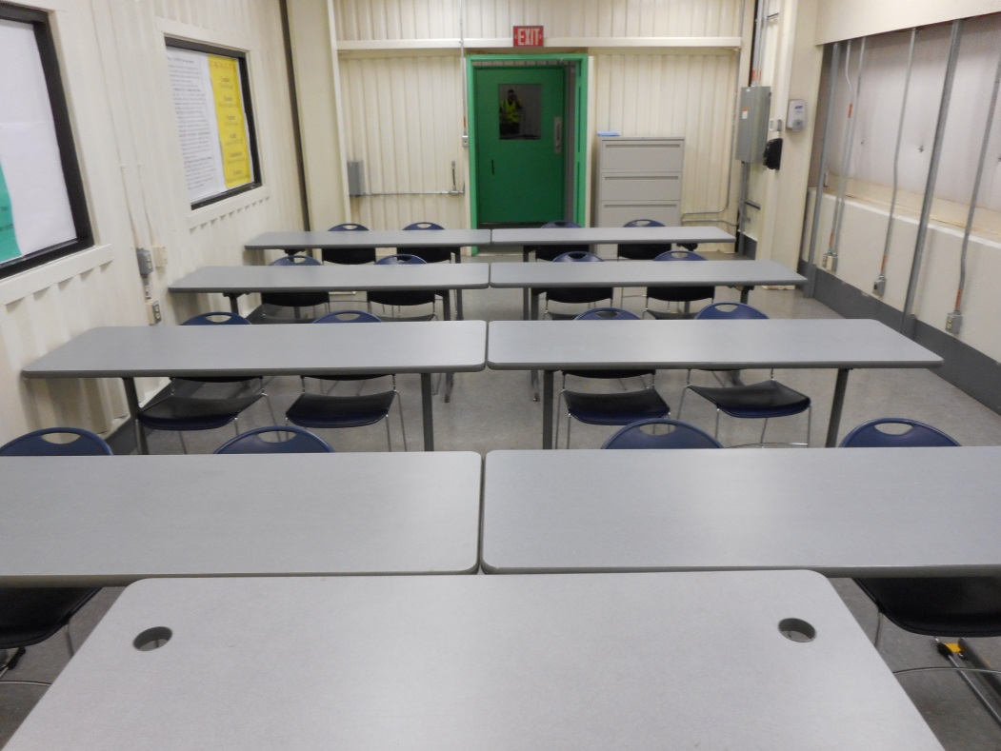
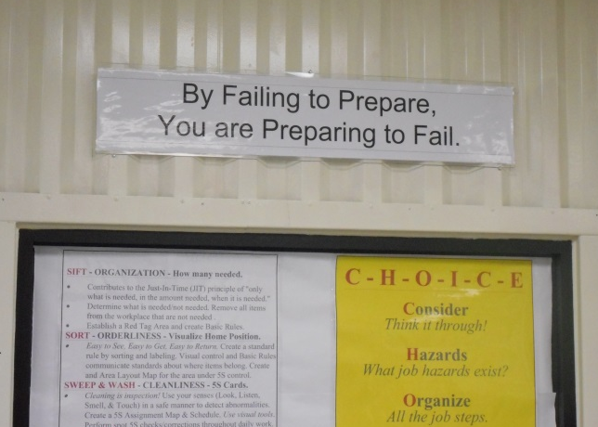
AMT Training Classroom

Slide 34
Maintenance Dojo
5s an area in the plant to be strictly used as maintenance training area
Created Spare tools cabinets
Fabricated trainers for all skilled areas of maintenance
Mobility in training
Tools readily available

Slide 35
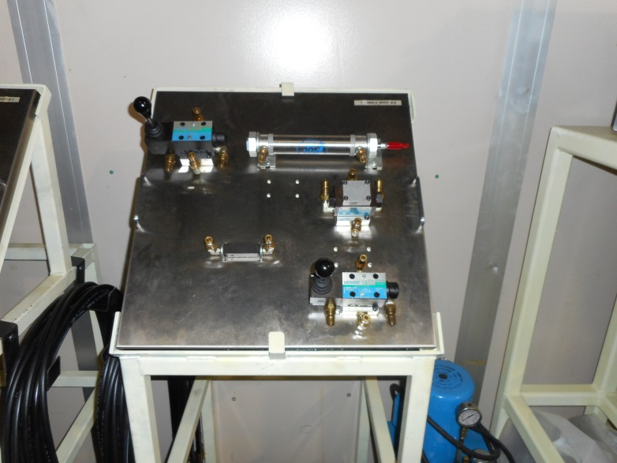
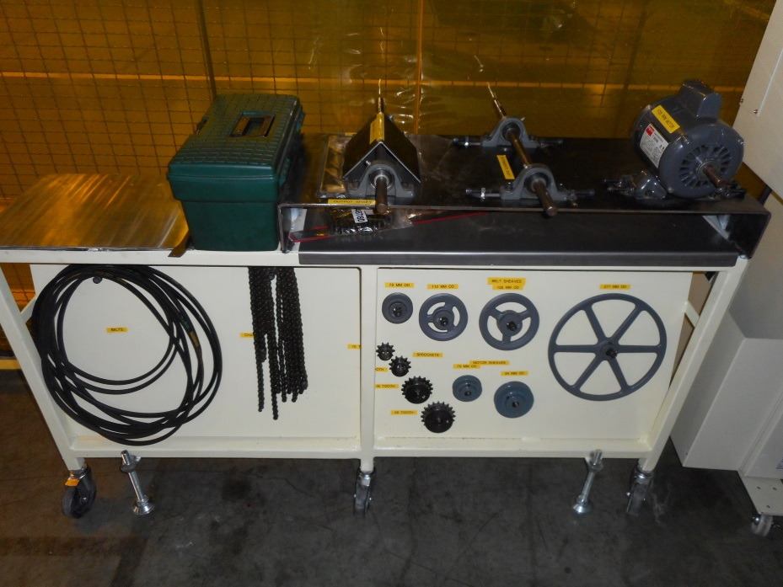
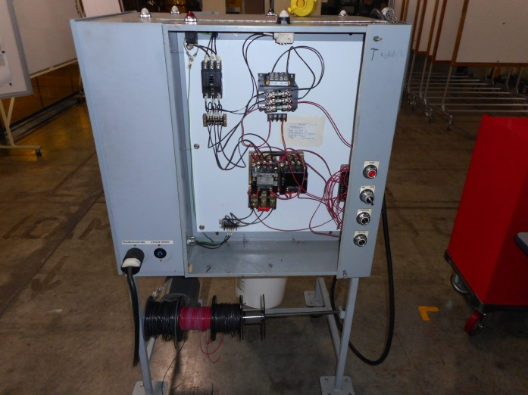
Maintenance Dojo

Slide 36
Hydraulic Hose Station
Hydraulic hose station was in need of standardization due to being unorganized
Inventoried fittings and hoses
Kanbans made
Fittings and Dies labeled
Made a hose rack

Slide 37
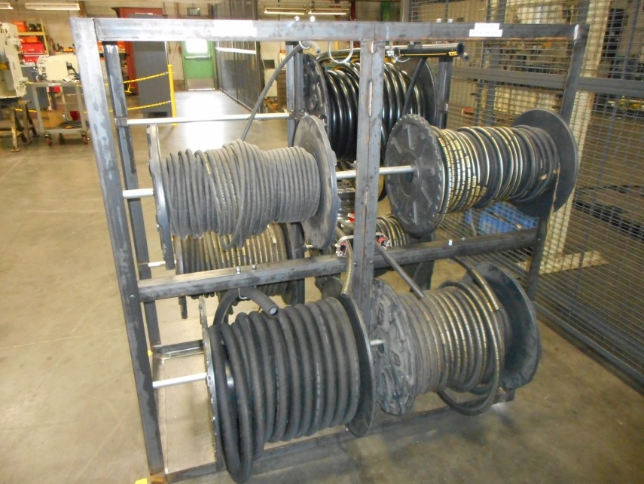
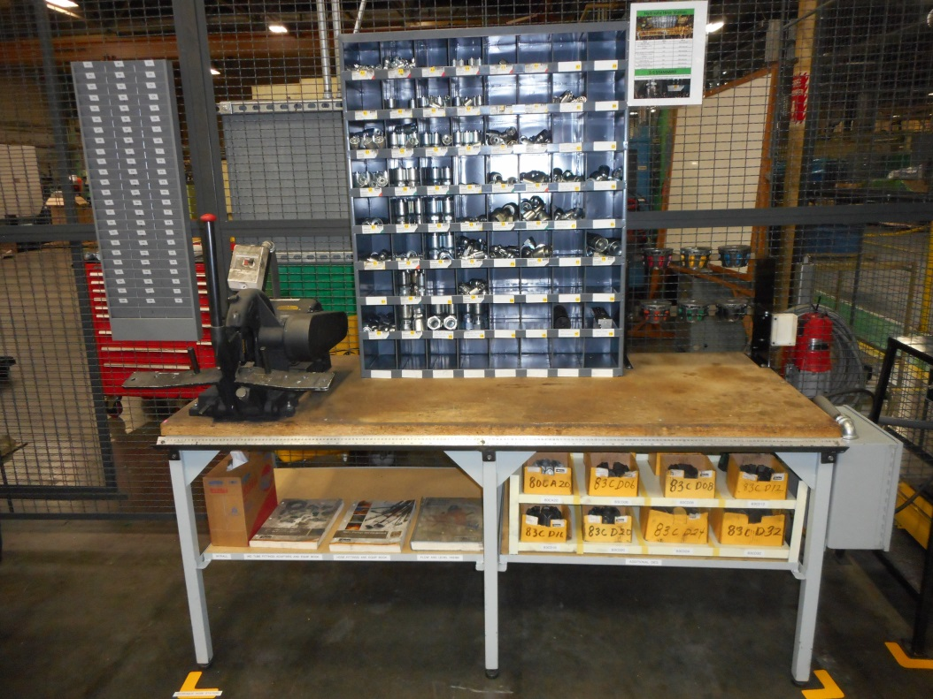
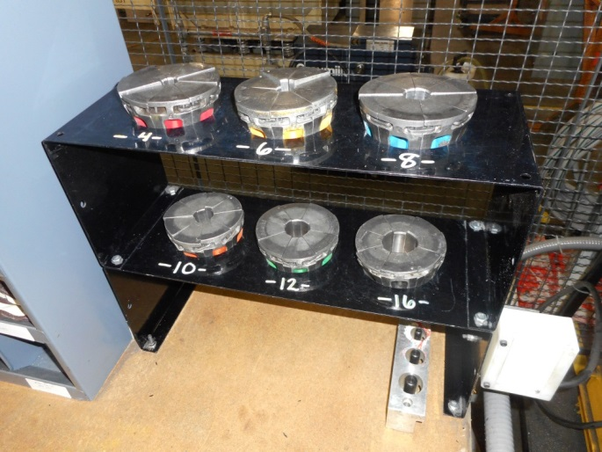
Hydraulic Hose Station

Slide 38
Confined Space Cart
Standardized a mobile cart for confined space entry
Equipped with all OSHA required items
Check list to return all items after use
Made available for all team members and contractors certified for confined space

Slide 39
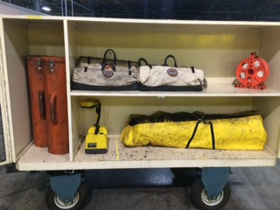
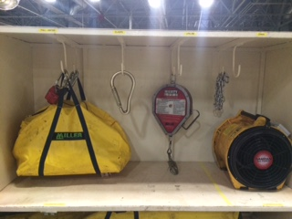
Confined Space Cart

Slide 40
Recruiting
Visited several local high schools and vocational schools.
Talked to students about pursuing a career in manufacturing.

Slide 41
TMMWV AMT Program Summary
Our program is young but growing rapidly due to the demand for skilled technicians in West Virginia
Very involved in our community
Helping younger students learn about manufacturing
Completed several projects at school and work

