Slide 1
TMMMS AMT Program
2nd Annual AMT Conference
May 19-20, 2015
Theo Babb, TMMMS Skilled AM
Bethanie Humphries, TMMMS Specialist
Isabella Sharpe, AMT Student
Cody Box, AMT Student
James Davis, ICC Instructor

Slide 2
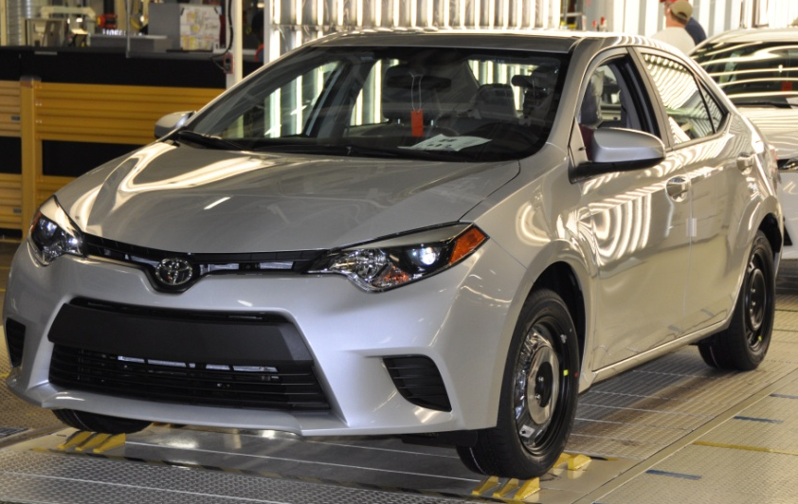
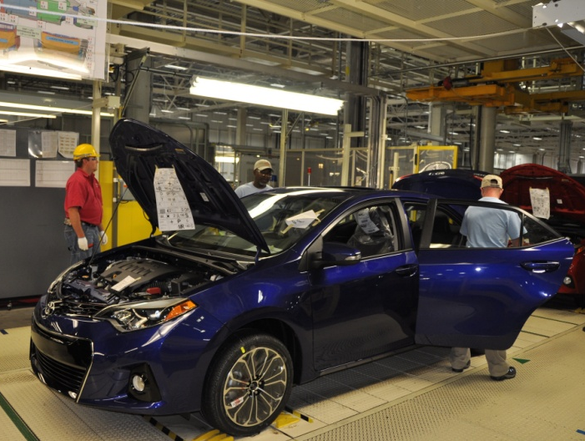
Toyota Mississippi
500,000th Corolla
February 12, 2015
Blue Springs, MS
2,000 jobs
$880 Million Investment
11th Generation SOP July 2013
Annual Capacity: 170,000 units
700 Corollas produced per day

Slide 3
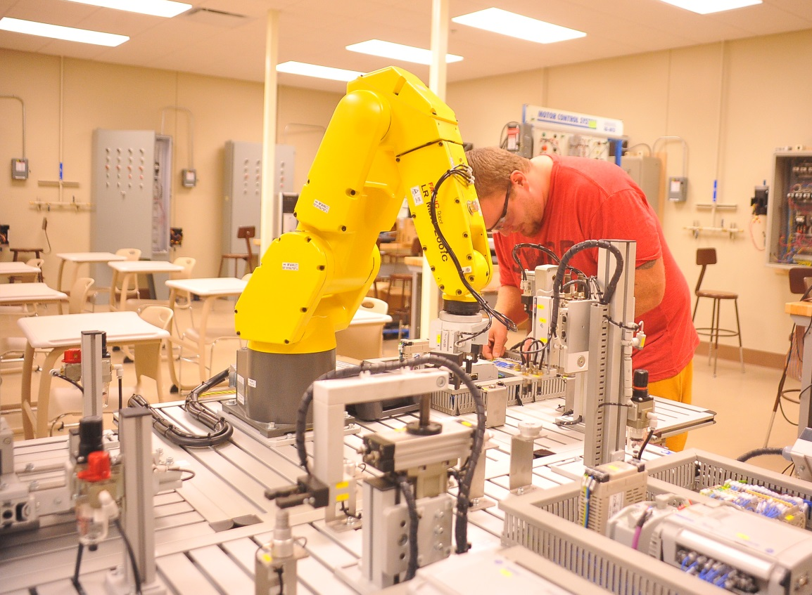
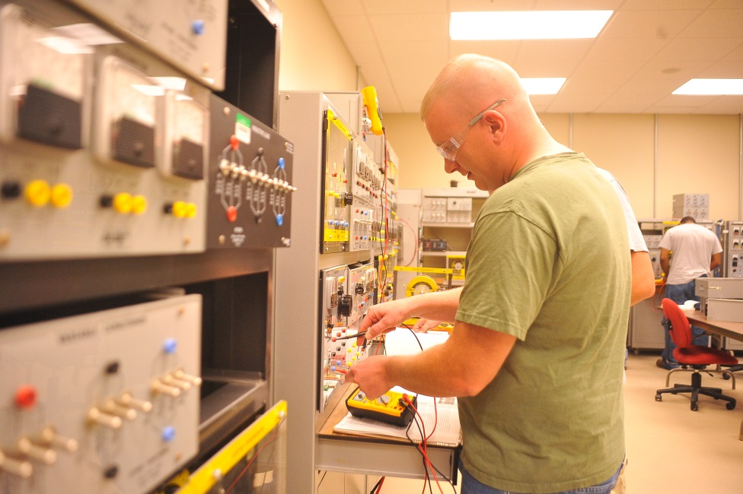
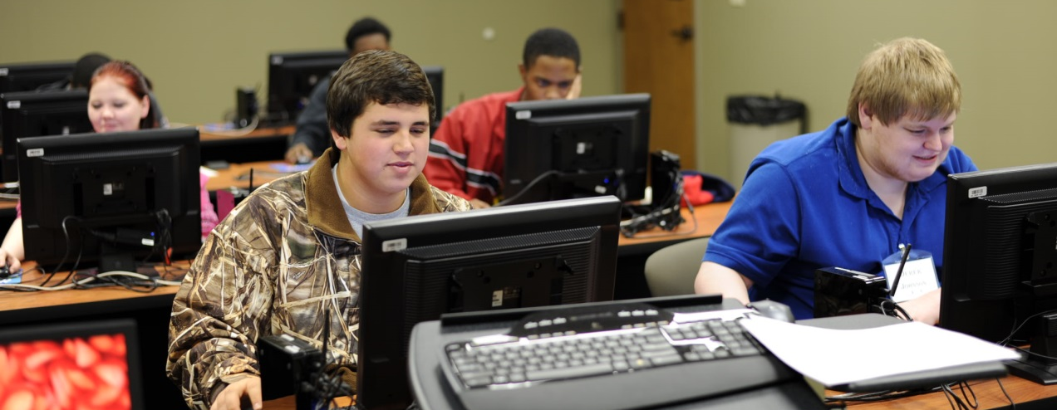
Itawamba Community College

Slide 4
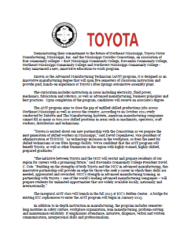
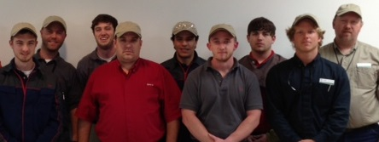
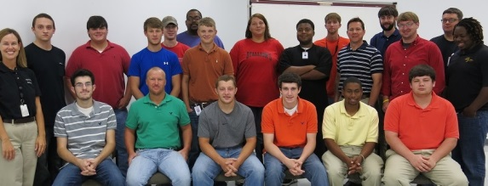
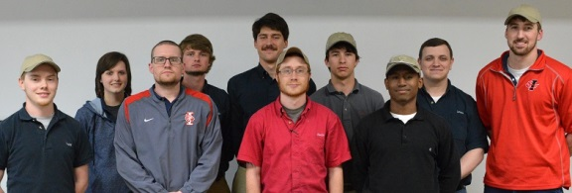
TMMMS AMT Program
December 2012
Announced partnership for AMT program at ICC
“Bridge group” of 10 sophomores in IM/ET started (4 hired FT – Jan14)
January 2013
August 2013
Inaugural AMT class started – 15 freshmen; 5 sophomores (2 hired FT – Jan15)
Cohort of 11 new freshmen started AMT program
August 2014
Notes:
December 2012 – Toyota Mississippi, along with Mississippi Corridor Consortium of 5 community colleges, announced partnership for Advanced Manufacturing Technician program.
January 2013 – “Bridge group” of 10 sophomores in Industrial Maintenance/Electrical Technology started; 5 entered internship phase in Fall 2013 and 4 were hired by TMMMS in January 2014
August 2013 – Inaugural AMT class started at Itawamba Community College – 5 sophomores in Industrial Maintenance/Electrical Technology – “bridge group” and 15 freshmen
May 2014 – 5 “bridge group” students graduated; 2 entered internship phase at TMMMS – hired by TMMMS in January 2015
August 2014 – Cohort of 11 new freshmen started AMT program – 1st semester in production
May 2015 – 12 students graduate – 1st group to complete 2-year program at TMMMS – 8 transitioning into internship phase

Slide 5
TMMMS AMT Program by the Numbers
Since 2013…
40 AMT Students (including 15 “bridge group”)
24 completed AMT program
6 hired full-time by Toyota Mississippi
7 start internship phase June 1st
10 entering 2nd year of AMT program
For the future…
12 AMT students scheduled to start Aug 10th

Slide 6
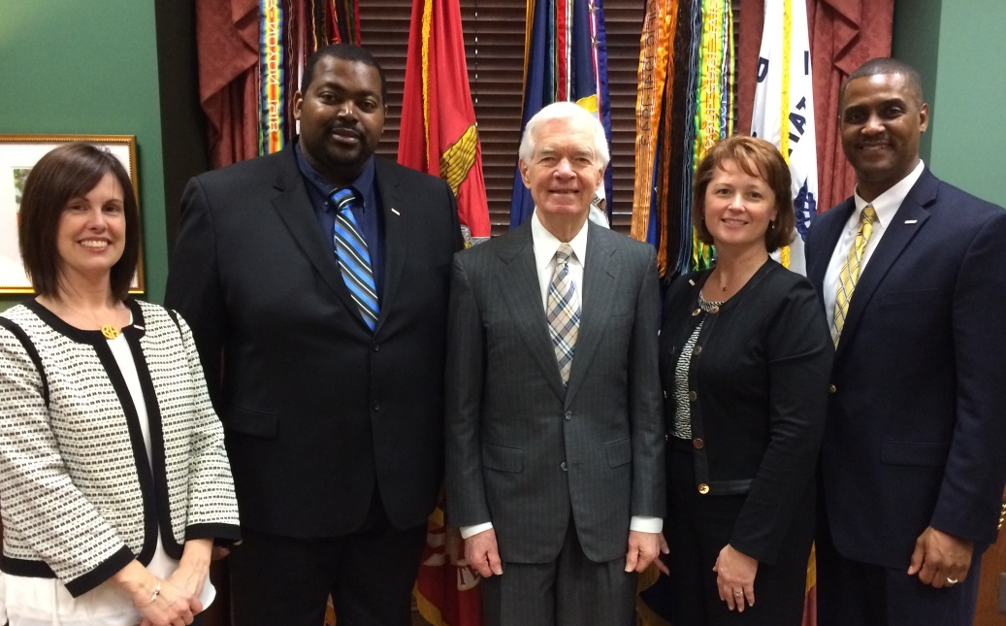
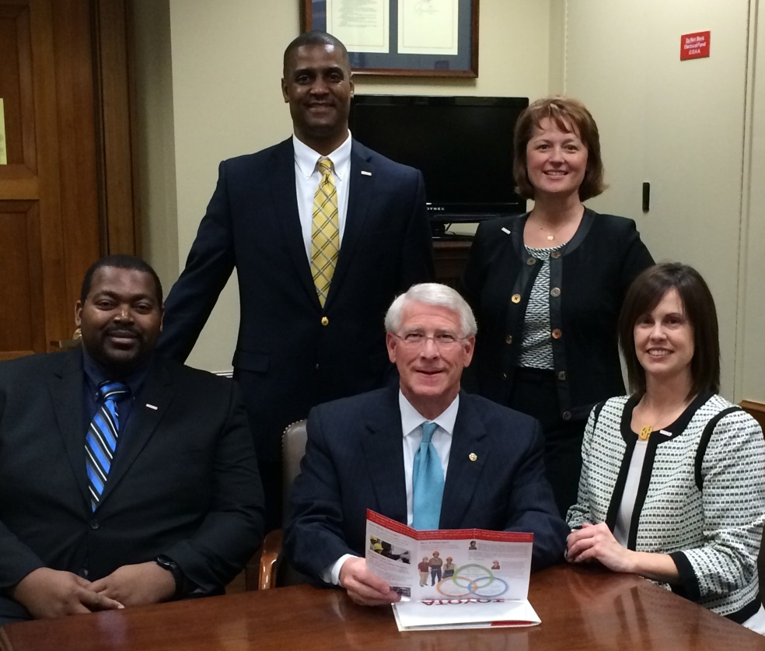
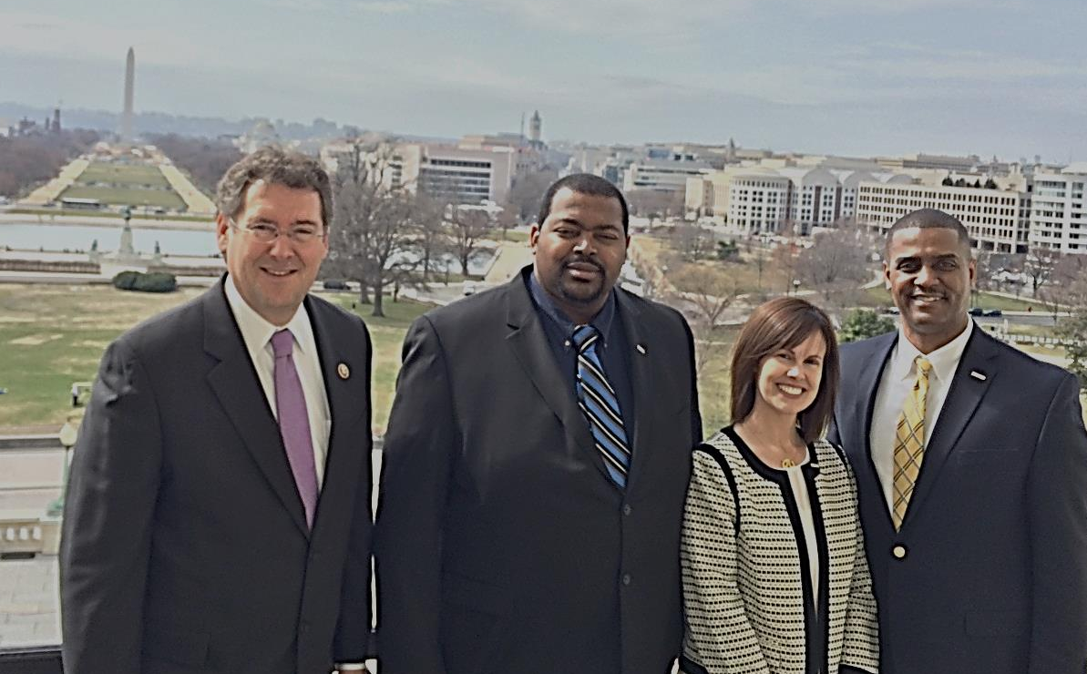
TMMMS AMT Program goes to DC

Slide 7
TMMMS AMT Program in the news

Slide 8
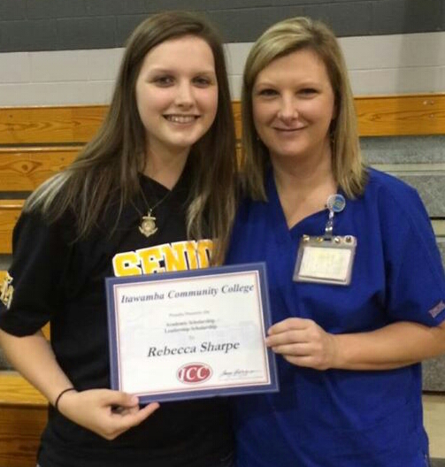
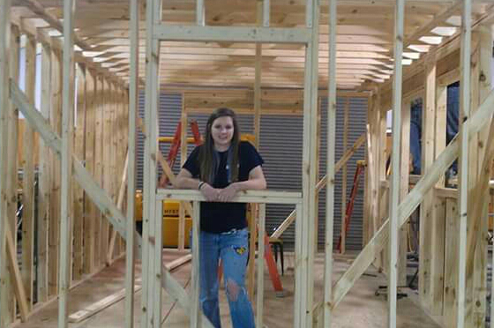
TMMMS AMT Student – Isabella
Educational path
Freedom to learn
How the AMT program has helped me

Slide 9
TMMMS AMT Student – Cody
Educational path
Hands-on learning
How the AMT program has helped me

Slide 10
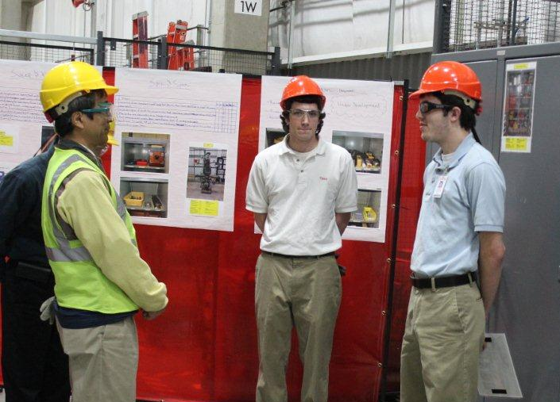
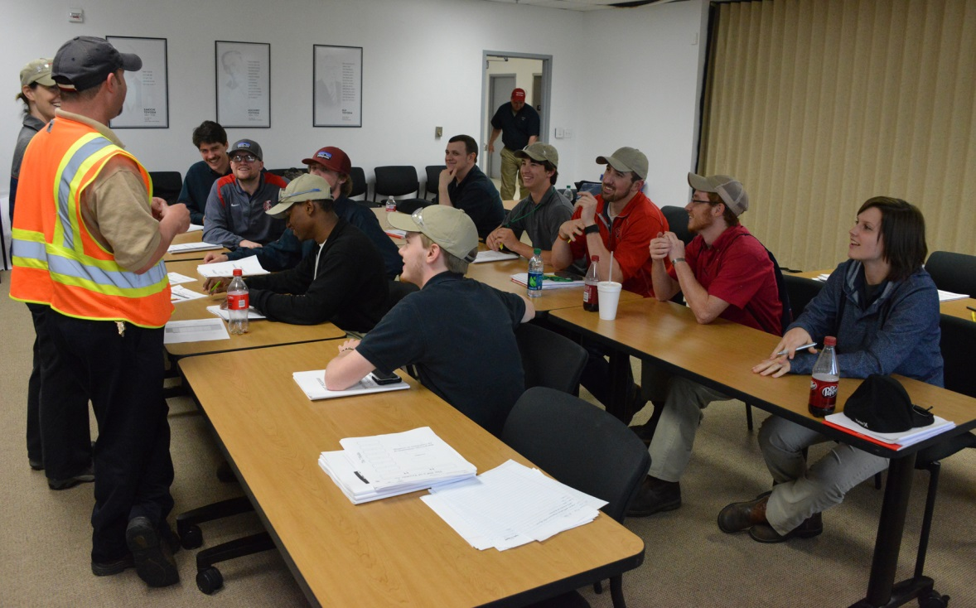
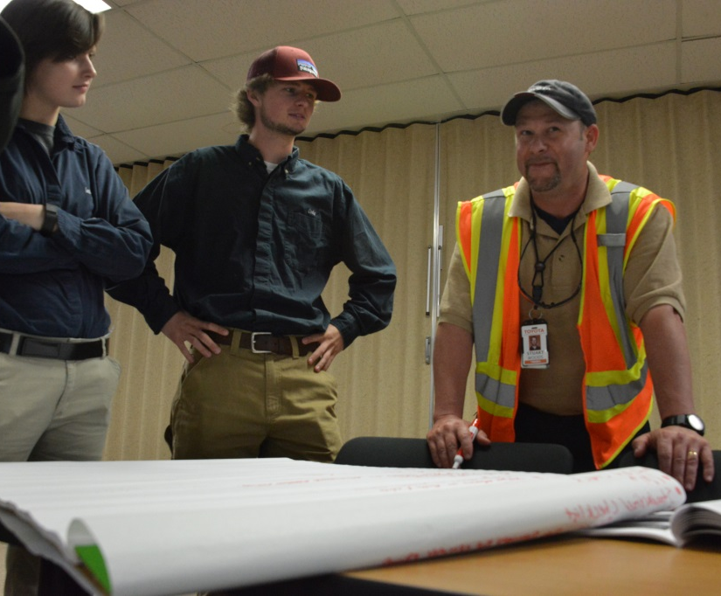
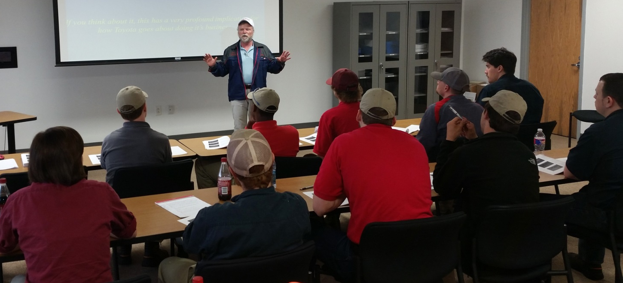
TMMMS AMT

