Slide 1
Tennessee AMT Consortium
TN FAME
Workforce Partnership Between Industry and Higher Education

Slide 2
Industry & Education Partnership
Industry must work with education to help solve the problem and both must help drive the change
Recognize the need to increase the size of the overall “workforce pie” vs. just your own piece
    No more stealing talent from each other
Jointly “Market "manufacturing to teachers, students, and parents
  School tours, Classroom Presentations, etc.
Identify community college and tech school partners
  JSCC very open to new way of teaching and training

Slide 3
What is Jackson doing about this problem?
Creating a partnership between Industry and Education
The AMT Co-op
The Advanced Maintenance Technician Co-operative

Slide 4
Jackson AMT
This journey started nearly 3 years ago
Investigated Federally Registered Apprenticeship programs
Heard about the Toyota AMT Program through local Toyota facility (Bodine Aluminum)
JSCC Fact finding tour
  Visited TMMK and TMMMS
Toyota AMT program presented to local industry leaders

Slide 5
Hurdles of the Program Launch
The Toyota model fit but we needed sponsors
We lacked having one large employer
Our partners in ECD and the Jackson Chamber were instrumental in building the sponsor base
Held several “recruiting” meetings with area manufacturers and they bought into being a part of the solution
Needed to renovate Jackson State hands-on labs

Slide 6
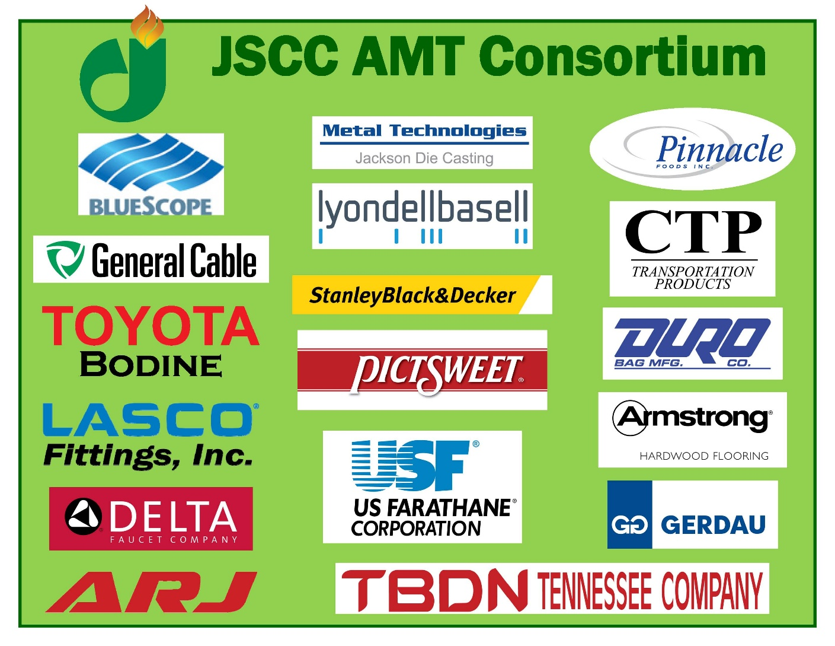

Slide 7
State of Tennessee Assistance
DRIVE to 55
  Increase the percentage of Tennesseans with college degrees or certifications to 55% by the year 2025
Labor Education Alignment Program (LEAP)
  Align graduates with industry needs
Pathways to Prosperity
  Career pathways linking high school, work, and community college for post secondary industry recognized credentials
Dream it Do it
  Campaign to Encourage Careers in Manufacturing
Tennessee Promise
  Beginning in Fall 2015, provide TN HS students last dollar scholarships to attend Community College or TCAT
Governor’s Equipment Grants
  $10 million in state funds to invest in new equipment

Slide 8
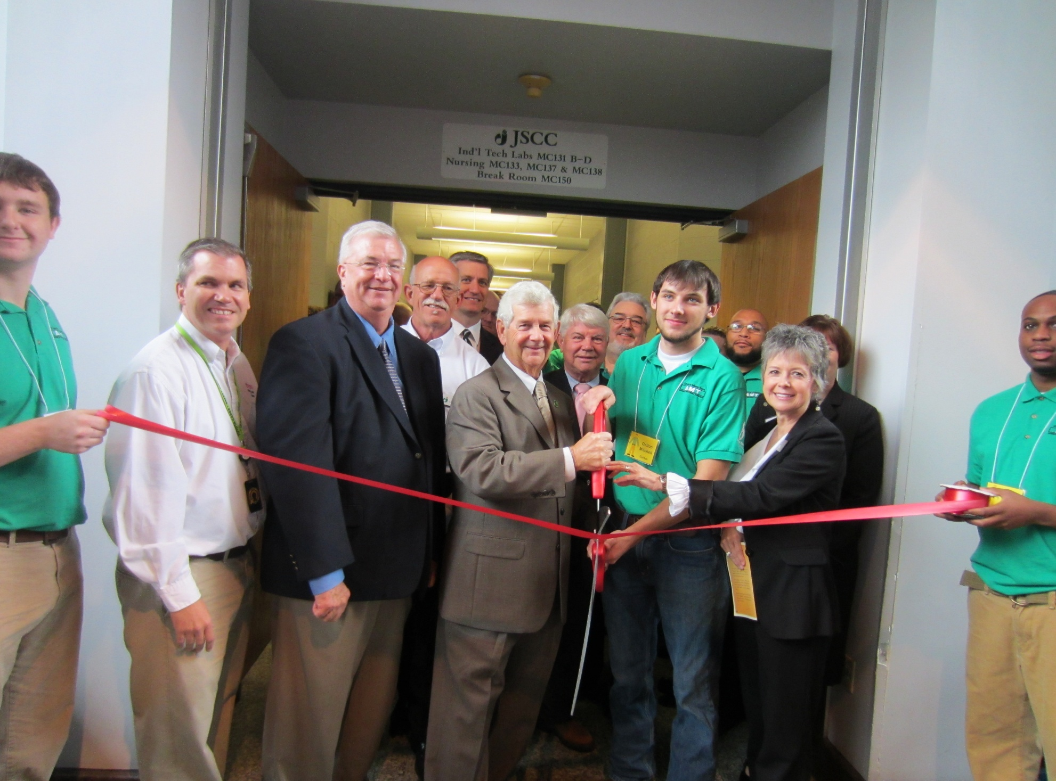
Totally Redesign the Learning Environment

Slide 9
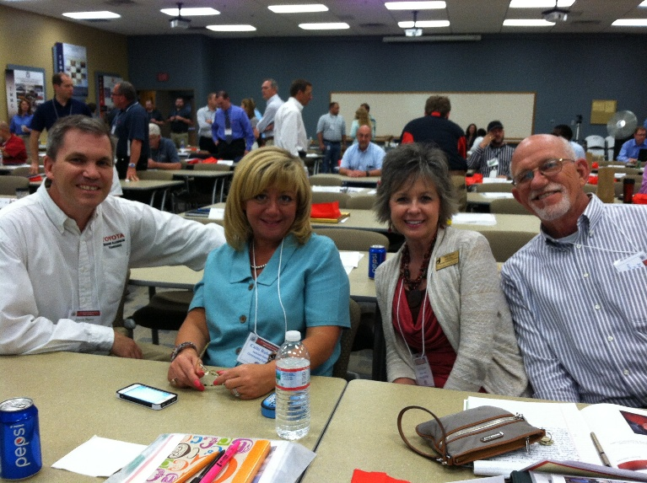
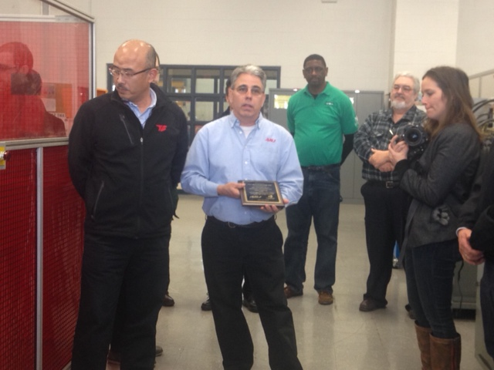
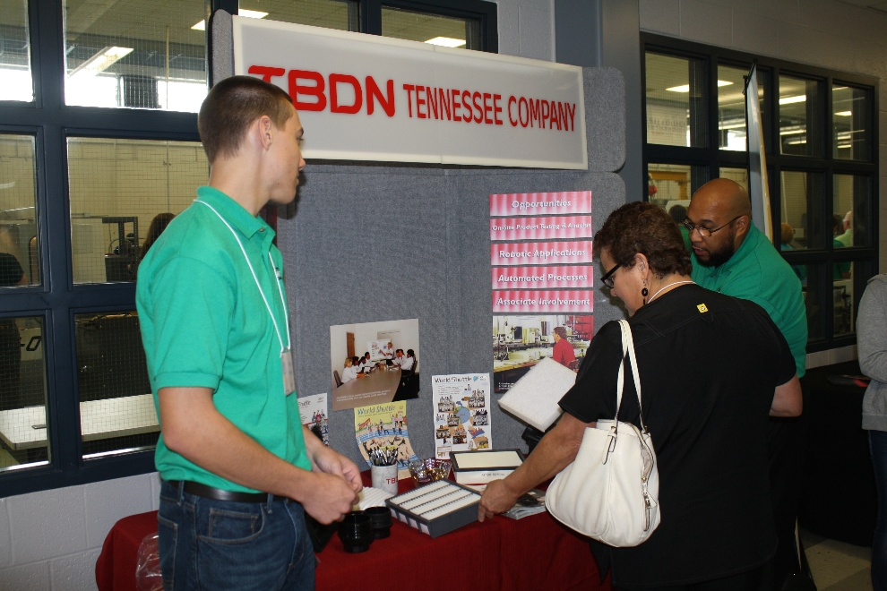
Then the fun began…
Developing policy
Preparing the labs
Recruiting the students
&
Our industry partners were
right there with the educators

Slide 10
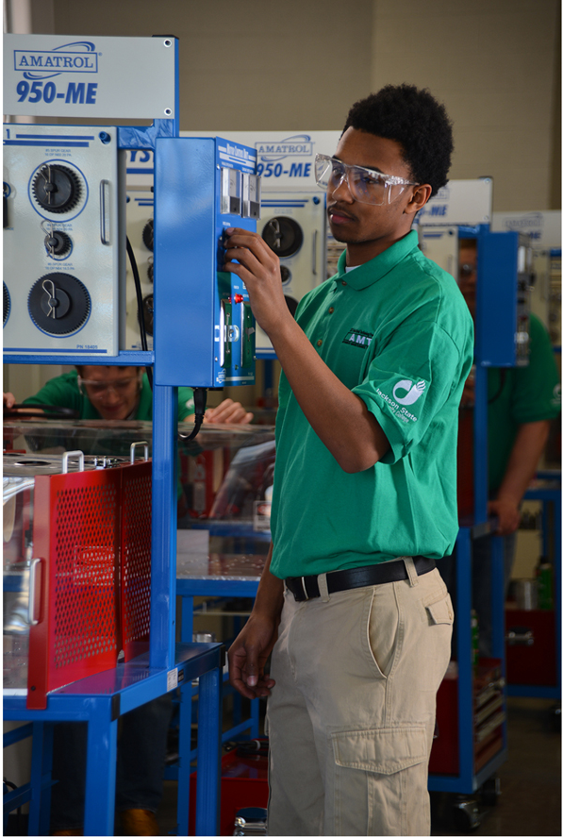
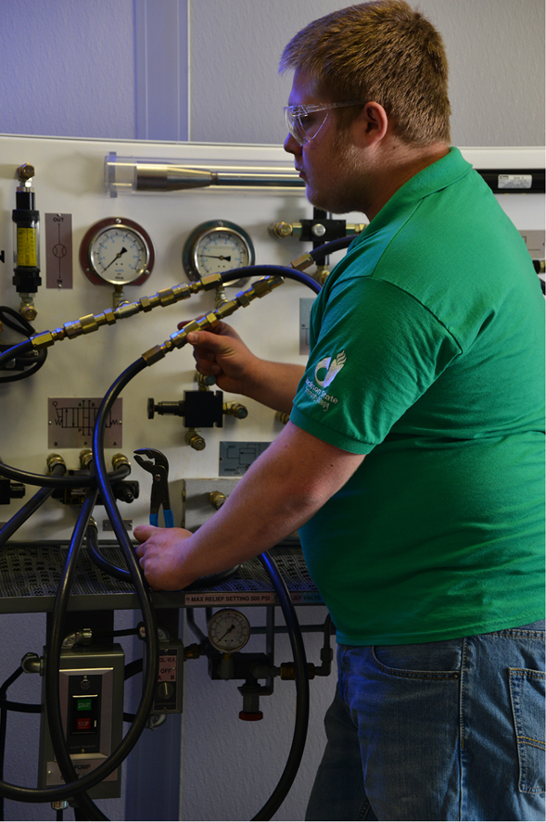
The Lab:

Slide 11
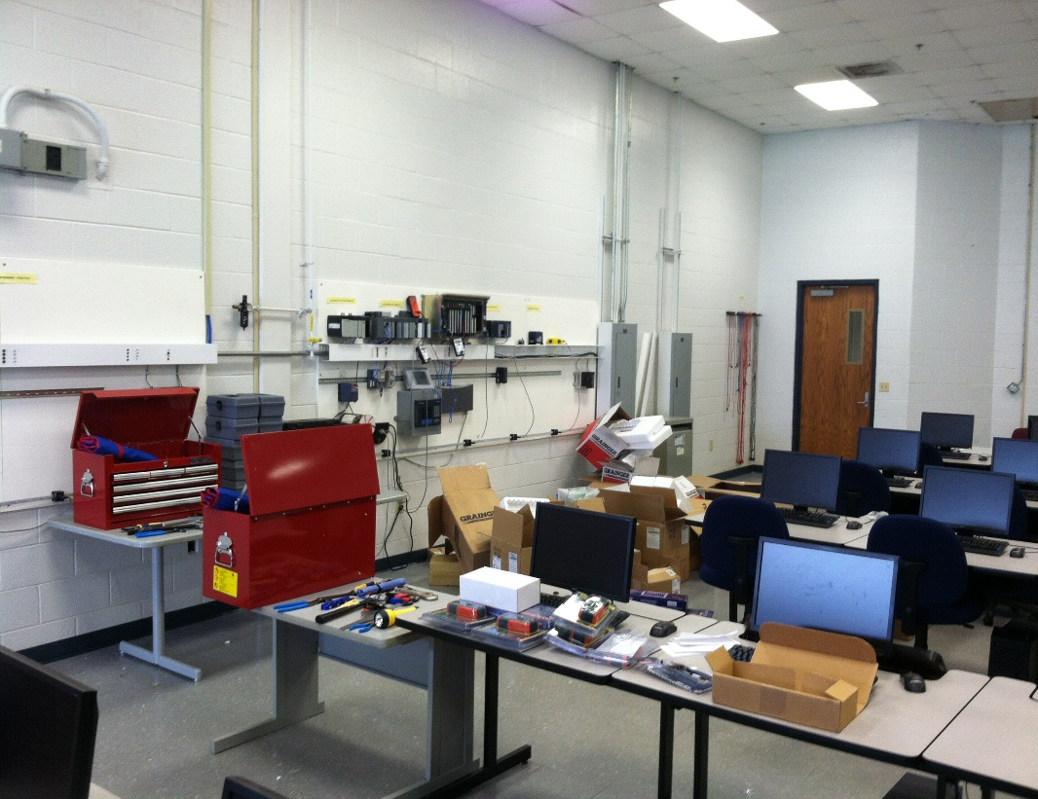
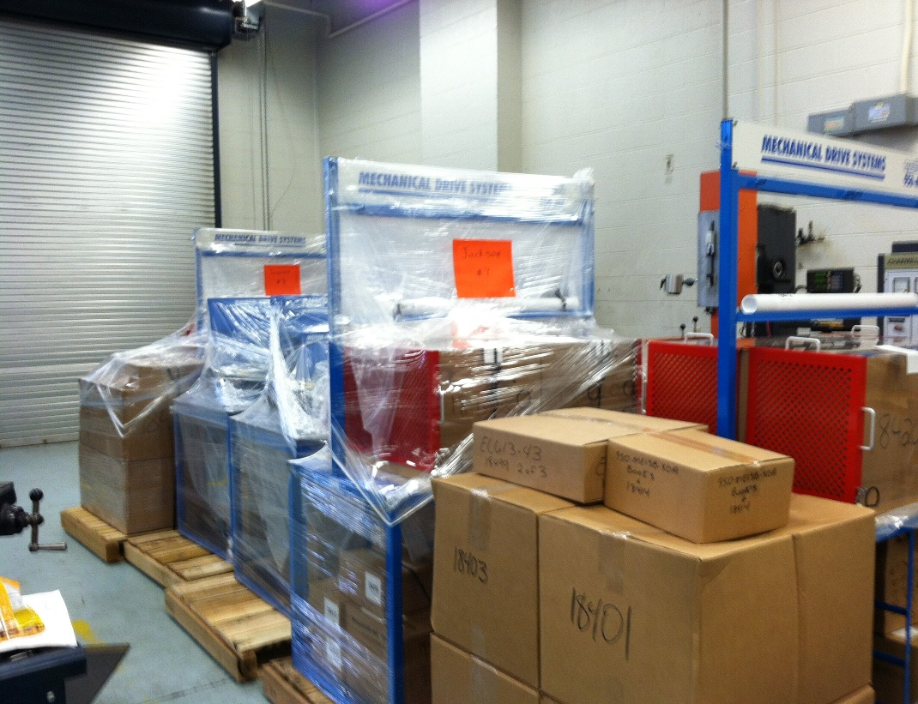
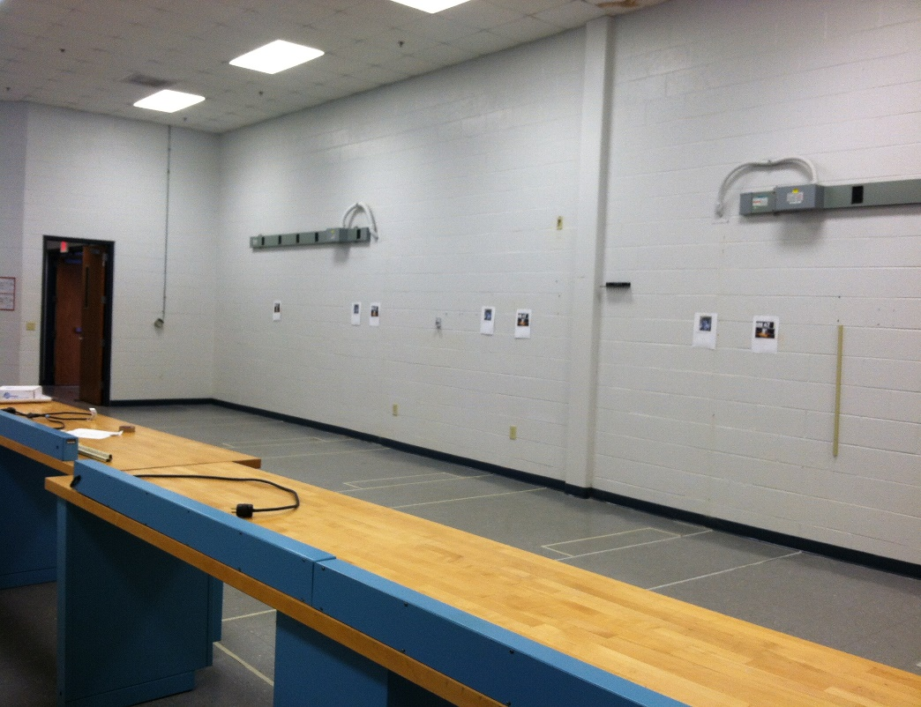

Slide 12
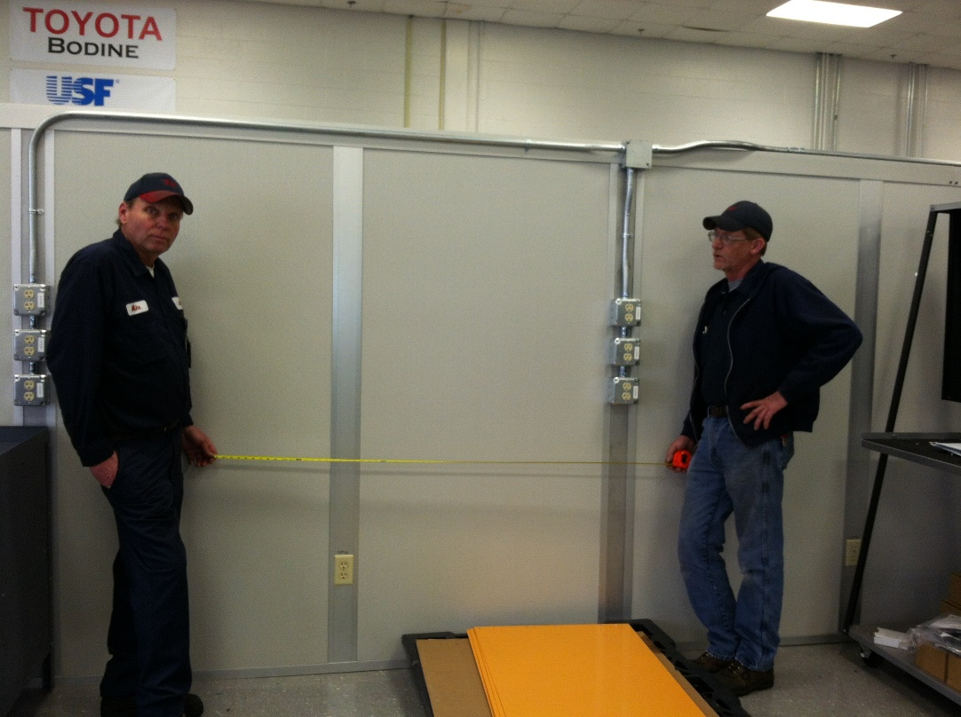
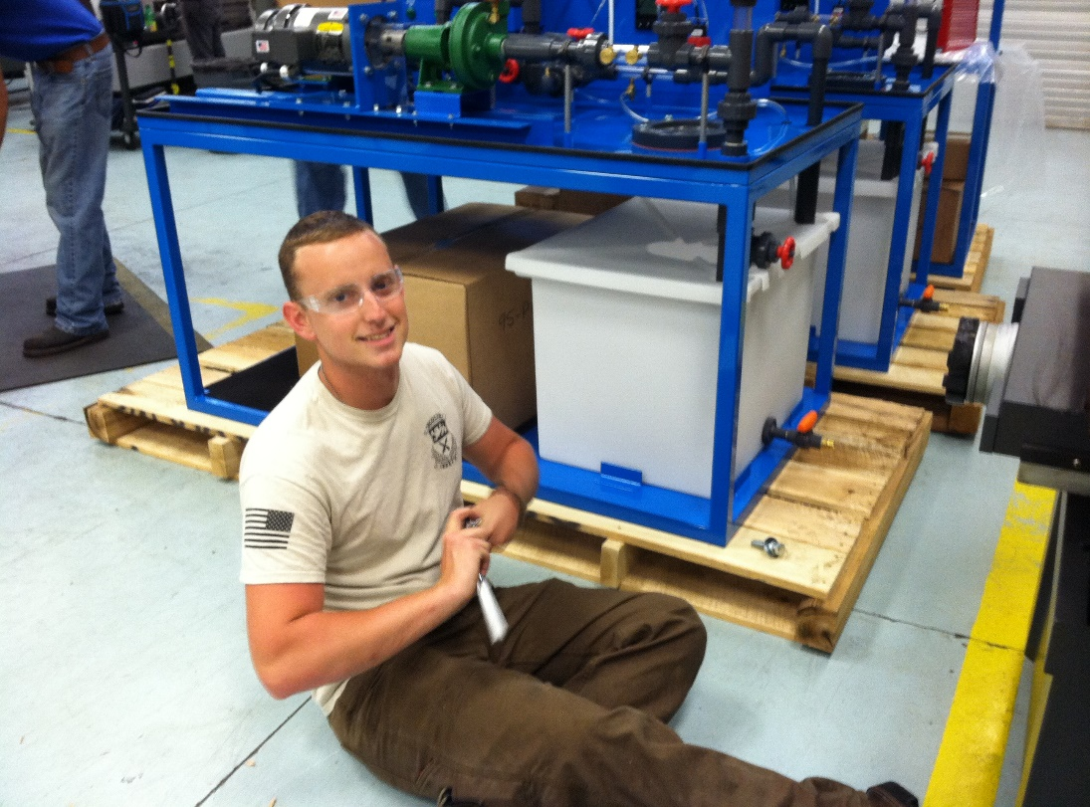
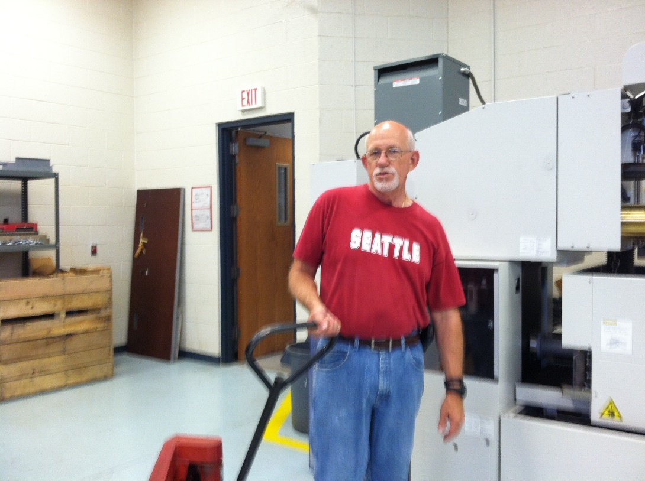
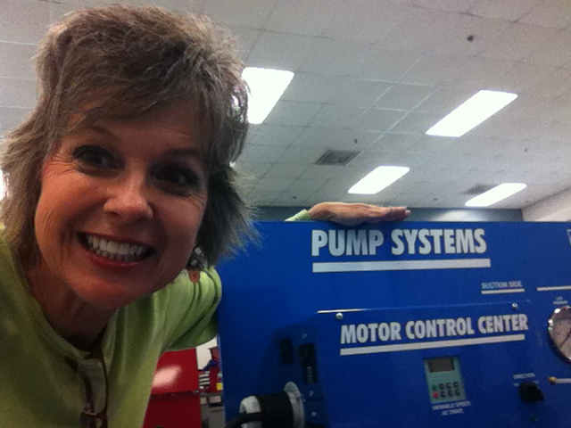

Slide 13
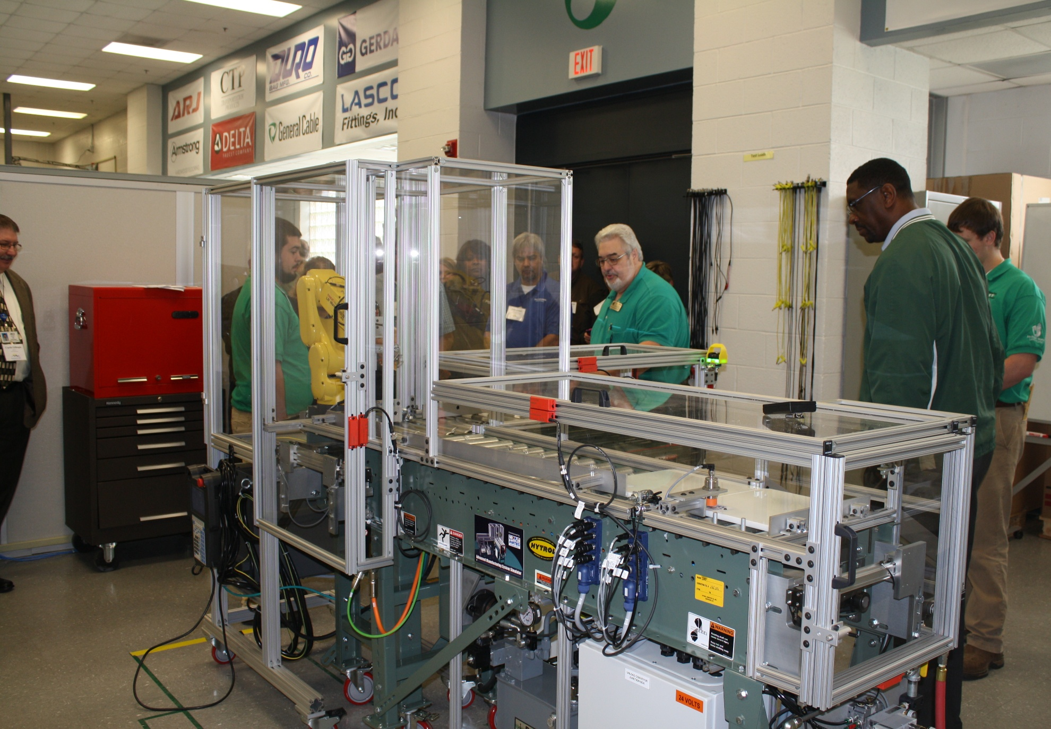
AMTEC Simulator

Slide 14
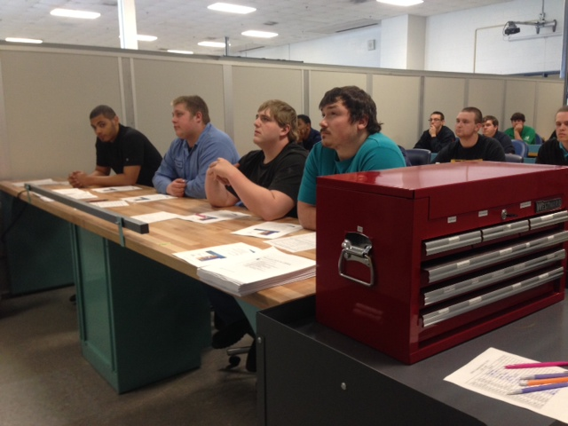
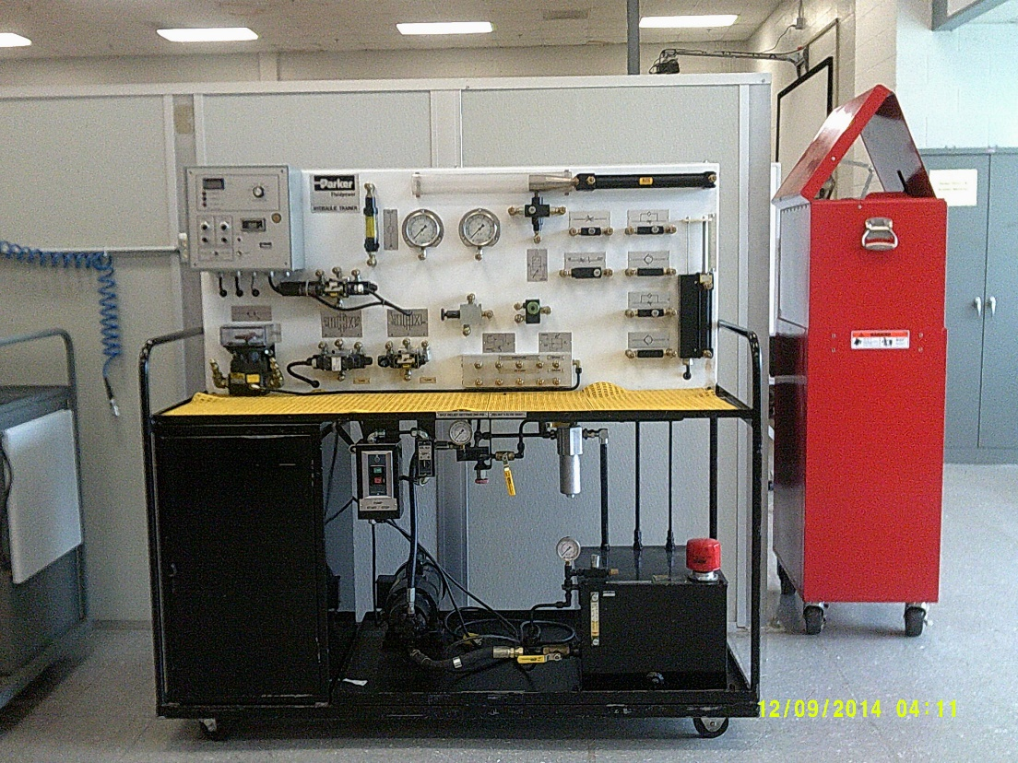
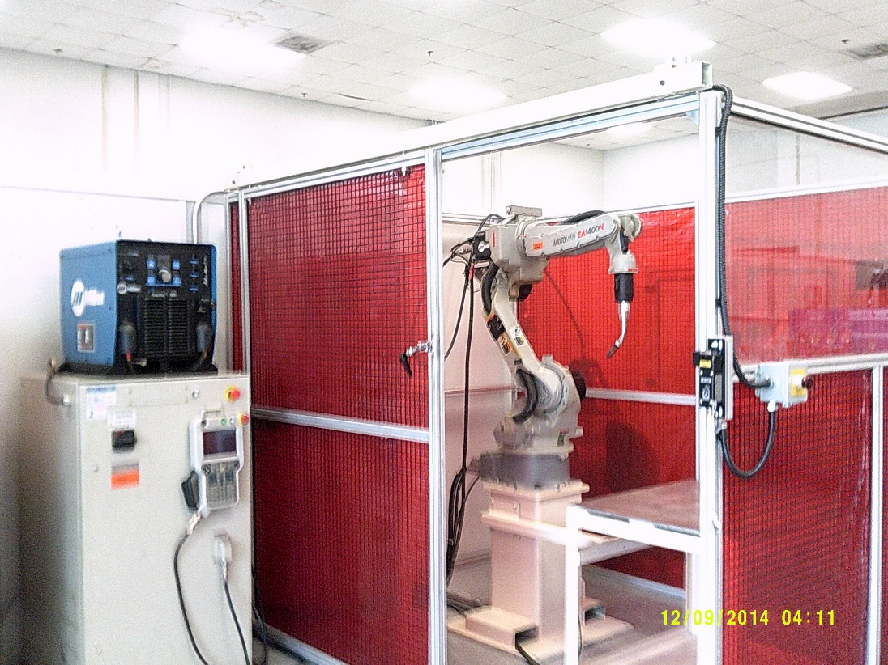
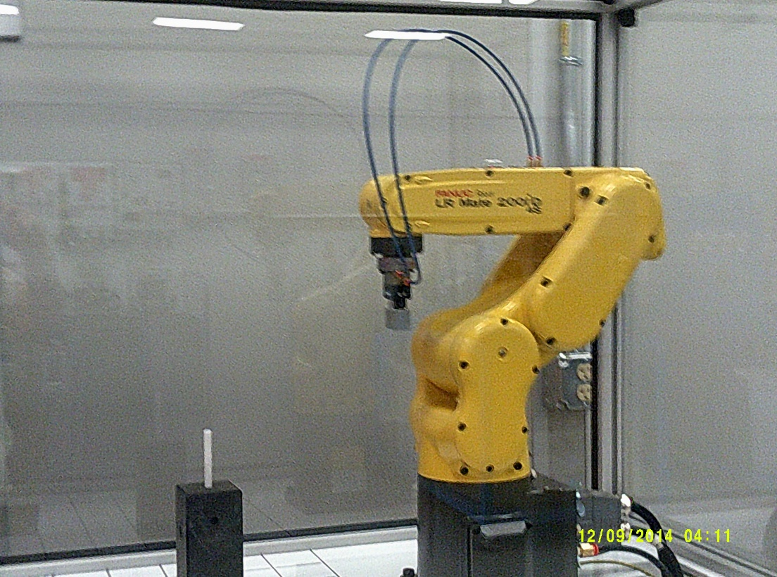

Slide 15
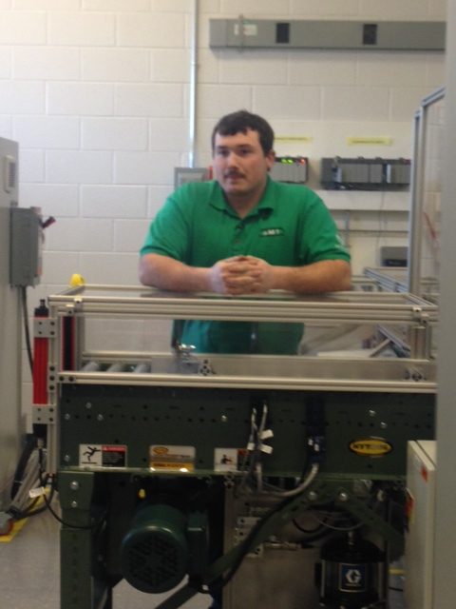
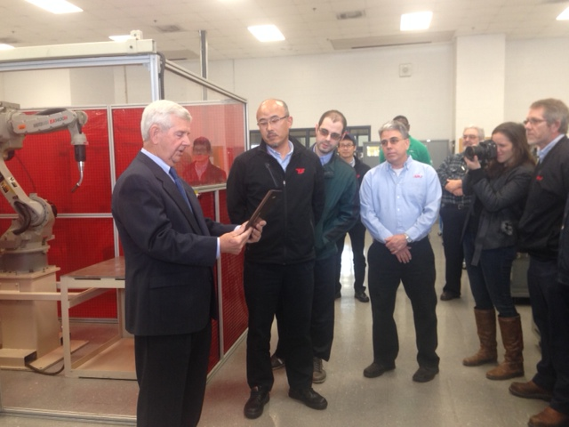
Industry Robotic Cell Donation

Slide 16
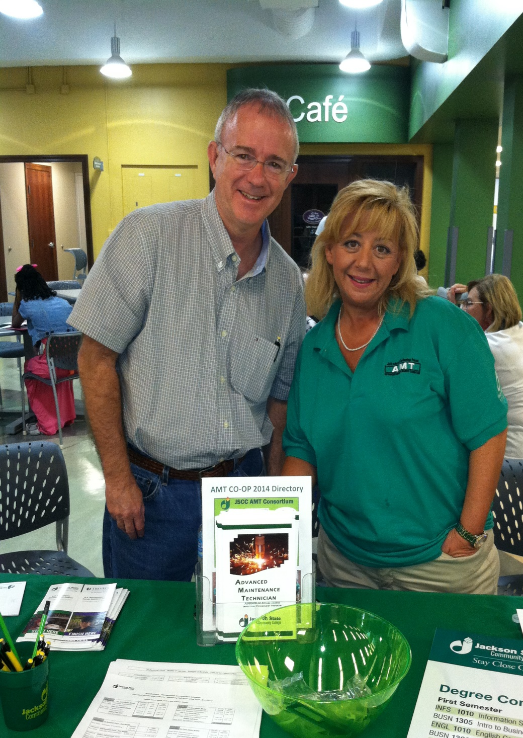
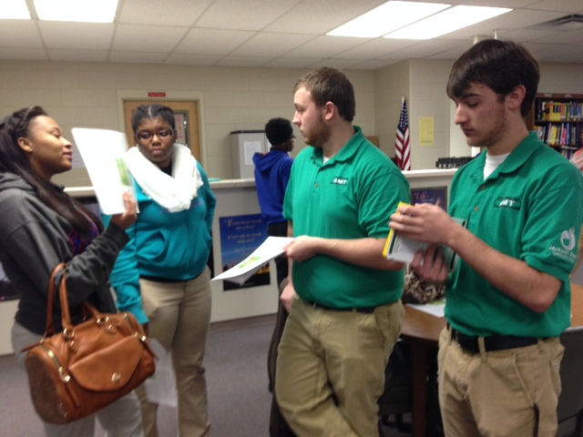
The Recruiting

Slide 17
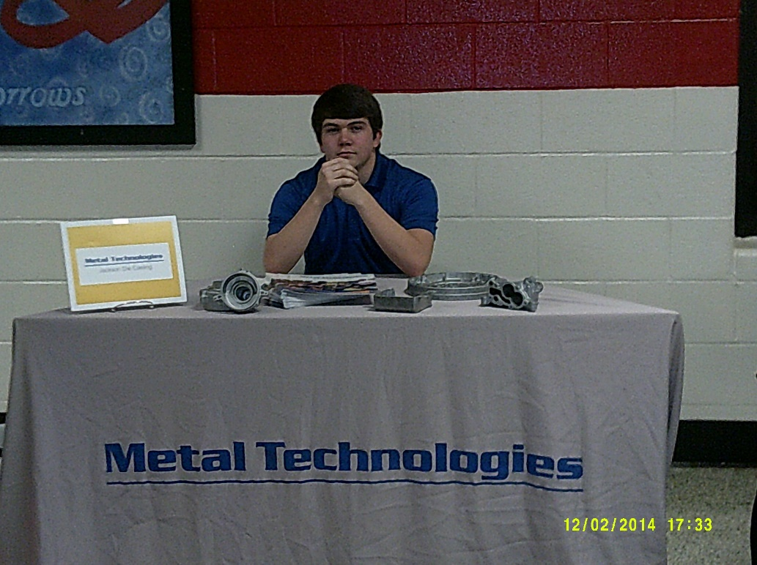
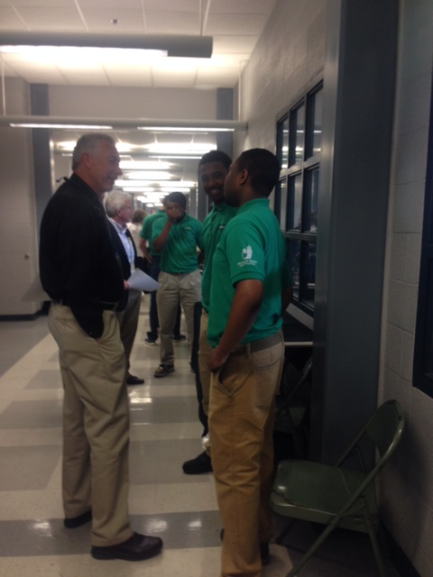
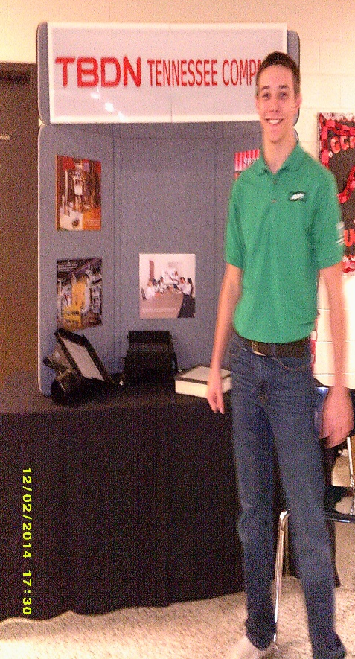
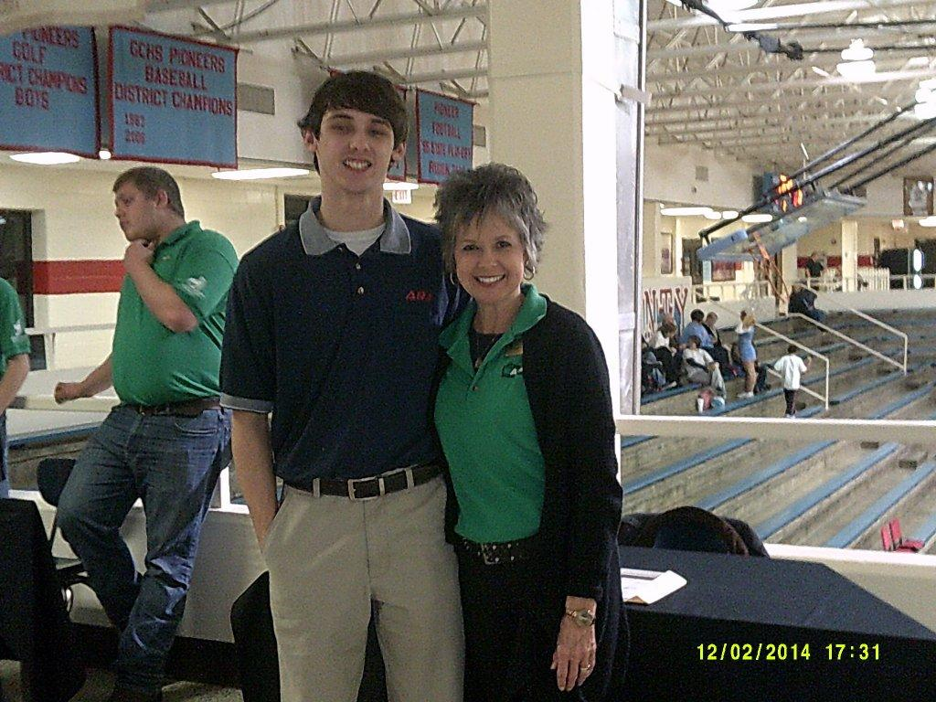
1st Year:
JSCC faculty and
FAME members
31 events
23 schools
1200 people
2nd year:
AMT students and FAME members
21 events
18 schools
1000 people

Slide 18
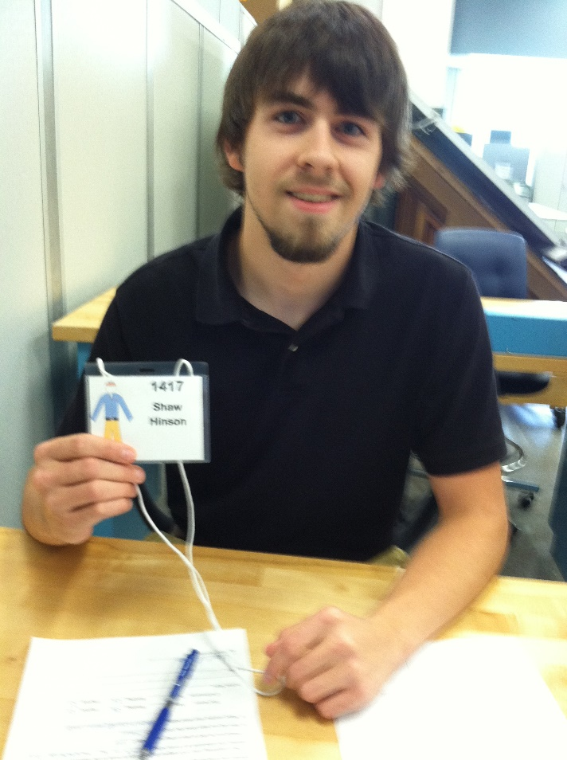

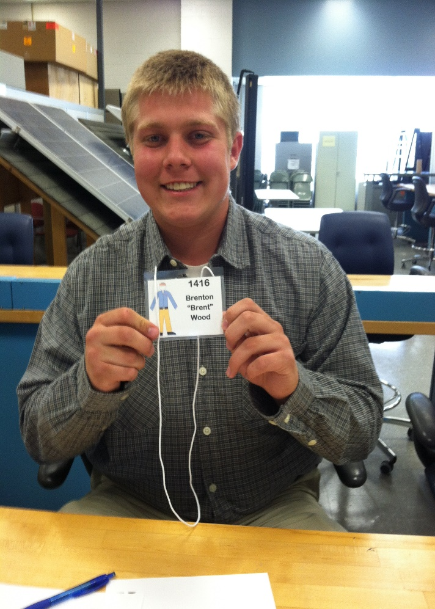
Interviews and Selections

Slide 19

16 Interviews in one hour!!!!
AMT Interview Schedule Friday, May 2, 2014
8:00 - 9:00
 | ID # | Name | Contact | School
1 | 141 | Devonnte Tuggle | 444-2236 | Northside
2 | 1411 | John "Trey" Haywood | 426-5062 | Madison
3 | 1412 | Jamal Daniels | 267-8169 | JCM
4 | 1419 | Mia Wilson | 616-2213 | Liberty
9:00 - 10:00
 | ID # | Name | Contact | School
1 | 1424 | Madison Young | 608-1064 | Chester Co
2 | 145 | Nathan Miller | 618-9599 | Humboldt
3 | 1418 | Trelyn Woods | 437-0318 | Liberty
4 | 1429 | Aaron Rainey | 780-9040 | Lexington
10:00 - 11:00
 | ID # | Name | Contact | School
1 | 1410 | Tyler McCaskill | 608-5538 | Chester Co
2 | 146 | James "Dalton" Mitchell | 608-5690 | Chester Co
3 | 147 | David "Cain" Lindsey | 358-2555 | Clarksburg
4 | 1420 | Jason Elrod | 780-9040 | Haywood
11:00 - 12:00
 | ID # | Name | Contact | School
1 | 149 | Tommy "TJ" Ross | 225-4548 | Milan
2 | 148 | Kyle Geary | 879-9219 | Chester Co
4 | 1422 | Anthony Keeton | 614-4991 | Lexington
Industry Lead Panel Interviews
Real World Experience

Slide 20
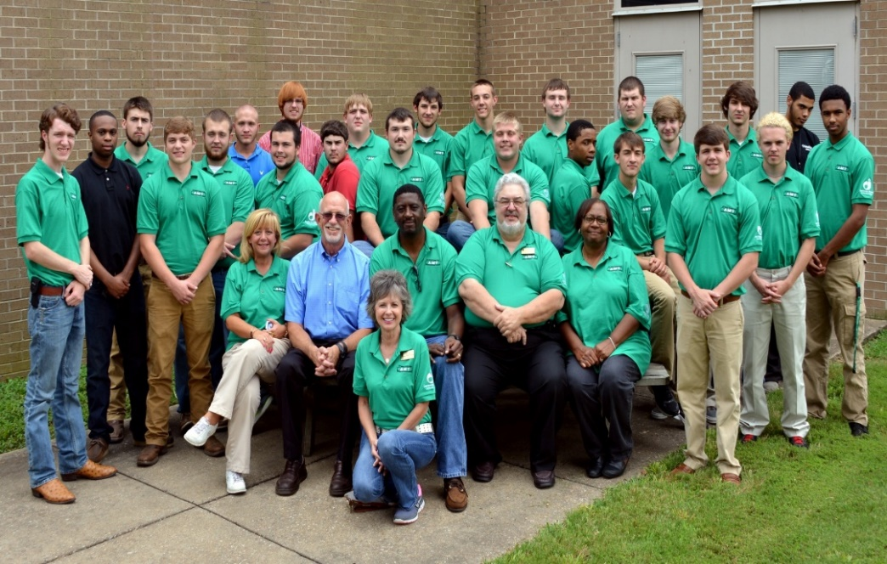
Tennessee AMT Statistics
2014 AMT Student Statistics
2015 AMT Student Statistics
AMT students receiving placement: 21
Retention rate:
  JSCC 88%
  AMT 79%
Student applications more than doubled for Cohort 2 AMT
AMT students receiving placement: 17
Higher ACT scores of the applicant pool
Very challenging for AMT consortium to choose student this year due to great pool of applicants

Slide 21

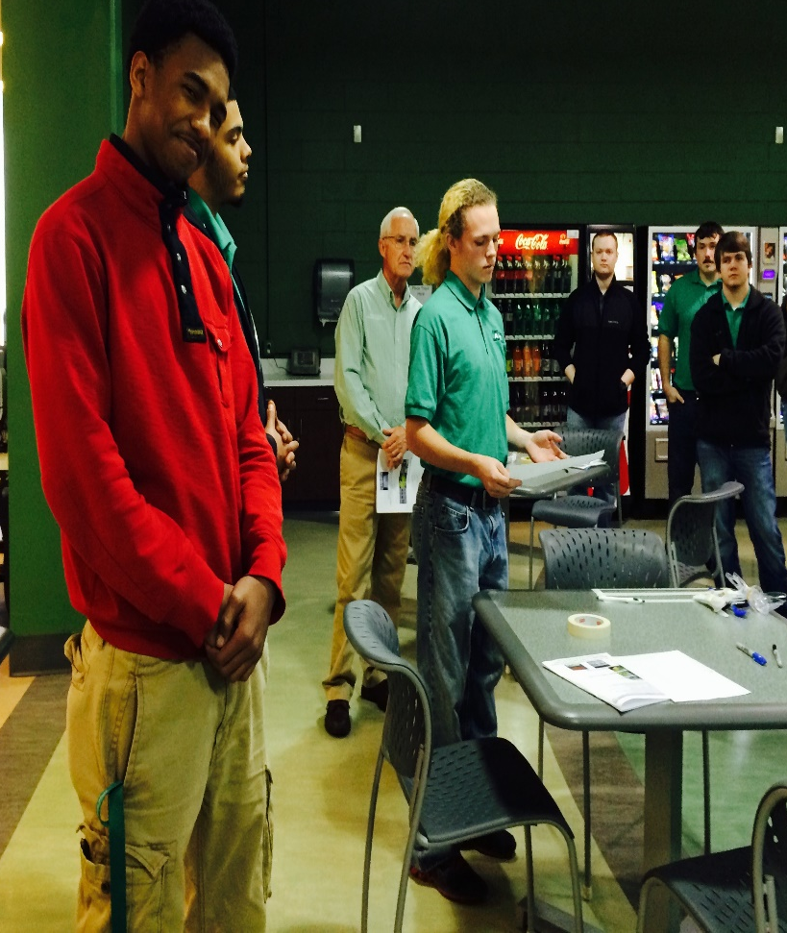

The classes
The Trainings
The JOB

Slide 22
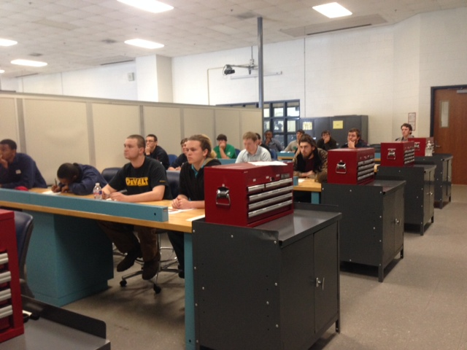
The Classes:
Students are divided into two cohorts: morning and afternoon
3 Technical classes and 1 General education class
TEAM meetings

Slide 23
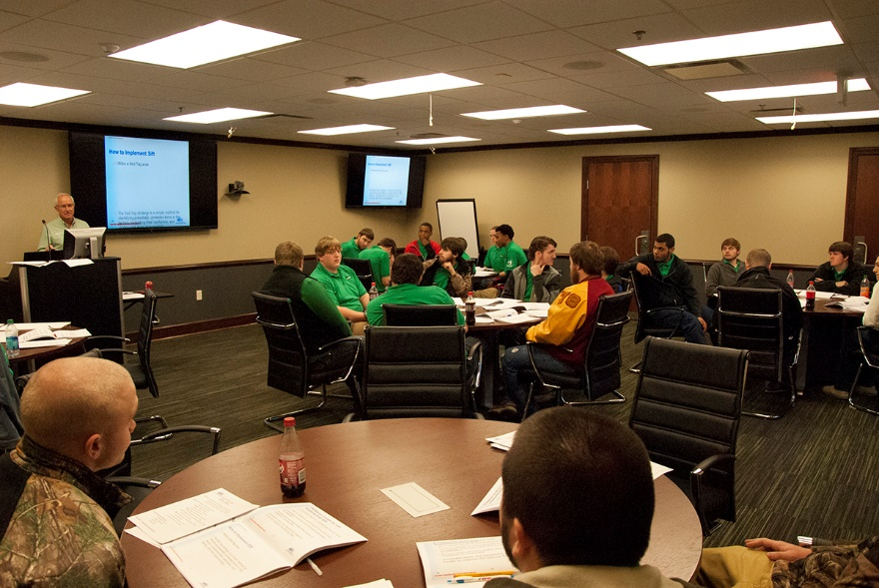
AMT Training Classes:
Toyota MCE
Personal Finance
OSHA 10 hour
Diversity & Sexual Harassment in the Workplace
Tooling U – Welding fundamentals
Working with different personalities
What is HR?
NCRC

Slide 24
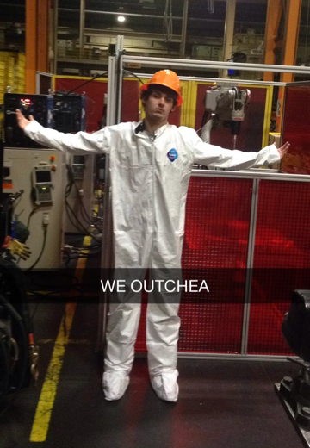
The JOBS:
15 Manufacturers
21 Job placements
$12/hour
$.50/hour salary increases
“Overtime” hours

Slide 25
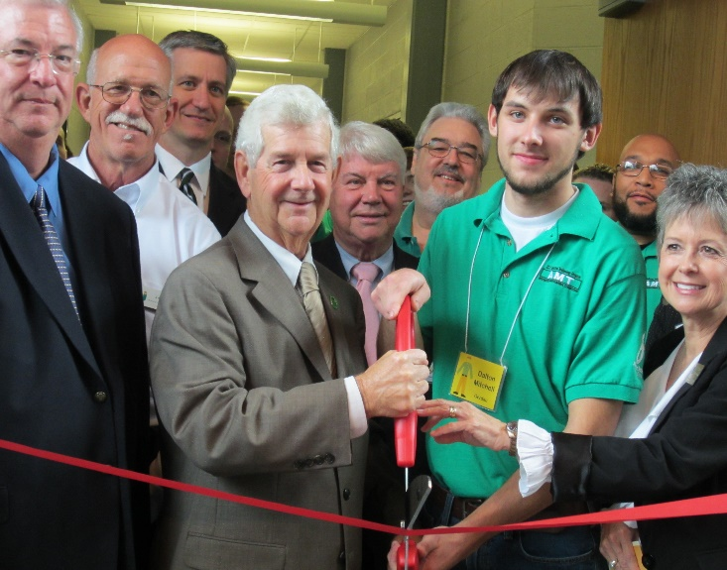
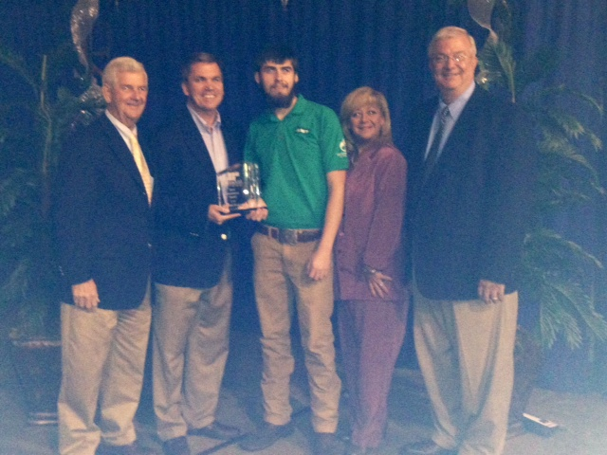
Tennessee AMT Highlights:
Ceremonies
Innovation Award – Southwest TN Development District
AMT Lab
Ribbon Cutting
ARJ Robotic Weld Cell Dedication

Slide 26
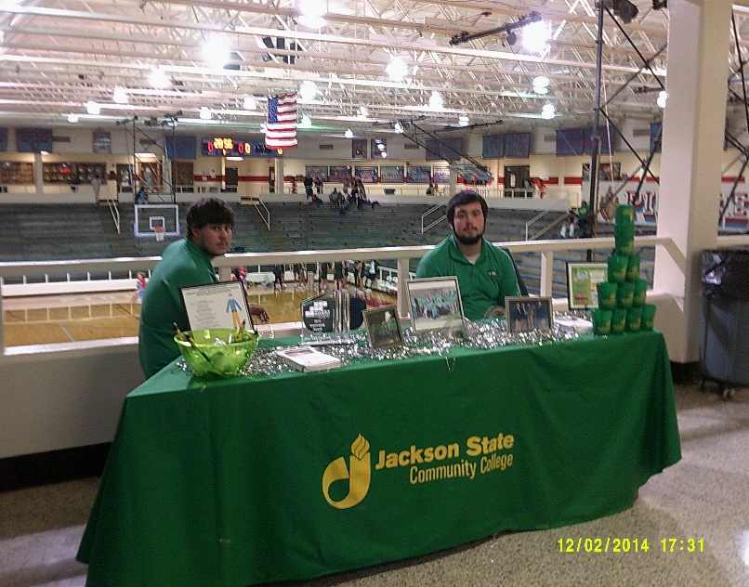
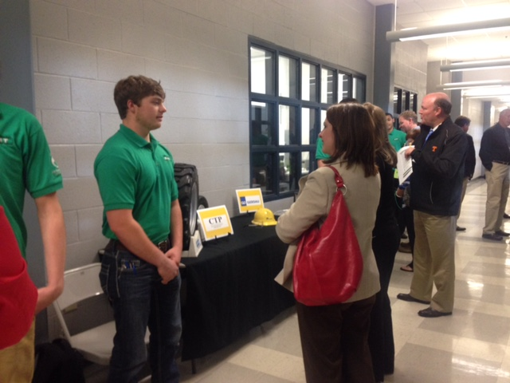
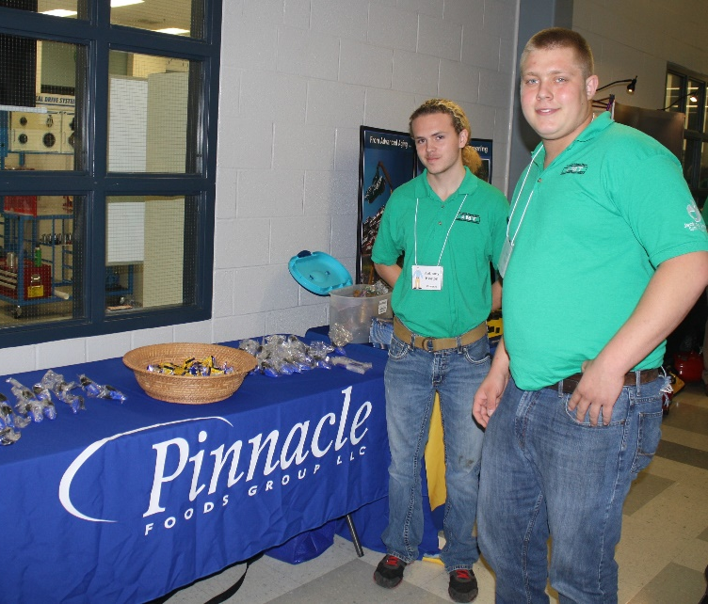
Events
Gibson County
Basketball Game
Career Fair
CTE Directors
State Conference
Break-out Session
Manufacturing Day 2015

Slide 27
Jackson’s Solution
DONE: Partnership between local industry and Jackson State Community College to improve curriculum
DONE: Industry Consortium working together to provide co-op experiences for JSCC students
DONE: State government providing legislation and grant monies to make it financially possible
ONGOING: State & Local marketing initiative to promote the value of manufacturing as a career
ONGOING: Local education leaders to help supply the pipeline with engaged, energetic, and qualified students

Slide 28
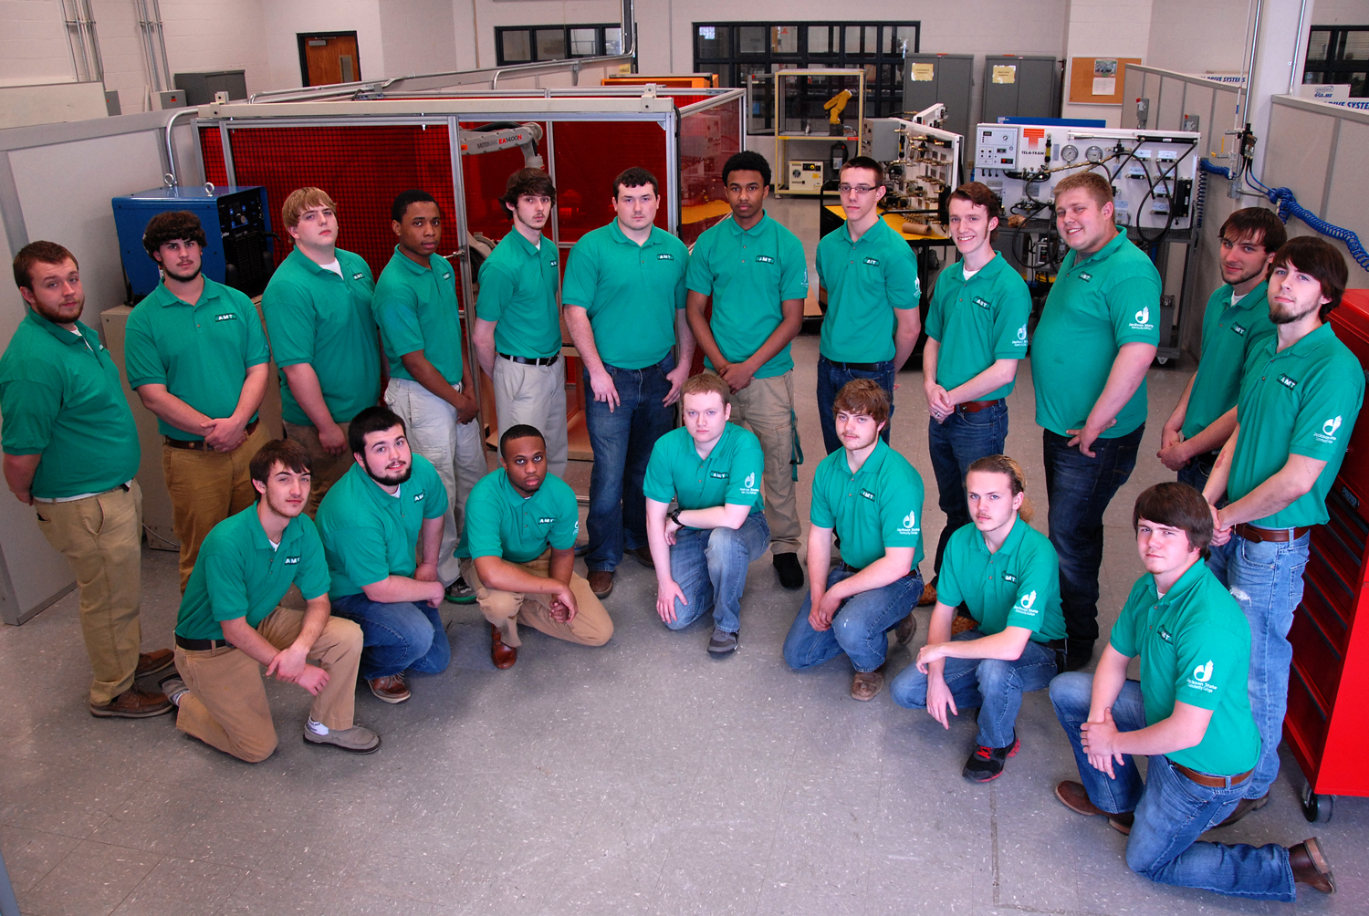
Tennessee AMT Green Shirts

