Slide 1
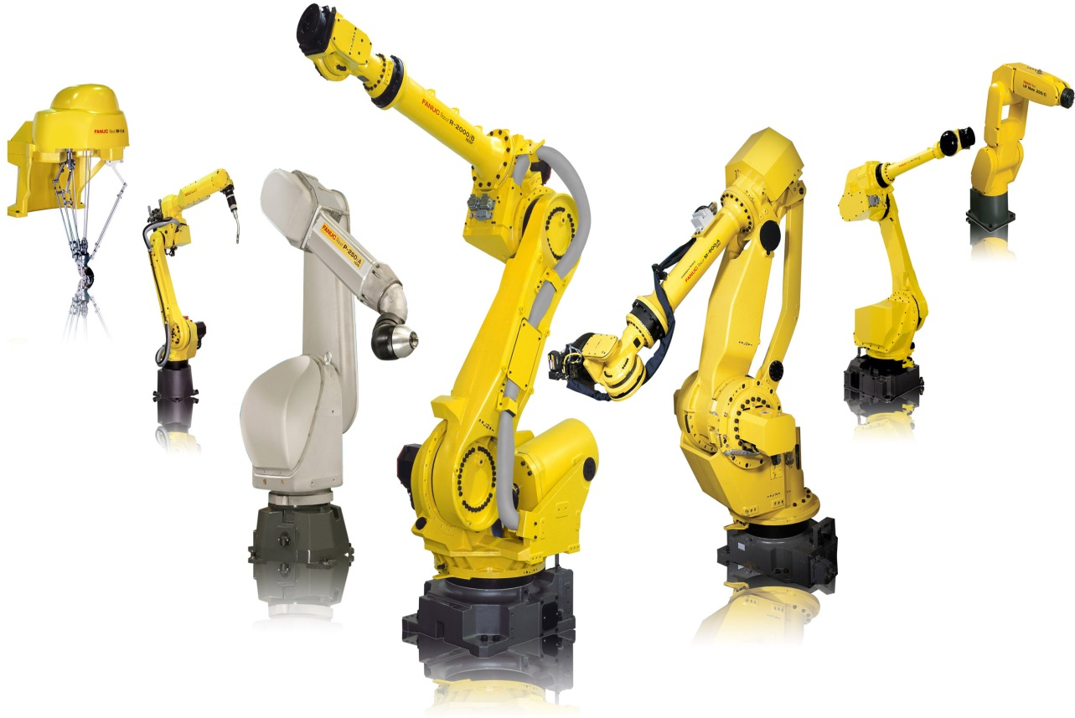
Advanced Manufacturing
Technician Program
AMT Missouri

Slide 2
ADVANCED MANUFACTURING TECHNICIAN PROGRAM
at
Notes:
Here are the companies that are currently apart of the AMT consortium at least for this initial pilot. We plan to start out small to allow some flexibility with managing curriculum and policy this first rollout.

Slide 3
ADVANCED MANUFACTURING TECHNICIAN PROGRAM
WHAT WILL BE TAUGHT?
Electrical / Electronic systems
Motor Controls & Circuits
Programmable Logic Controllers (PLC)
Fluid Power systems
Machine Tool processes
Fabricating & Welding techniques
Robotics

Slide 4
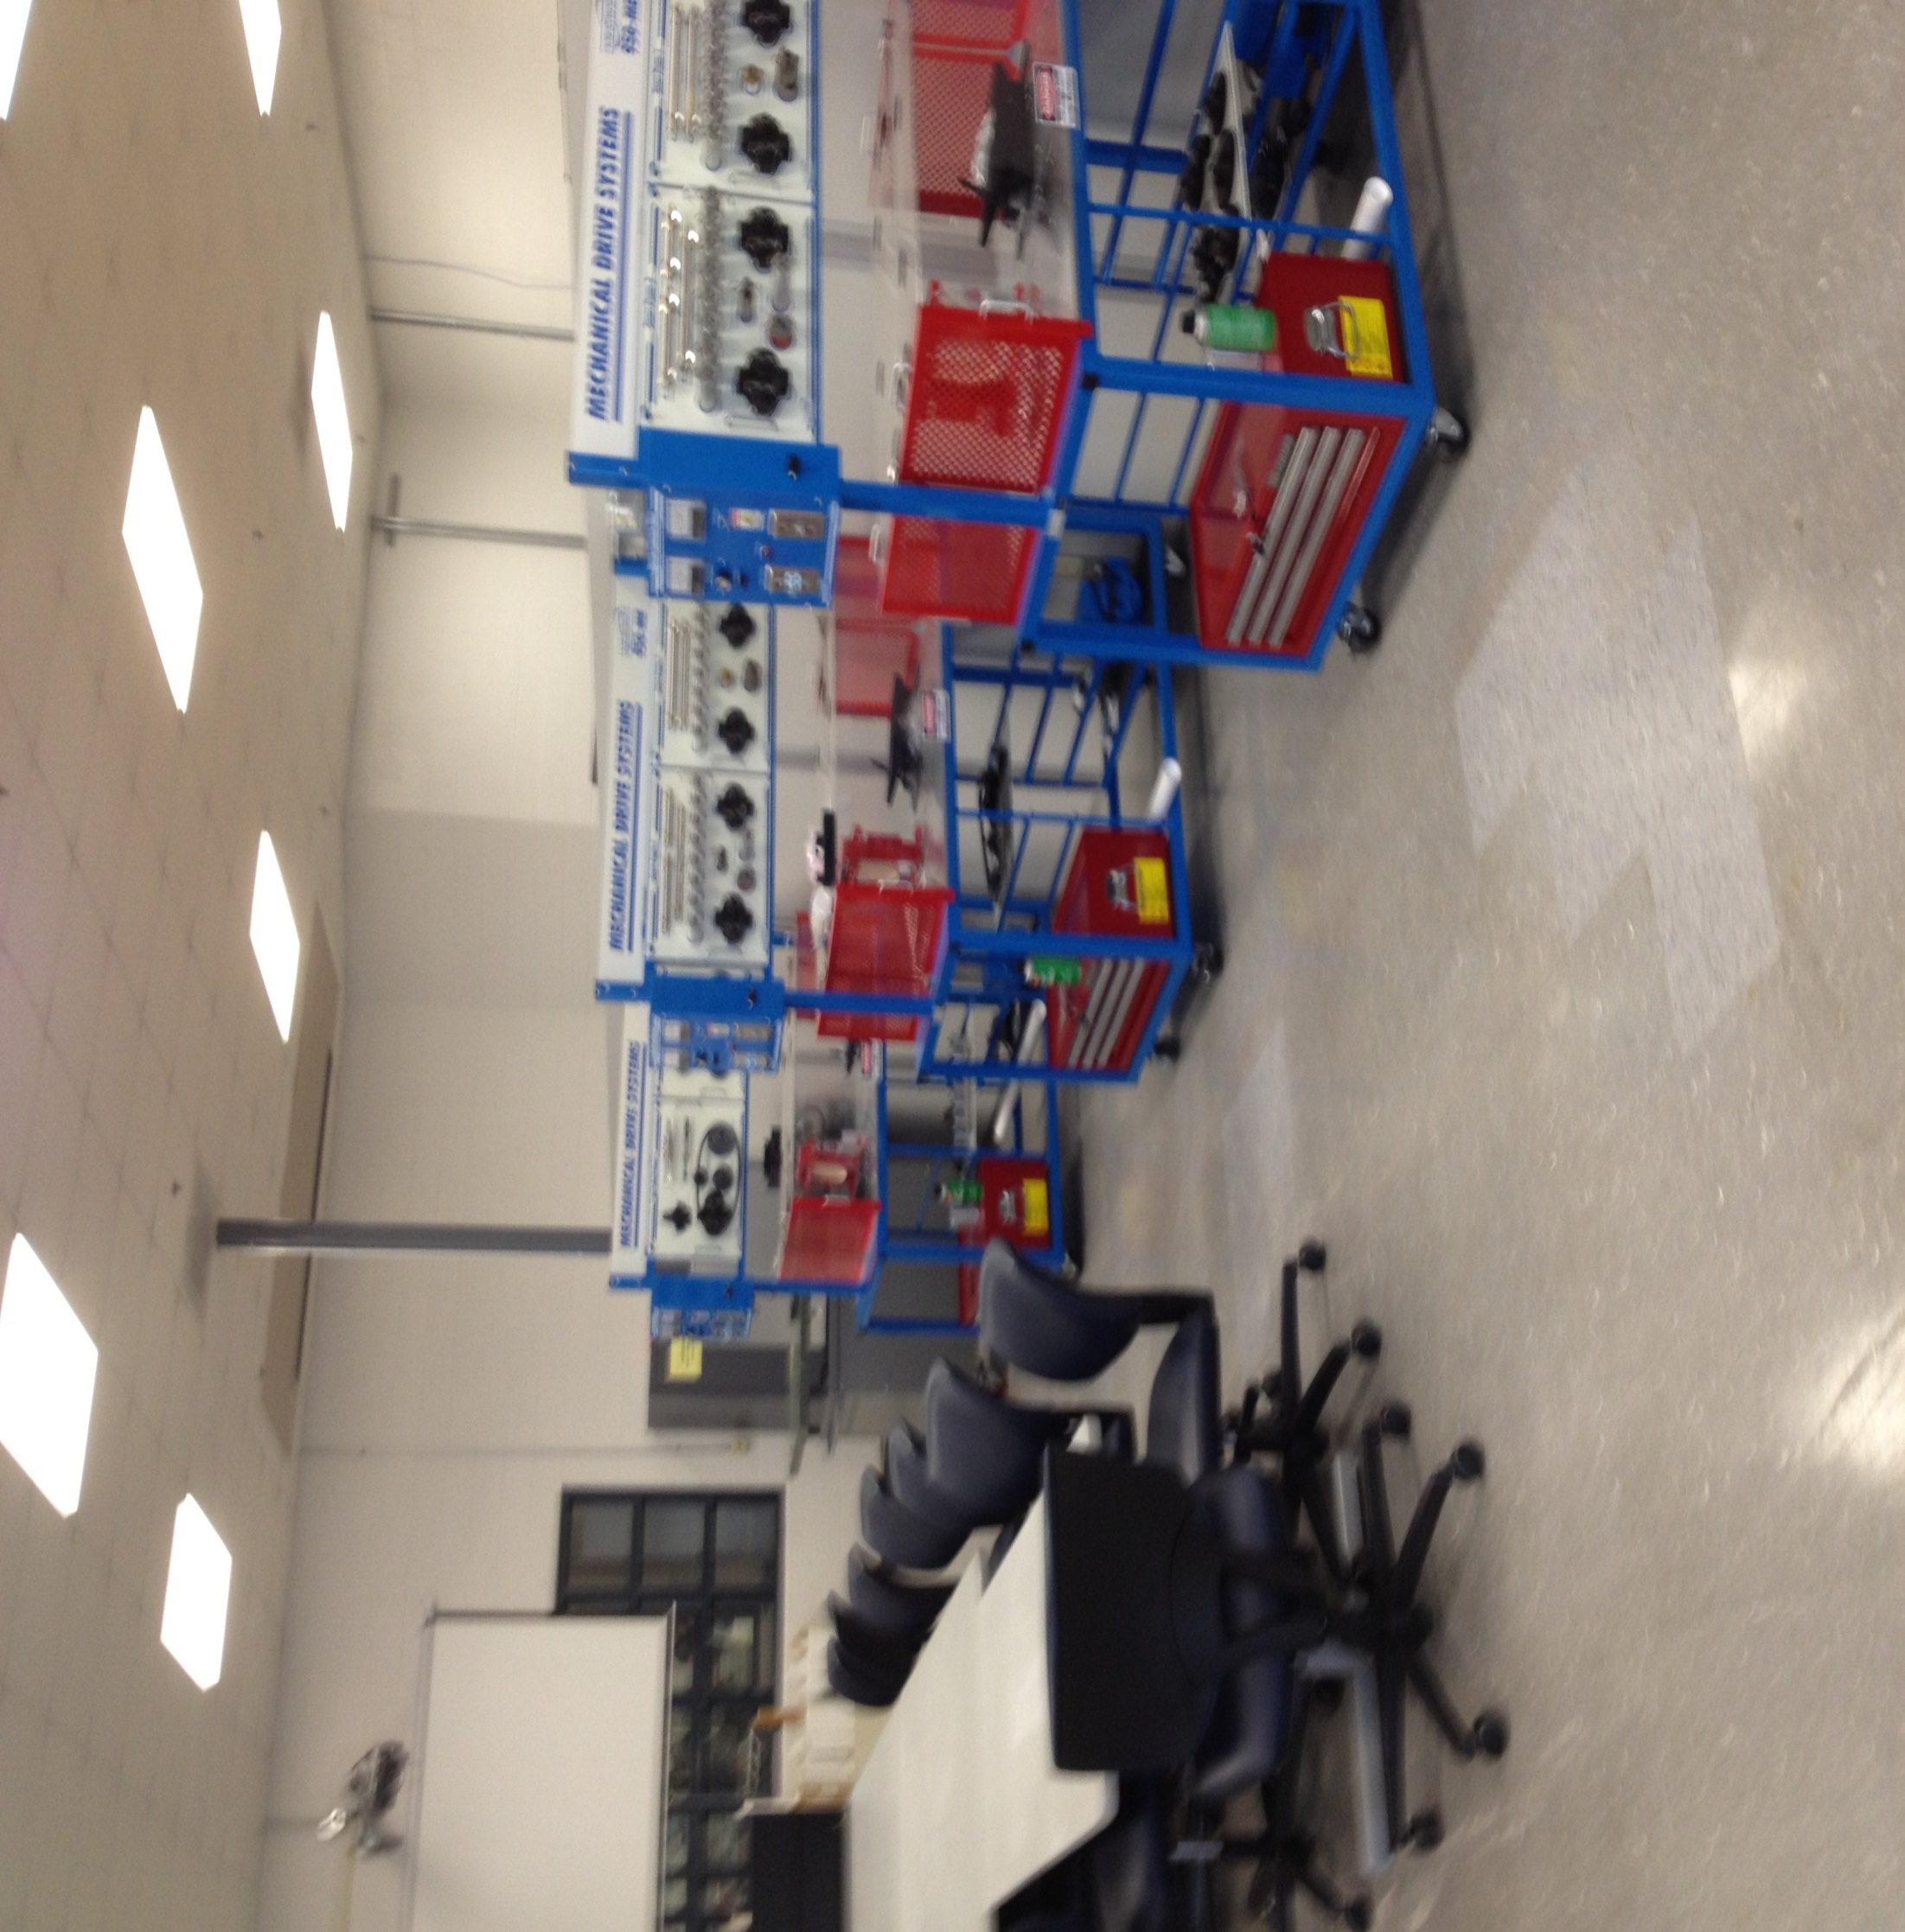
Notes:
This is a picture of the classroom in TN, which is unlike your typical classrooms. The classrooms are set up to allow students come together, discuss and collaborate and then work in teams out on the trainers. This mirrors how most skilled technicians operate on the floor in the companies, emphasizing teamwork and problem solving.

Slide 5
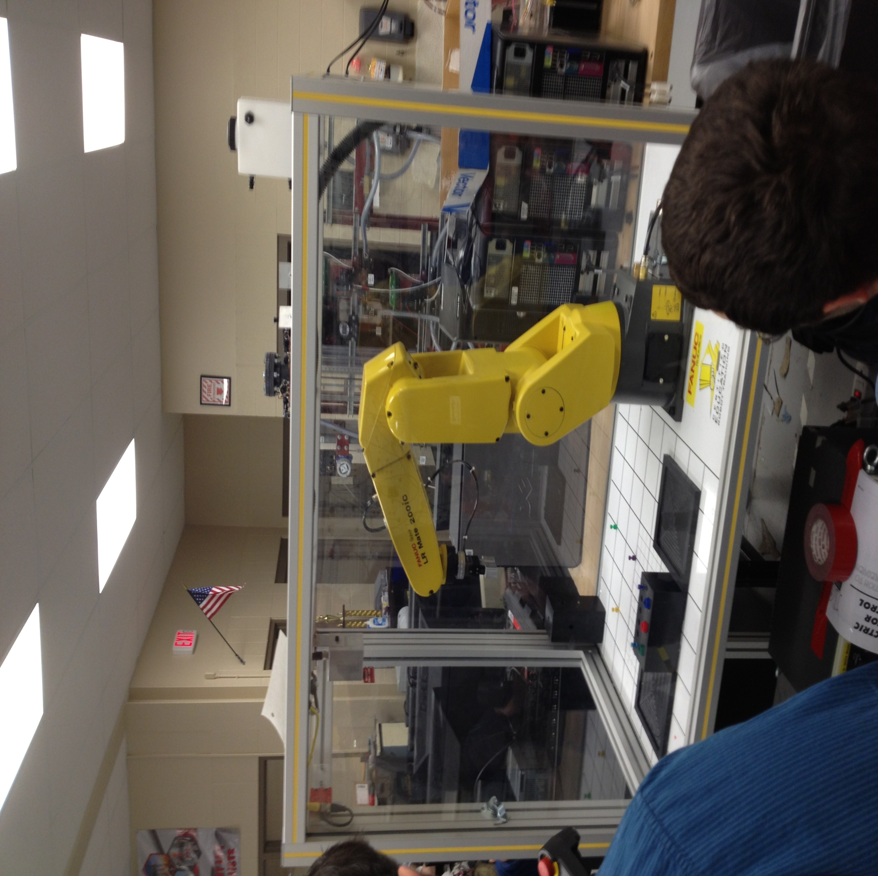
Notes:
The schools utilize state of the art technology currently used in many manufacturing environments.

Slide 6
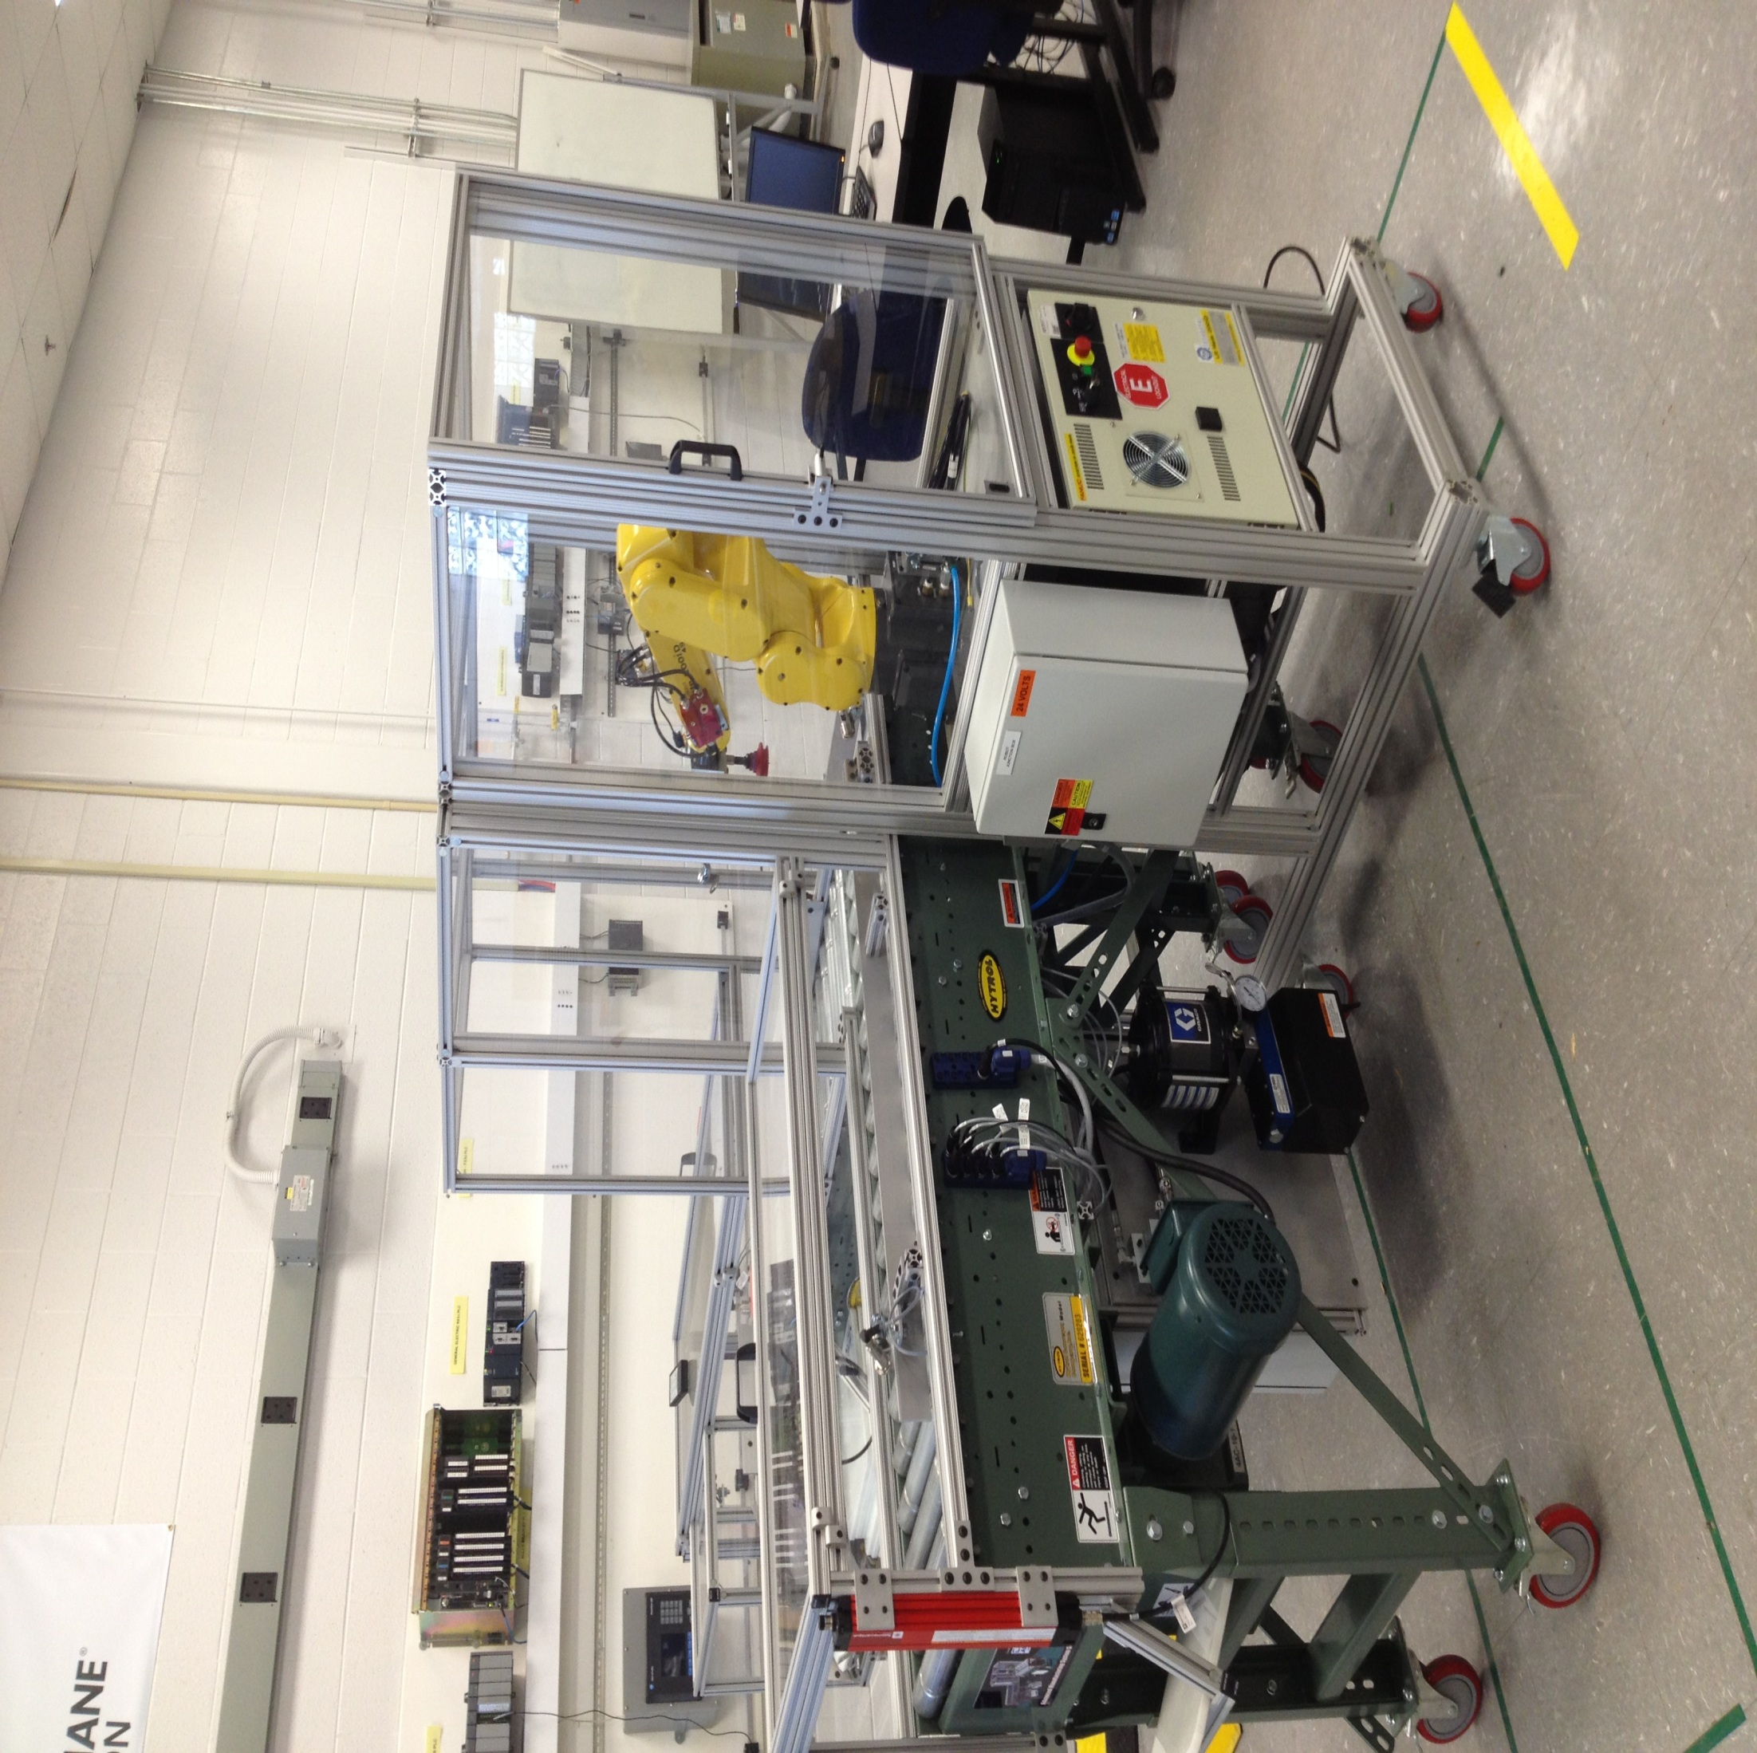
Notes:
At a high level most AMT degree programs offer the same general concept in terms of curriculum. This piece of equipment is at every technical school supporting AMT and is composed of all the fundamental concepts built into the curriculum. The intent for this $200k machine is to be used throughout the program to provide context to the electrical, fluid power, and mechanical classes. It's the "real world" application of the technologies presented in those classes and provides deeper learning. In addition, it is used as a capstone to the program, where the students will be asked to go in and troubleshoot random and multiple faults on the piece of equipment.

Slide 7
ADVANCED MANUFACTURING TECHNICIAN PROGRAM
NEXT GENERATION Technical Degree
ACT/ Compass
Math
22/66
Reading 18/70
English
18/88
8+ Hrs /Day
Advanced Manufacturing Technician Program
Associate of Applied Science
Selection Process Target Criteria: High School Graduates 1/3 Math Ranking ½ Class Standing PLTW Participant
 | 1st Semester | 2nd Semester | 3rd Semester | 4th Semester | 5th Semester
General Education | Math | Writing | Science | Social Science | Public Speaking
Technical Core Areas | Intro to Electricity Fluid Power | Motor Mechanics | Controls PLC | Welding & Machining Drawings | System Troubleshooting Robots
Manufacturing Floor Experience | Production Experience | Maintenance Introduction | Maintenance Foundation |  | Priority 1 Mastery Start
Manufacturing Core Exercises The DNA of Manufacturing | Safety Culture
 |  | Workplace Organization
 |  |  | Learn Manufacturing
 |  |  |  | Problem Solving
 |  |  |  |  | Maintenance Reliability
Personal Behaviors | Attendance – Communication – Diligence – Teamwork – Interpersonal Relations - Initiative
Internship
M | T | W | Th | F
WORK | School | WORK | School | WORK
Weekly Schedule
5 Straight Semester
CHARACT- ERISTICS WHEN HIRED
40+ Hrs / Week
Communication and critical think skills
Multiskilled
Technical
Foundation
Floor experience
and hands-on
skill
Continue Practicing Activity
Good safety
practice on hire
Coach
Continue Practicing Activity
5S understanding
and practice on hire
Coach
Continue Practicing Activity
Lean mfg thinking
and practice on hire
Coach
Coach
Problem solving thinking and use on hire
Continue Practice
Coach
Understanding of maintenance practice on hire
Excellent worker behavior on hire
Notes:
This is a sheet that I’d like to draw your attention to. Most of what you need to understand about the program is reflected on this sheet.
The eligibility requirements reflect the rigor of the curriculum, as test scores are used for course placement and program admittance.
ACT min scores are 22 for Math, and 18 for English and Reading
Compass min scores are 66 for Math, and 70 for English, 88 for Reading
Also each student will be asked to write an essay explaining their interest in the AMT program and ultimate goal in applying.
Meeting these requirements and completing an application does not guarantee admission, as students will be contacted to attend an interview process with the company sponsors.

Slide 8
ADVANCED MANUFACTURING TECHNICIAN PROGRAM
 | M | Tu | W | Th | F
8-10 hrs | WORK | SCHOOL | WORK | SCHOOL | WORK
 | Program Work (1-2 hrs)
2-4 hrs | HOMEWORK & STUDY
Make Every Developmental Minute Count
Aligning Technical Skill with Core Curriculum
Work Start (July 2015) | Fall 2015 Themes: Safety Culture Tech Core: Intro to Electrical, Fluid Power Toyota Bodine: Safety Dojo TW/TPS Basic Electrical 3 Phase Electrical OJT Advancing standardization STW/ WIS TLS checks | Holiday Break | Spring 2016 Themes: Workplace Organization Tech Core: Motor Mechanics Toyota Bodine: Troubleshooting FMDS JKK Arc Flash OJT Line Machine FCN Motion Checks Visualization of MC status Problem Communication SAIBO Report | Semester Break | Summer 2016 Themes: Lean Mfg Tech Core: Controls, PLCs Toyota Bodine: Toyopuc Basic Welding Dojo 3 Pillar system OJT AGV Build Mechanical build Wiring Sensors PLC Work Confirmation | Semester Break | Fall 2016 Themes: Problem Solving Tech Core: Welding, Machine drawings Toyota Bodine: Toyopuc Intermediate PID Quality Mgmt. systems Change point Intro to QCs OJT Quality Circle Maintenance Kaizen Overall Facilities - Enviro Impact LP C-Level Training | Holiday Break | Spring 2017 Themes: Maintenance Reliability Tech Core: Systems Troubleshooting, Robots Toyota Bodine: Simutech e-learning FANUC Robot ABB Robot Robodrill Intro to TBP OJT Individual TBP theme LP B-level training Advanced troubleshooting | GRADUCATION
Notes:
This an accredited AAS degree through State Technical College of Missouri, that runs 40 hours per week for (5) straight semesters.

Slide 9
ADVANCED MANUFACTURING TECHNICIAN PROGRAM
April | May | June | July | August
Held first MO AMT consortium meeting Student Recruitment activity Student/Parent meeting held | MO AMT consortium consensus on curricula sequence | MO AMT student selection MO AMT consortium agreement on curriculum content | - MO AMT student orientation | - MO AMT program SOP
* Slightly delayed due to lengthy decision process in determining and selecting technical school.

Slide 10
TECHNICIAN PROGRAM
Notes:
Thank you for your attention today, are there any questions?

