Slide 1
Alabama FAME
Established April 2014
Notes:
Good Morning. My name is Angela McCue and my safety commitment is to tell the what and the why when it comes to safety to help develop future leaders.

Slide 2









10 Companies
Notes:
I would like to share with you the journey that TMMAL has taken with the AMT Program. There are currently 10 companies in our collaborative.

Slide 3
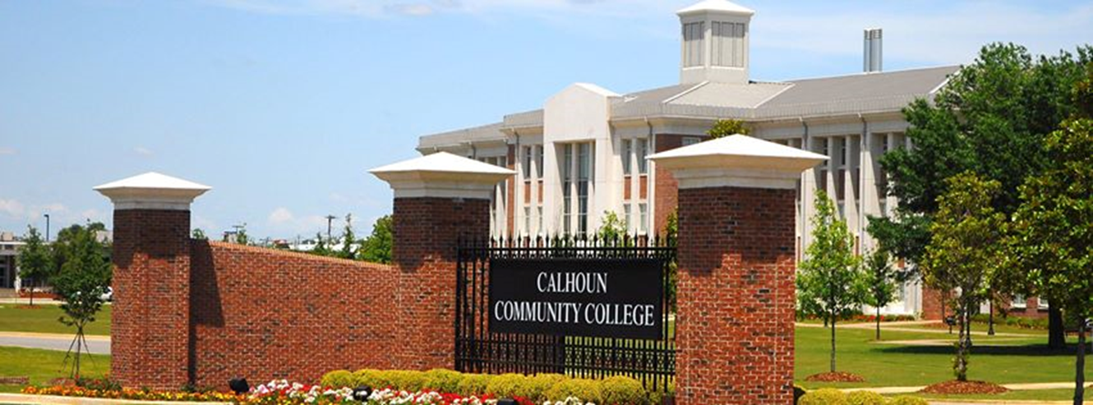
College Partner
Calhoun Community College
Notes:
Our college partner is Calhoun Community College. It is located in Tanner Alabama.
With 11,000 students, Calhoun is Alabama’s largest 2 year college.

Slide 4
Alabama FAME Leaders
Scott Russo – Maintenance Manager & AL FAME Leader
Angela McCue – HR AMT Leader
John McBride – Maintenance TL
Barry Cooley – Maintenance TL
Collis Sims – AMT Director at Calhoun
Patrick Rouse – AMT Instructor

Slide 5
Total Number of Students

Slide 6
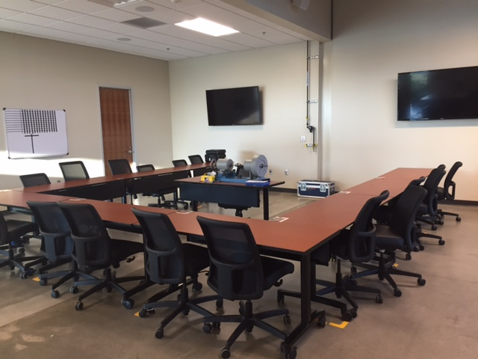
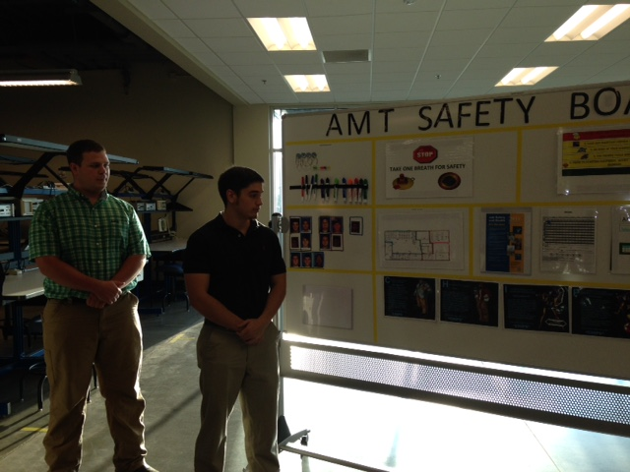
AMC

Slide 7
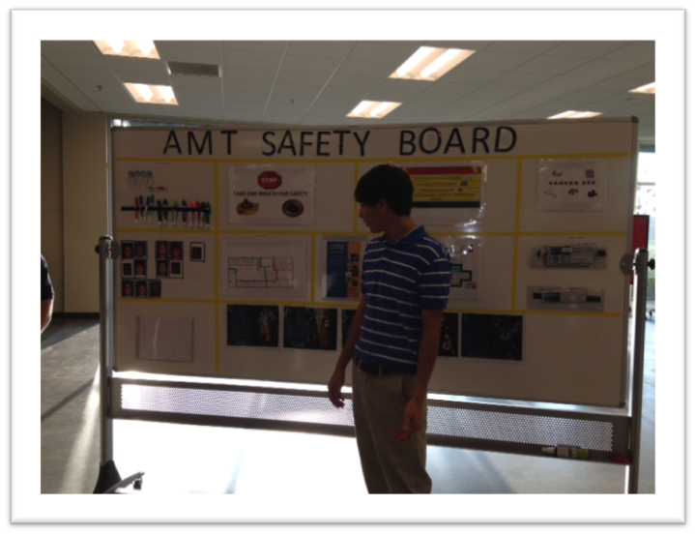
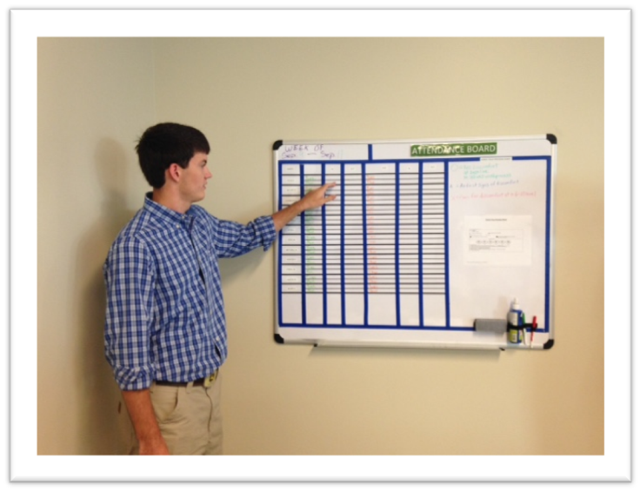
AMC

Slide 8
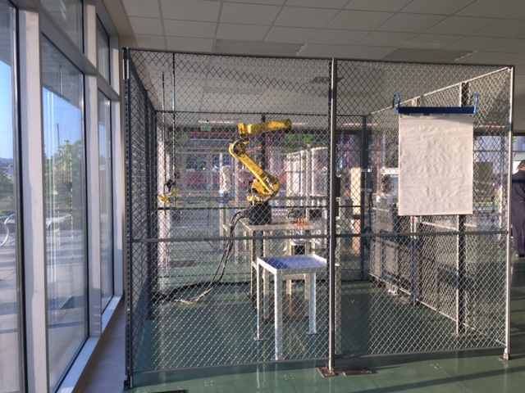
Robots

Slide 9
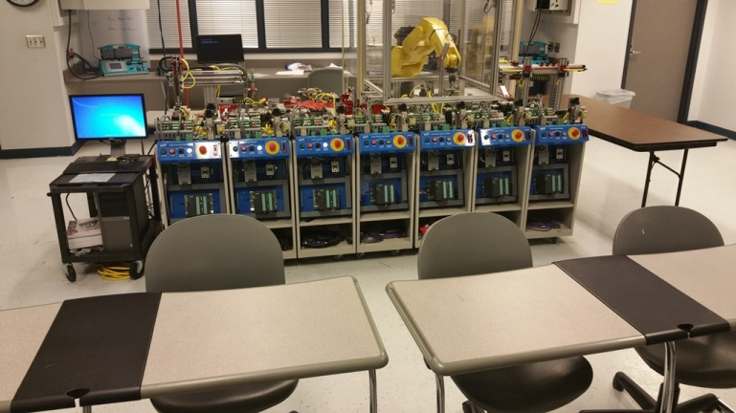
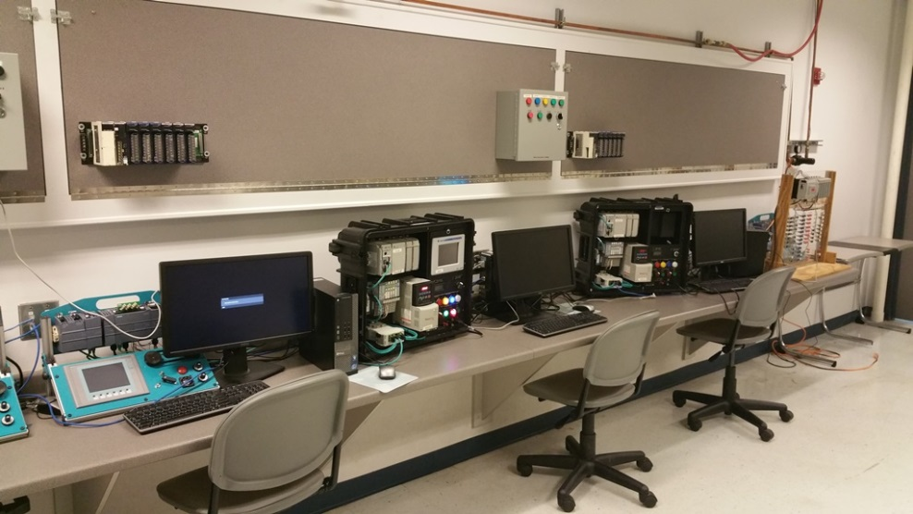
PLC Training Area

Slide 10
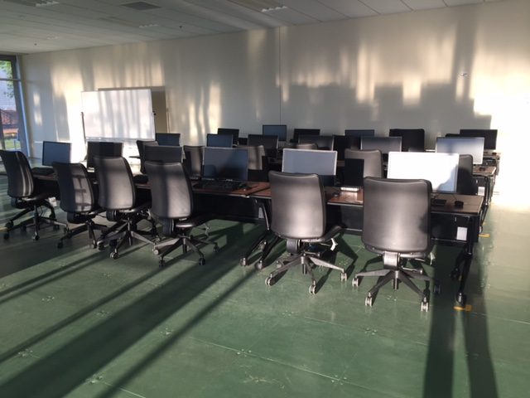
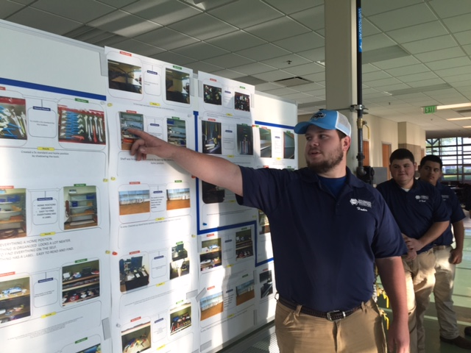
Computer Lab

Slide 11
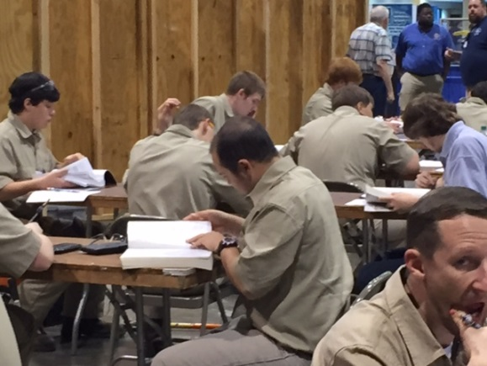
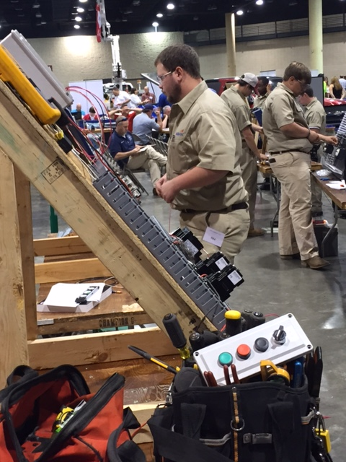
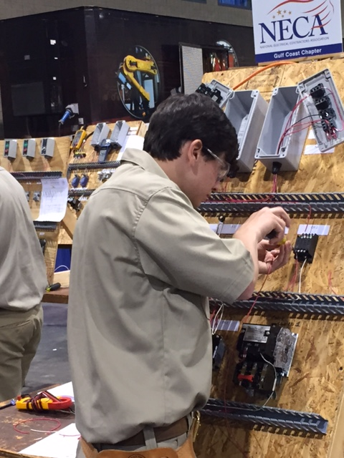
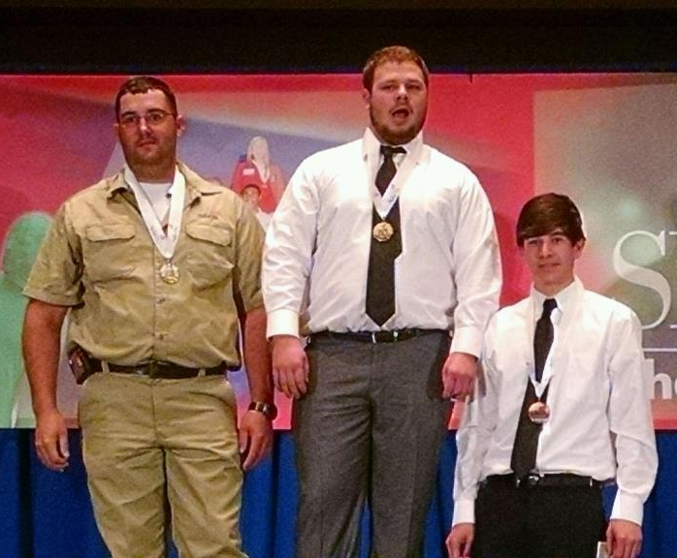
Highlights
Skills USA State Champions
Notes:
This year, we had 4 students compete in the Skills USA Alabama State Competition. 2 students competed in Industrial Motor controls, 1 student competed in Technical Math and another competed in Residential Wiring.

Slide 12
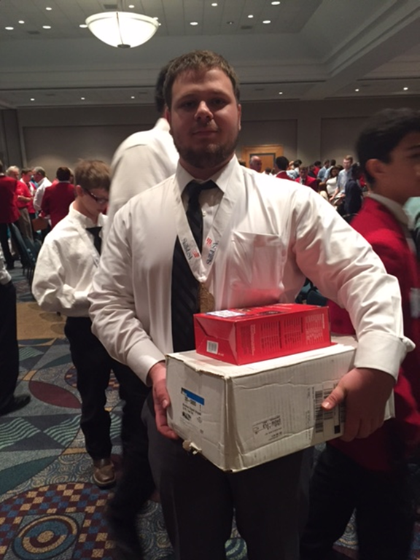
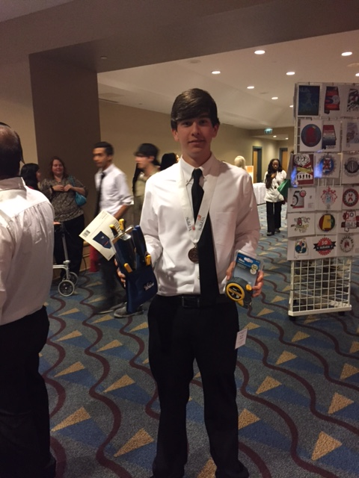
Skills USA
Notes:
Hunter Pack won Gold – 1st place in Industrial Motor Controls and Blake Zirbel won Bronze – 3rd place in Industrial Motor Controls. Hunter will compete at the nationals in June.

Slide 13
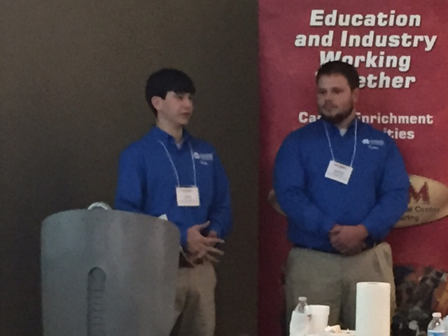
CARCAM NVC
Notes:
Consortium for Alabama Regional Center for Automotive Manufacturing National Visiting Committee. It’s a grant from the National Science Foundation. Business leaders tell educators what they need in a potential employee.

Slide 14
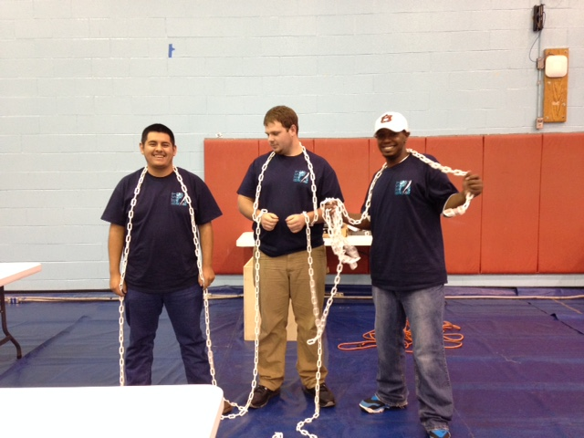
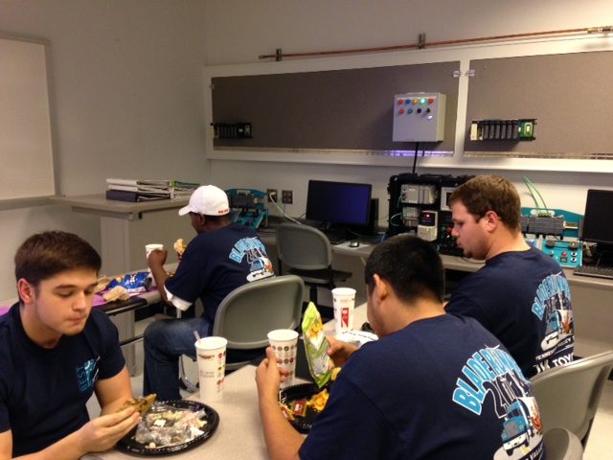
Best Robotics
Notes:
At the Best Robotics Competition, students develop the ability to work in teams, serve in leadership roles, think analytically, and apply technology in solving complex industrial design problems

Slide 15
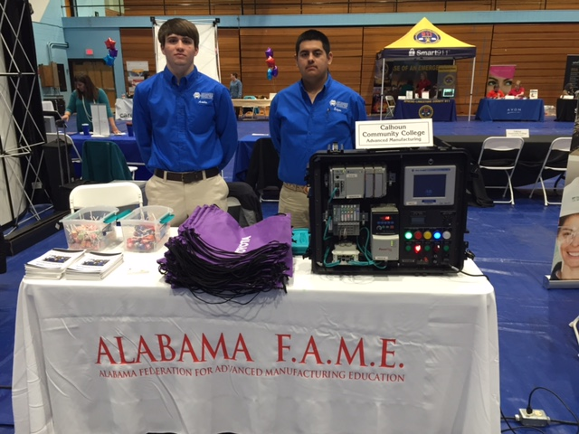
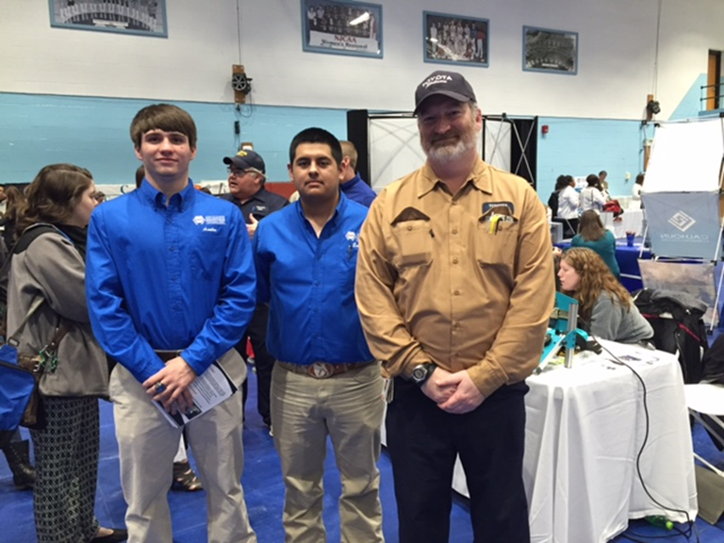
Career Fairs
Notes:
We were able to get our message out to over 5000 students through career fairs and expos. The students attended with us and made more impact with other students.

Slide 16
Questions?

