Slide 1
Tool & Die Advanced Manufacturing Technician Program Tool & Die AMT!
Tool & Die AMT Future Direction

Slide 2
Tool & Die AMT
Current Condition
Manufacturing Companies throughout North America are having difficulty finding new talent to staff T&D shops. In a 2011 Deloitte report of 1100 US Companies surveyed 83% reported moderate-to-serious shortages in skilled machinists.
Few schools offer T&D programs of any kind.
No school totally meets the needs of industry.
Notes:
The total number of unfilled Skilled jobs at the time of this survey was 600,000. Tool & Die was not directly spelled out but was grouped in the numbers with Machinists. We are currently in the forth year since the survey was published, it was estimated that this shortage would have increased another 76% by now.
I personally know that since 1993, finding qualified Tool and Die T/Ms has been very challenging. We have tried several different programs in the past to off set this gap;
- Off the street hires, Low skill or issues with the multi-skill level Toyota requires.
- In house training programs, this received mixed reviews as it relied of the shops to conduct unsupervised training for the Skill specific needs.
- Tool & Die Graduate Program, This program produced good results, it consisted of a 12 month intensive training program post graduation from a T&D collage. But this program required a high level of resources to make it work. We no longer have these resources.
So what do we do?

Slide 3
Basic Strategy
Tool & Die AMT
We need to countermeasure the current and future Tool & Die staffing needs.
One solution - Implement the Tool & Die AMT program to develop skilled Tool & Die team members whose knowledge, skills and initial work capabilities are at a globally competitive level.
Notes:
The Maintenance AMT program has been producing very good results, so it seemed natural to model this program after it.
Less than 15% of companies surveyed use educational Institutions like technical schools and community colleges as a resource for skilled workers. By developing this program and getting buy in from a central college we can start filling the gap of qualified workers.

Slide 4
Tool & Die AMT
The Ideal Situation:
Regionally T&D is fully staffed, and fully skilled.
A structured development program for continued growth of the T&D team member skill.
Include the “Maintenance Core Exercises” and “Professional Behavior Development”.
Notes:
The MCE’s and Professional Behavior Development are crucial skills that are lacking with all post graduate students today. (Work ethics have also changed, quotes like “you want me to start work at 6:00am? And I’m expected to be here every day on time” are common comments heard from some new workers.) I know of several cases where a new worker would ask to be relieved on line to use the restroom and just walk out of the plant, sometimes before first break.
This program will also bring other elements to the table that are missing from normal college programs.
A. Technical skills
B. Professional skills such as communication and presentation
C. The Maintenance Core Exercises, these include;
Safety, 5-S, Lean Manufacturing, Machine Reliability, and Problem Solving

Slide 5
The Solution
Design the path to get there
Work & Performance Development
Industry Best
Work Preparation
Work & Learning Readiness
Equal or better than Europe & Asia’s Best Crafts Preparation Programs
At a globally competitive achievement level
Notes:
Plant the seeds early with both the school K-12 and the families. This is a very important step especially to get the parents on board.
Set up a college partnership to provide WHAT we need, WHEN we need it, and at the TIME it is needed.
Next we have pulled together the best practices from the German, Asia, and American programs, tailoring what is needed to support the company needs.
So what can you do to plant seeds? Here are some ideas;
Work with your partner school to have special event days, it really says a lot when someone from industry comes to a school to promote their need.
Simple Motors
Hover Craft
Robots
Plant tours

Slide 6
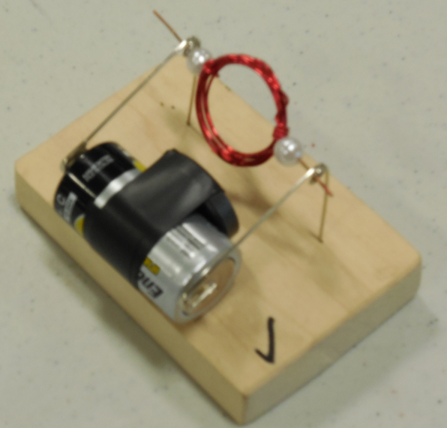
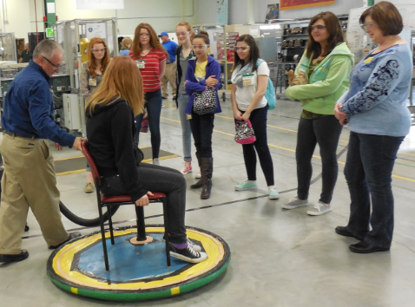
Ideas you do to get the seeds planted:
Middle School Visits to your College and Plant with interactive demonstrations
Vacuum Cleaner Hovercraft
Simple DC Motor
Notes:
Here are a couple of Ideas that get the kids excited about science and engineering.
If you have a robot cell that can be demonstrated or better yet have the kids operate they become more engaged.
You could tailor these events around Tool Maker work besides maintenance work. The key is to engage and excite the kids.
We do these on Fridays as the college does not have classes on Fridays, even if you did 1 per month think of the number of kids you could be reaching.

Slide 7
Career Pathway For Tool & Die AMT Student To becoming a FAME Tool & Die Team Member
Students recruited from local High Schools by the same process as Maint. AMT
Student graduates from High School
Accepted into T&D AMT program by the Local Plant
Receive company financial support
Passed core T&D classes at NEMCC
Local plant floor development and experience.
Fundamental Training at NAPSC or Local Plant
Tool & Die Intern at Local plant
Hire T&D Maintenance TM with a 3 year obligation.
Notes:
Target schools that use the “Project Lead the Way” principles, ridding piggy back on the Maintenance AMT recruiting program already in place. Focusing on the students that show interest and aptitude for the T&D trades.
The student is recruited by Jan. 31st. of the of the school year. This is to ensure the college will have dorms for them to stay in.
Must pass all the perquisites to be accepted into the program. Minimum ACT scores of Math- 19, Reading- 20, and English- 18, but shoot for higher scores so you have the best candidates!
The financial support package will cover such things as Tuition, Room and Board at the collage, books and school fees. ($8,400.00 per student, per year)
Besides being required to pass all the school required curriculum in addition the students will also have to pass the “FAME core” classes;
- Safety, 5-S, Lean Manufacturing, Reliability Centered Maintenance (RCM), Problem Solving
6. The floor rotations will be structured with exercises geared to reinforce the studies taught in the previous semesters enhancing the learning.
6- week T&D Training activities at NAPSC or your local plant will be used to level up the skills required to perform daily work.
A 12-24 month merit based Internship coupled with additional shop specific training that would be needed such as; Plastic processing would be taught on a requested basis during this time.
Upon completion of the internship and the availability of job position openings the student gets hired in at an entry level T/M. The period of obligation is under review by legal it should be 3 to 5 years from their hire date.
We also want to target some of non-traditional students up to 20%, Ex-Military, Older student that never completed a degree but have some training, etc.
Federation for Advanced Manufacturing Education (FAME)

Slide 8
The Result
Visualize The Final Product
Next Generation
Tool & Die Team Member
Tool & Die Skills plus an understanding in welding, Electrical and Hydraulics
All NAMC Tool & Die Team Members
Notes:
All of the these principles will be reinforced through out the program.

Slide 9
So How Will We Accomplish This
The Tool & Die AMT Program will consist of Students from their local area Plants that have Tool & Die shops. These students will be enrolled full time with North East Mississippi Community College (NEMCC) Boonville Ms. and employed through a variable work force provider at each local plant.
Students will receive a wage during floor rotations.
Notes:
This coupled with the financial support are the major differences between the Maintenance AMT program and T&D AMT program.
All the students will travel from their home plant to attend the same college.
This will help to control the curriculum and more efficiently train the lower numbers of needed T/Ms for this group.
As this program grows it is possible it will expand to other colleges with T&D programs across the US.

Slide 10
Tool & Die AMT Program Principles
Tightly connected/coordinated career path.
Consistently produce technicians that are on par with the best in the world.
Every step & activity is “best practice.”
Data-based management.
Notes:
IN summary; because of all these factors we believe the students that graduate from this program will meet our needs into the future.

Slide 11
Tool & Die AMT Schedule
August – December
Fall YR 1
January - May
Spring YR 1
June - July
Summer YR 1
August – December
Fall YR 2
Local Plant
Orientation, 1 month
Power Machinery III
Computer Numerical Control Operation II
Die Design 1
Public Speaking
Humanities / Fine Arts Elective
Tool & Die GTAW
MCE, Core TPS-M
Power Machinery I
Blueprint Reading
College Algebra
English Comp I
Die Repair
Oxy Fuel Cutting
MCE, Core Safety
Power Machinery II
Computer Numerical Control Operation I
Adv. Blueprint Reading
Precision Layout
Tool & Die SMAW
MCE, 5S
LOCAL PLANT 6-WEEK FLOOR ROTATION
January - May
Spring YR 2
June - July
Summer YR 2
August – December
Fall YR 3
January - May
Spring YR 3
Power Machinery IV
Metallurgy
Special Problem
Jigs Fixtures and Tools
Psychology
Introduction to GMAW
MCE, Problem Solving
Local Plant
Internship 12 to 24 months
LOCAL PLANT 6-WEEK FLOOR ROTATION
Principles of Hydraulics & Pneumatics
Industrial Electricity
Trigonometry
Principles of CAD
MCE, Core RCM
Fundamental Skills training at NAPSC
Toyota Troubleshooting Techniques
Notes:
This slide is representing the suggested curriculum for this program. We are solidifying the curriculum with the school. Courses we are negotiating to be added are:
Die Fabrication 1
Die Fabrication 2
Die Design 2

Slide 12
Tool & Die AMT Program Current Status:
Received approval to move forward from TEMA HR GM.
Start up funding is in the process of being approved. Estimated cost per student for 5 semesters of training and floor rotations is $142,473.00
Agreement with college in process of being approved.
Once confirmed we will officially announce the program and partnership with NEMCC and roll it out.
Notes:
Cost break down; $25,114.00 for college costs and NAPSC training, $117,360.00 for wages during floor rotations and internship spread over a 3 year period.
These costs may sound high, but investigating on how much does it cost to replace an employee the range can be as much as 20% to 150%. This equates to $10,000.00 to $75,000.00 for a position making $50k per year. (Then this replacement may not meet the needed skills.)
Recruiting is planned to start in September of 2015.
The target date for the first class to start is the fall semester of 2016!

Slide 13
Notes:
This is the approval document we used to get the program started.

Slide 14
Tool & Die AMT
Questions?
Contact Information:
Denis Taylor 502-868-2945

