Slide 1



Slide 2
History
Originated in 20 year continuing education program at Toyota
KY FAME industry partnership launched in 2009.
  9 manufacturers in the Bluegrass region
First student sponsorship program at Bluegrass Community & Technical College in 2010
  4 companies
  14 sponsored students
Governor Beshear announced state organization in January 2015
  State level board of directors
  70 companies committed to sponsor over 20 students in fall of 2015
  Goal to create chapters in each workforce investment area by end of 2015

Slide 3
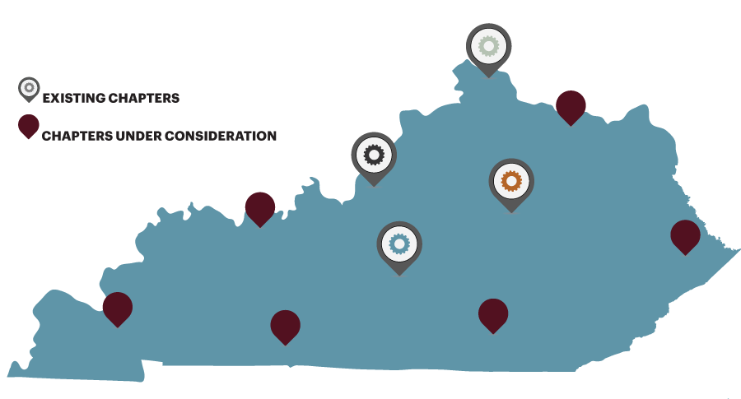
State Board of Directors
Chapters:
- Bluegrass
- Greater Louisville
- Northern KY
- Lincoln Trail
- Greater Owensboro

Slide 4
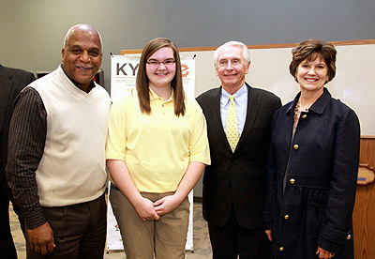
Partners
Employers
Students
Kentucky Cabinet for Economic Development
Kentucky Community & Technical College System
Kentucky Association of Manufacturers

Slide 5

KY Cabinet for Economic Development
Economic and Workforce Development Strategy
Marketing KY FAME
Chapter Development
German Dual Certification

Slide 6
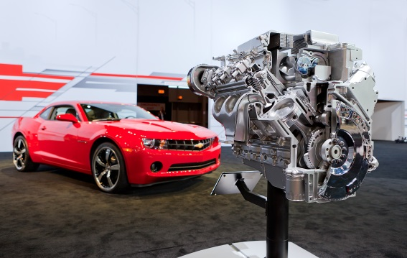



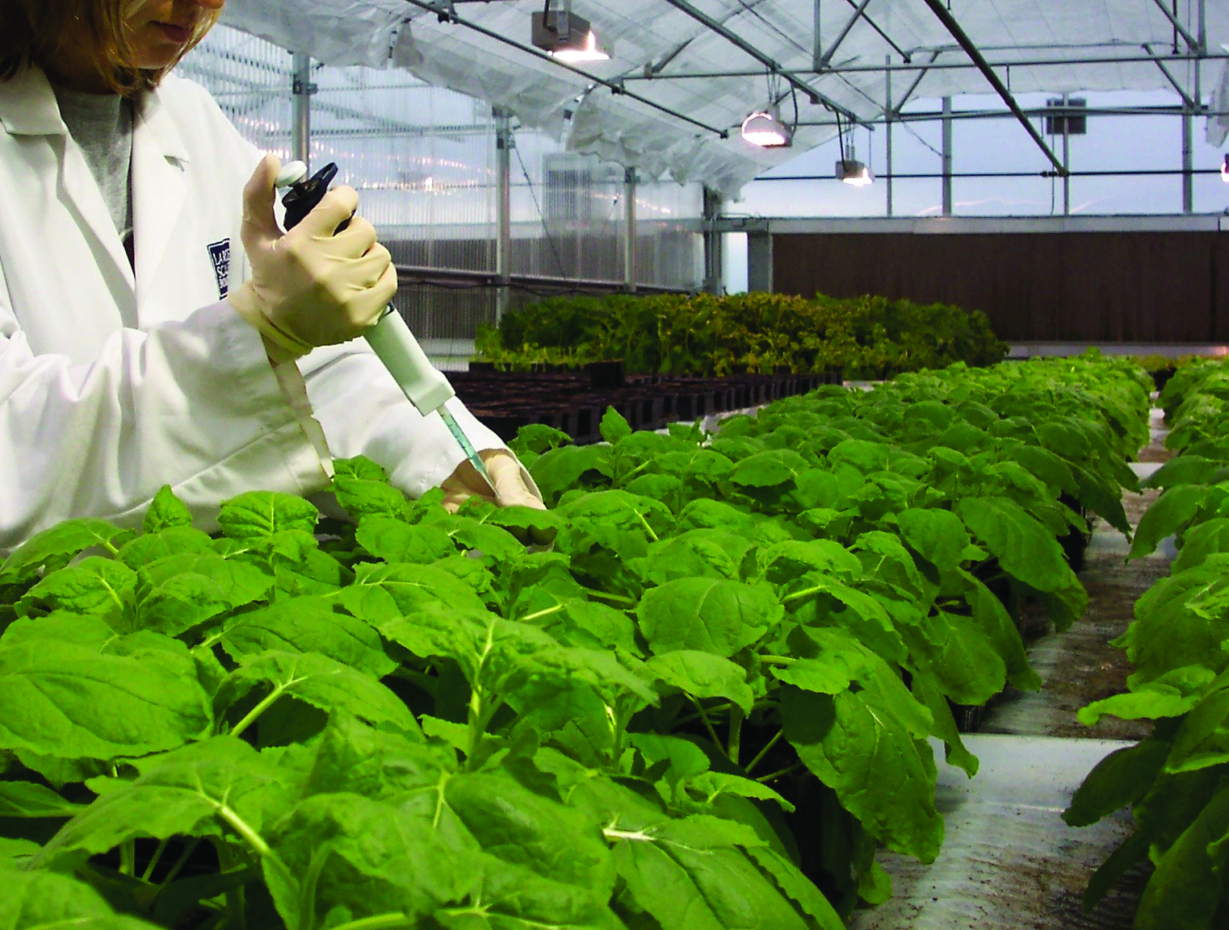

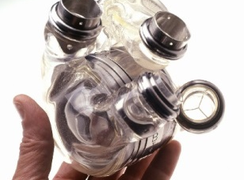
^{WORLD CLASS WORKFORCE}
Kentucky’s superior workforce produces cutting-edge products that have revolutionized the world
The Kentucky Skills Network is Kentucky’s workforce system and provides employers with world-class customer service and quality resources.

Slide 7






1 – Recruitment & Job Placement
2 – Customized Training
3 – Training Incentives
4 – Workforce Pipeline Development

Slide 8
www.kyfame.com

Slide 9

Classes & jobs begin
Student sponsorship
Employer Driven Interest & Commitment
1
5
Program
Launch
Interview & Select Students
Commitment to Lead
HOW TO START A
CHAPTER
K-12 School
Engagement
Select chapter
officers
2
4
KY FAME Promotion in Regional School Districts
Organizational
Governance
3
Student focused
Company Open House
ID roles and
responsibilities
(Companies, Education
and Economic Development
KCTCS Teacher Training
Educational Institution Commitment
MOA with Chapter

Slide 10

KY FAME: German Dual Certification
  In-State Evaluation
  Fall 2014: The Association of German Chambers of Commerce and Industry’s (DIHK) conducted an in-state evaluation of AMT.
  Winter 2015: AMT curriculum evaluated in Germany
  Results
  AMT degree will be recognized in United States and Germany.

Slide 11
KYFAME
Education Partner
M. Dianne Leveridge, PhD
KCTCS Director of Technical Programs

Slide 12
KYFAME Model challenges
Single delivery
Consistency
Safety
Curriculum
Program Sustainability
Continuous Improvement
Quality

Slide 13
Education Transformation
KYFAME FACILITATED ACADEMIC APATATION

Slide 14
Academic Adaptations
Education Purveyor Becomes Education Partner
Infrastructure Changes
Curriculum Changes
Mindset Changes
Quality & Consistency

Slide 15
Academic adaptation
Infrastructure Partnership
KYFAME FERPA Agreement
..\..\KYFAME\SecurityProcesses\FAME-KCTCS Data Sharing Agrmt-with logos.pdf
Sharing student progress on a deep level requires strong FERPA Release and Data-Sharing Agreements.
Students agree to deeper exchange (FERPA)
Frequent employer-educator communication
Real-time progress reports
Employer classroom engagement
Cohort management
Continuous Feedback & Improvement

Slide 16
Curriculum changes
Education Purveyor Becomes Education Partner
Curriculum Changes
  Rich Curriculum: 68 – 71 Credit Hours required Board of Regents approval
  Manufacturing Core Exercises
  Personal Behaviors
  Concept alignment with workplace

Slide 17
Curriculum changes
AMT Track Curriculum
Track developed based upon the Industrial Maintenance Technician AAS program
December 2014 KCTCS Board of Regents approved credit hour exception
MCE’s adopted into curriculum
68 – 71 credit hours
Link to AMT Track Order ..\AMT_Order.xlsx

Slide 18
Infrastructure changes
Education Purveyor Becomes Education Partner
  Schedule: 2 days campus; 3 days employer
  Comprehensive content days
  Workplace alignment

Slide 19
Quality & Consistency
Education Purveyor Becomes Education Partner
  KYFAME Model Training (June, 2015)
  Consistent delivery system-wide
  Third party assessment
  Evaluation process

Slide 20
Employer-education Partnership
Novel partnership
Conversation changes
Participation changes
Partnership instead of prescriptive
Problem-solving
Collaboration instead of siloism
Employer = customer

Slide 21

KY Association of Manufacturers
Fiscal Agent
Resource Management
Conferences
Advocacy

Slide 22























































Slide 23
THANK YOU

