Slide 1
State of the
AMT Program
Dennis Dio Parker
May 19, 2015
South Charleston, West Virginia

Slide 2
Active Programs
8 Programs with enrolled students
  KY FAME-Bluegrass (5th year)
  WV FAME (3rd year)
  IN FAME/P (2nd year)
  Mississippi (2nd year)
  Texas (2nd year)
  Tennessee (1st year)
  AL FAME (1st year)
  IN FAME/J (1st year)

Slide 3
Active Programs
4 Programs Starting
  MO FAME (St. Louis metro)
  KY FAME-Greater Louisville
  KY FAME-Northern Kentucky
  KY FAME-Lincoln Trail (Elizabethtown)

Slide 4
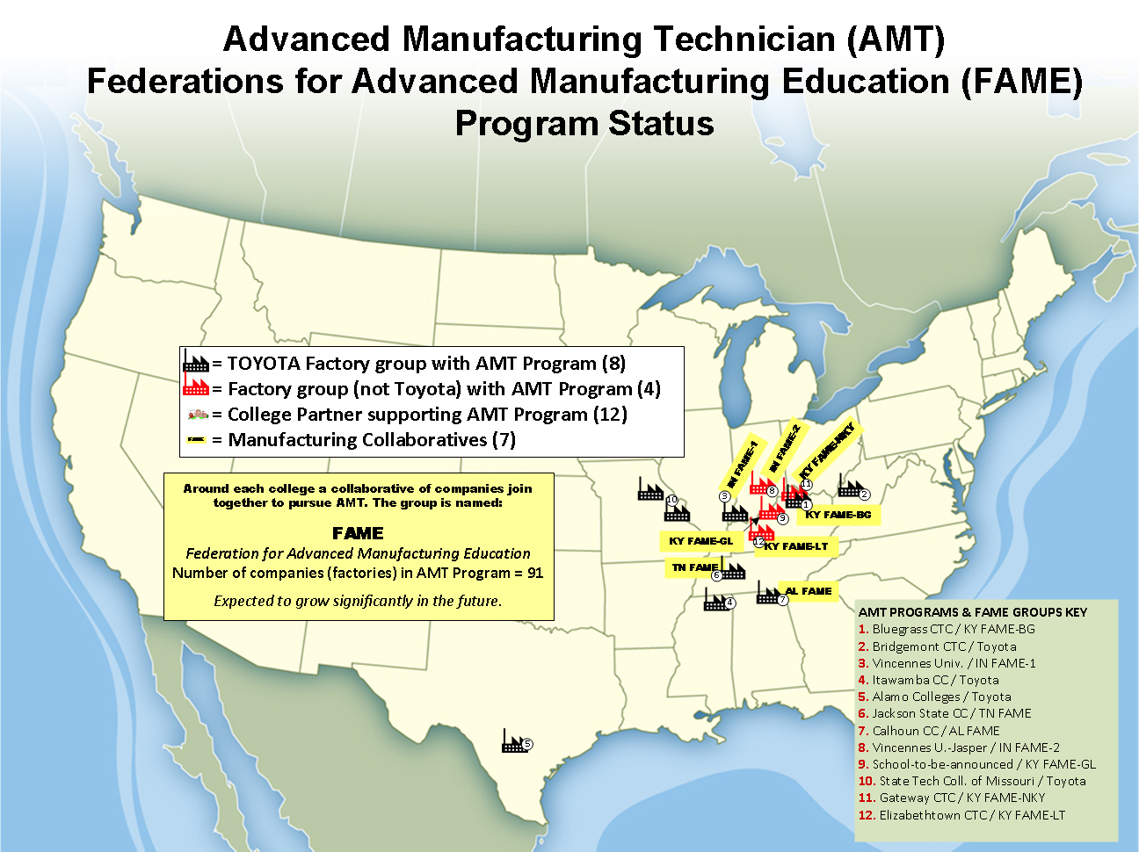

Slide 5
By the Numbers
12 Active programs/12 community colleges
8 States
91 Committed Employers
  8,000+ Largest single-site employer
  10 Smallest single-site employer
5 Programs now graduating students
3 Pathways programs (AMT/AMB/AME)
2 Universities (Northwood U., Univ. of Kentucky)

Slide 6
FAME Companies (91)
3M
AGC Automotive
Akebono Brake
Altec
ARJ Manufacturing
Armstrong
Atlas Machine & Supply
Bodine Aluminum (Toyota)
Bodine Aluminum/St. Louis (Toyota)
Bodine Aluminum/Troy (Toyota)
Brown Precision (2015)
Cantalent Pharma Solutions
Carlisle
Central Motor Wheel of America
Commonwealth Machine Tool
CTP Transportation Products
Custom Polymers
Delta Faucet
Durobag
E.D. Bullard
EFI
Enprotech
Fischbach
Flex Films
Florida Tile
G.R. Spring and Stamping
GE/Electrolux
General Cable
Hahn Automation
Heartland Automation
Hitach Automotive Systems-Berea
Hitachi Automotive Systems- Harrodsburg
Indiana Furniture
INOAC
Jack Daniels (2015)
Jasper Engines and Transmissions
Jasper Rubber
Kimball Electronics
Kimball International
Lasco Fittings
Lectrodryer
Lee Spring Co.
Linamar
Link-Belt
L'Oreal
LyondellBassell
Masterbrand Cabinets
Matsu Alabama (2015)
Metal Technologies/Jackson Die Casting
Metalsa
Mid-Park
Montaplast
Mouser Custom Cabinetry
Mubea
Natoli Engineering
NGK Sparkplug
Nth Works
OFS (Office Furniture Systems)
OLON
Pictsweet
Pinnacle
Raytheon
Reynolds Metals
Robert Bosch
Safran/Messiger Bugatti
Sealing Life
Shelby Industries
Snap-on-Tools (2015)
Sonoco
Stanley Black & Decker
Steelcase (2015)
Stober Drives
TBDN
TBIN
ThyssenKrupp Presta
TOPY
Toyota Motor Manufacturing, Alabama
Toyota Motor Manufacturing, Indiana
Toyota Motor Manufacturing, Kentucky
Toyota Motor Manufacturing, Mississippi
Toyota Motor Manufacturing, Texas
Toyota Motor Manufacturing, West Virginia
True Manufacturing
U.S. Farathane
Wabash Produce
Wagstaff
Watauca Foundry
Webasto
Westport Axls
Yamamoto
Zoeller

Slide 7
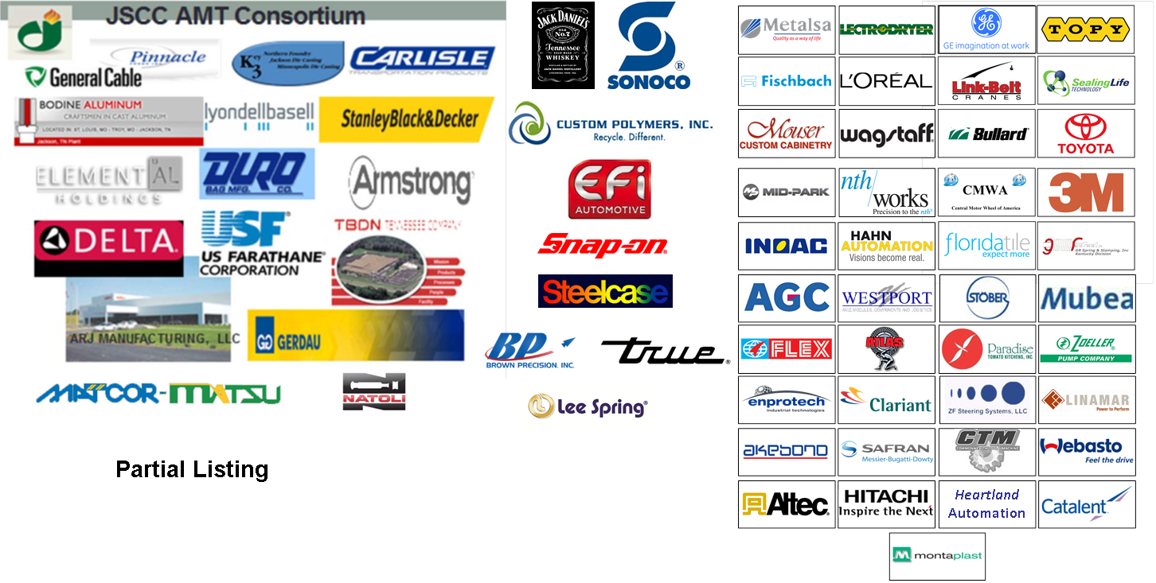




FAME
Federation for Advanced Manufacturing Education
The Collaborative of Employers Supporting AMT
“Support” = Sponsoring an AMT student
Current: 83 employers
Expected by 8/15: 91+
Partial Listing

Slide 8
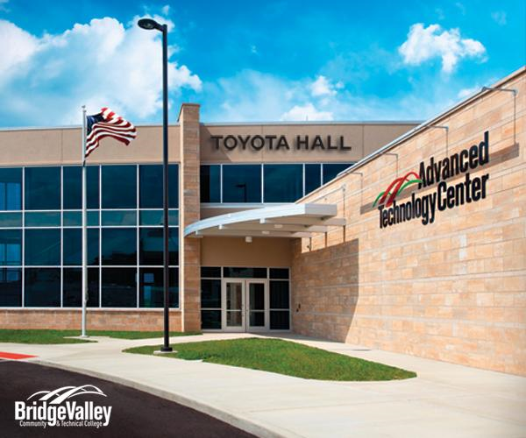
Sustainment/Strengthening/Growth
West Virginia ATC Dedicated – August 19, 2014
Designed to support the AMT Program Model

Slide 9
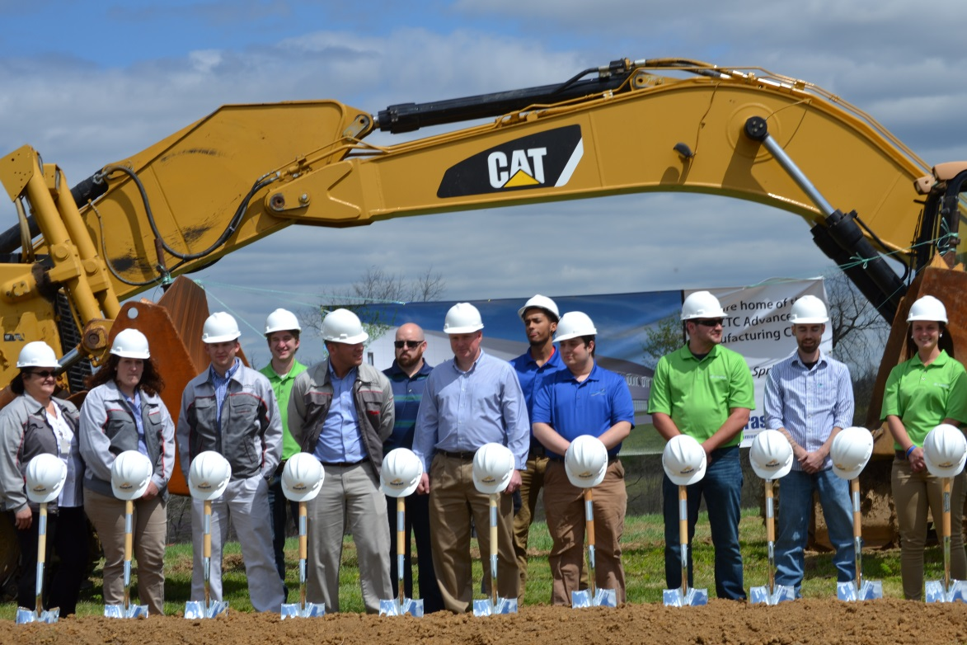
Sustainment/Strengthening/Growth
Bluegrass Community & Technical College, Advanced Manufacturing Campus Groundbreaking
Designed to support the AMT Program Model

Slide 10
MCE Faculty Training/Certification

Slide 11
Internship Growth
x

Slide 12
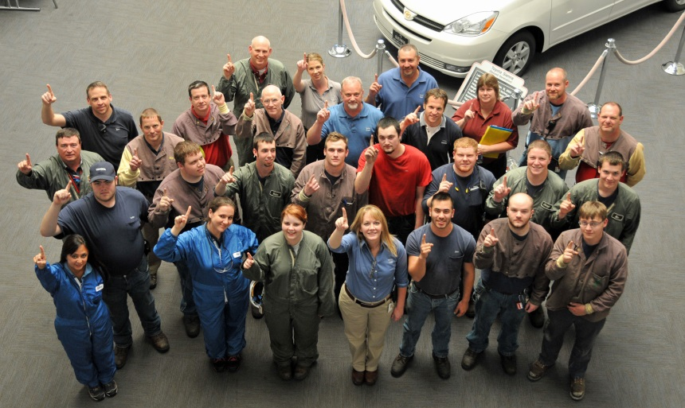
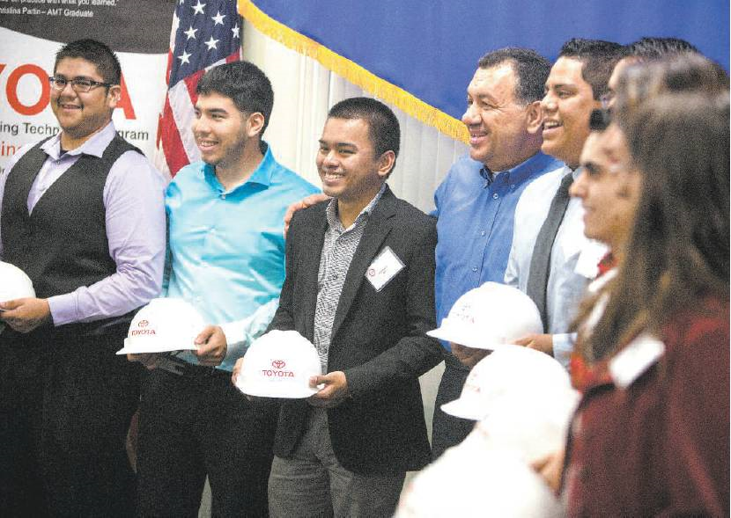
First Graduating Classes
IN FAME/P
In Princeton, Indiana
Vincennes University
Texas
In San Antonio
Workforce Center for Excellence with St. Philip’s College

Slide 13
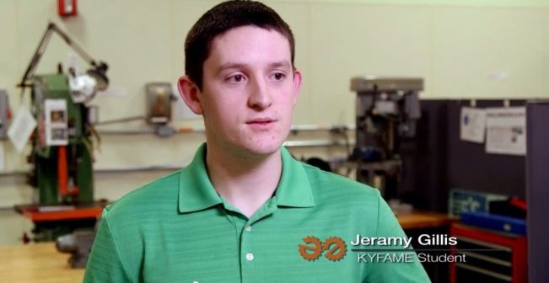
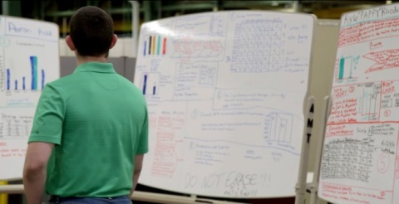
AME: Adv. Manufacturing Engineer
Trail started at University of Kentucky 8/2014
Companies selected Electrical Engineer path
Special advisor/enhanced activities
Continuous engineering co-op assignment
GOAL: Produce the most job-ready manufacturing engineers on the globe.

Slide 14
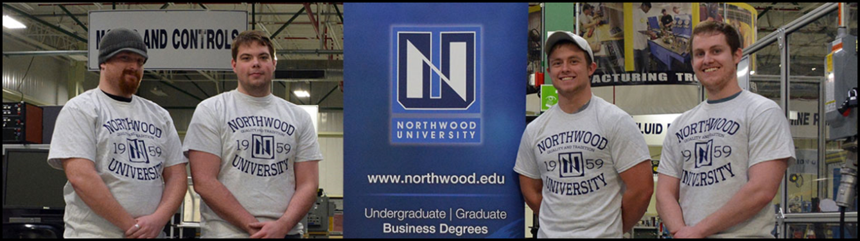
AMB: Adv. Manufacturing Business
Trail started at Northwood University 1/2015
12 students in pilot group
Special advisor/enhanced activities
Post-hire activity
GOAL: Strengthen every level of team member by KEY ROLE+BUSINESS+LEAN = Global Best

Slide 15
Kentucky Takes It to a New Level
PROBLEM = Current technical programs do not produce adequate talent. Companies worry about expanding, locating, committing.
Wide anecdotal awareness that new graduates are unprepared for work. High employer frustration
RESULT -> Lost economic strength, employers lost to other states, other nations.

Slide 16
Kentucky Takes It to a New Level
KY FAME employer group incorporated as a state-wide organization, enables new chapters
Governor appoints KY FAME State Board of Directors
Economic Development Cabinet strongly promotes program across commonwealth to both employers and students
Economic Development Cabinet develops significant resources to support KY FAME.

Slide 17
Kentucky Takes It to a New Level
KCTCS approves a new degree track with the AMT name on it.
KCTCS converts MCE’s to credit courses
KY FAME + KCTCS AMT Program = New Employer Collaboratives enabled state-wide
RESULT
  KY FAME-Greater Louisville
  KY FAME-Northern Kentucky
  KY FAME-Lincoln Trail

Slide 18
Kentucky Takes It to a New Level
Result (continued)
  40+ companies in KY FAME
  Coordinated effort for economic growth based on superior talent
  2-3 new collaboratives likely in next year
Global Result
  Powerful new message to take overseas, especially to employers who are hesitant about U.S. technical talent. Kentucky is actively using AMT to attract global business.

Slide 19
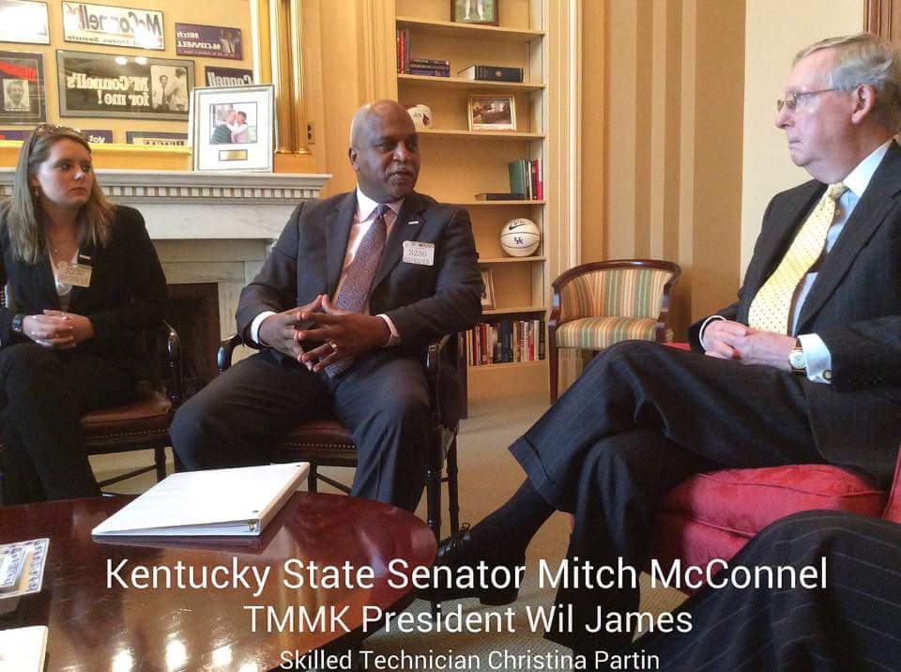
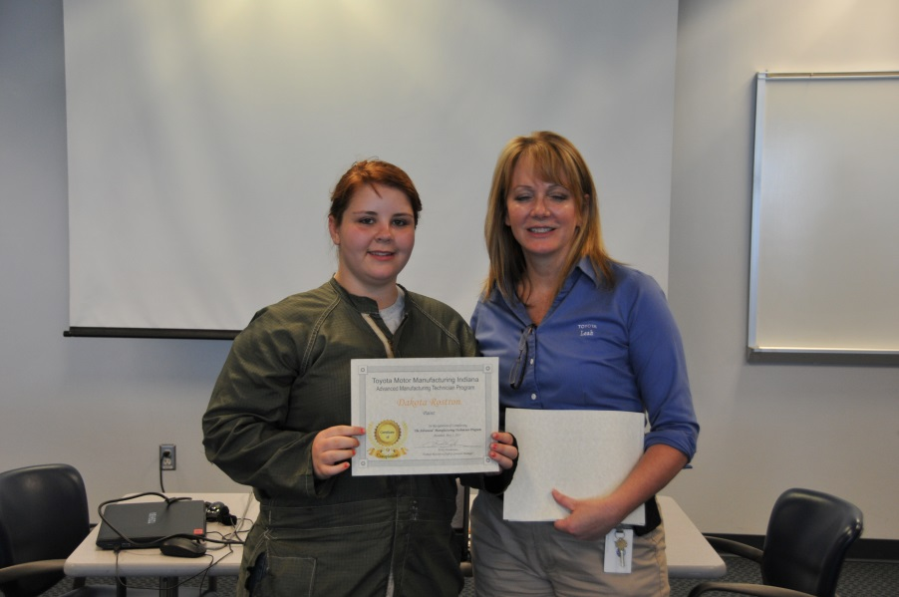
AMT Students Are Making an Impact
Christina Partin of Kentucky meets with Senate Majority Leader Mitch McConnell in Washington, D.C. Thomas Word of Mississippi also visited national legislators in D.C. (no pic available)
Dakota Rostrun of Indiana gained admission to Rose-Hulman University, considered by many to the be No. 1 engineering school in the nation.

Slide 20
AMT Has Won 3rd Award
ACT (American College Test) bestowed the “Work Readiness Award” to Kentucky.
Because of program standardization note that state awards are considered, by the program, to be national.
AMT was the chief program cited for award.
Adds to :
  NCPN/Kuder Natonal 1st Place Career Pathway Award
  New York Hall of Science “Global Science Award” for leadership in STEM education

Slide 21
Key Partnerships
Project Lead the Way
Best STEM program for AMT and the Advanced Manufacturing Career Pathways in the U.S.
National Alliance for Partnerships in Equity (NAPE)
Diversity organization to assist in accelerating the inclusion of females and minorities in technical and engineering careers
Northwood University
Long-time business partner with strong business program aligned to manufacturing and coordinated with AMT

Slide 22
Current Challenges
Rapid growth of AMT makes support difficult
Traditional faculty slow to adopt AMT method
MCE training of faculty is significantly behind
MCE certifications to teach locally is behind
Slow to fully implement Program Assessment
Current AMT-dedicated resources at Toyota are significantly overburdened
Problem Awareness: As program grows recruiting quality may be an emerging issue

Slide 23
Emerging/Future Activities

Slide 24
The Advanced Manufacturing
Career Pathways (AMCP)
AMT – Create the world’s strongest technician
AMCP – Create the world’s strongest workforce
Use AMT Principles
  Select (where applicable) best talent
  Structure entire program for maximum performance
  Set high standards
  Seamless pathway: no gaps, no duplicates
  Align educational outcomes to meet work needs
  Continuous benchmarking to ensure top program

Slide 25
The Advanced Manufacturing
Career Pathways (AMCP)

Slide 26
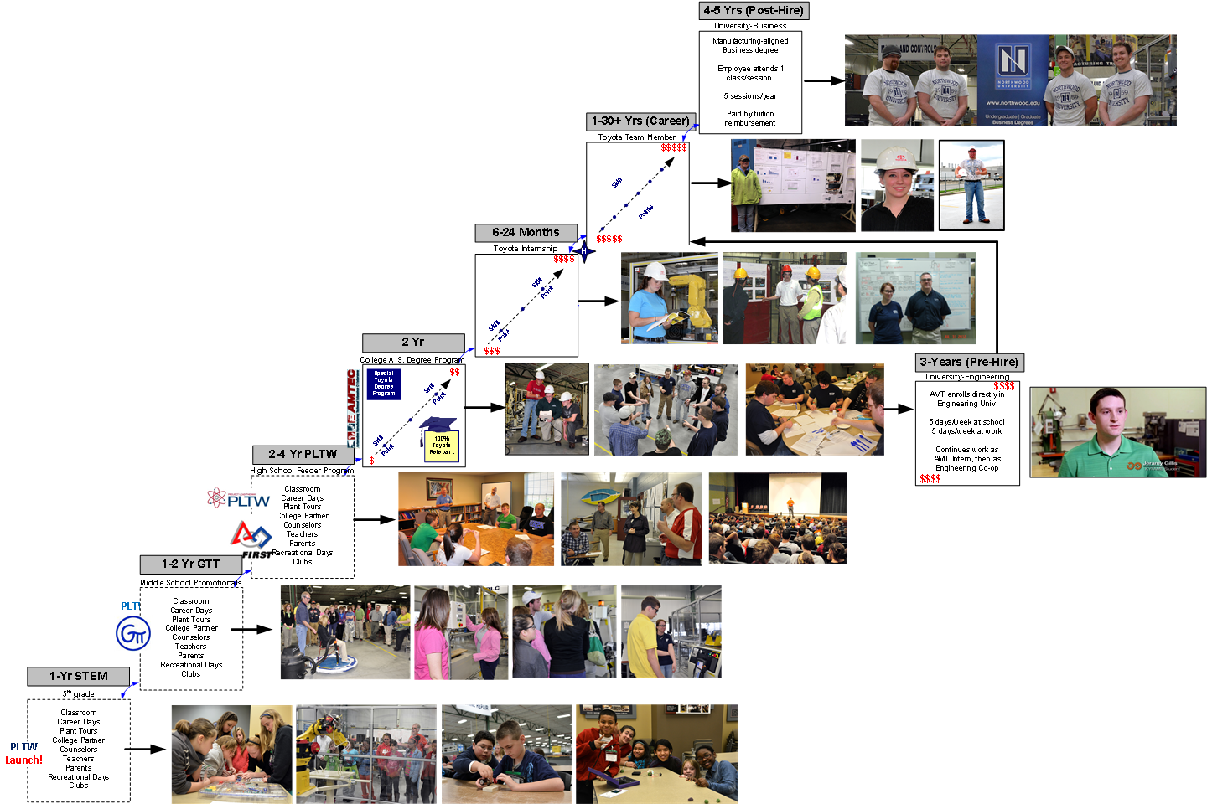
K-12 Pathway: Ready to Move Out

Slide 27
K-12 Pathway
Why the K-12 Pathway?
  Not enough kids interested in STEM
  European/Asian proportional interest higher
    Fewer choose STEM education/careers
    Workforce is short of employees
  Diversity of technical/engineering workforce is low
    Major contributor to worker shortage
    Lost brain power
  Manufacturing is an unpopular career choice
    Major contributor to worker shortage

Slide 28
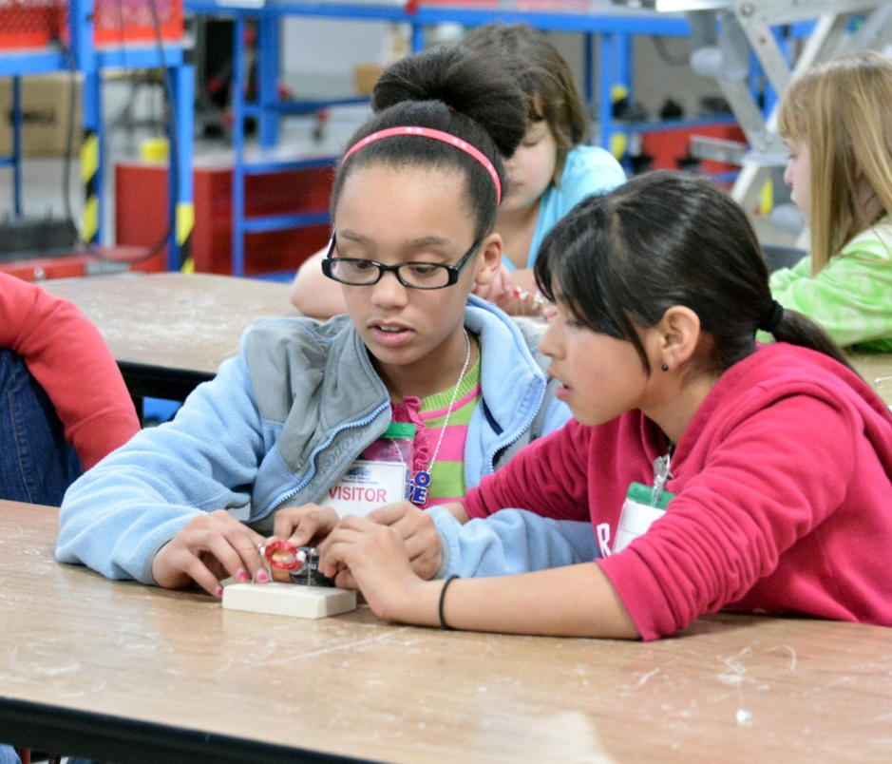
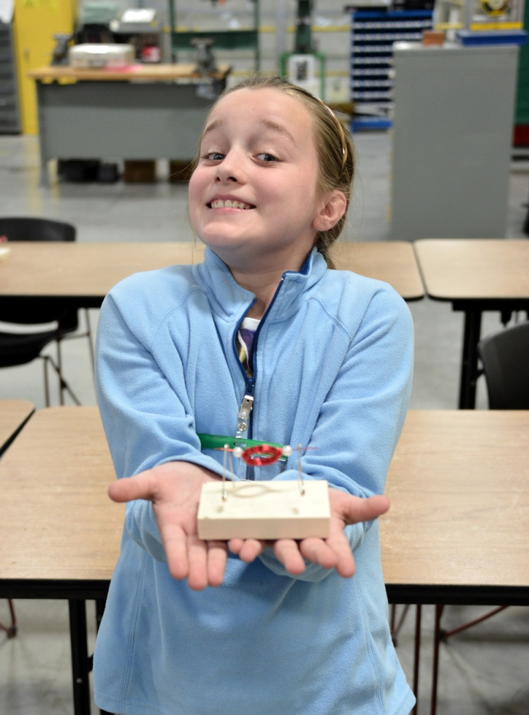
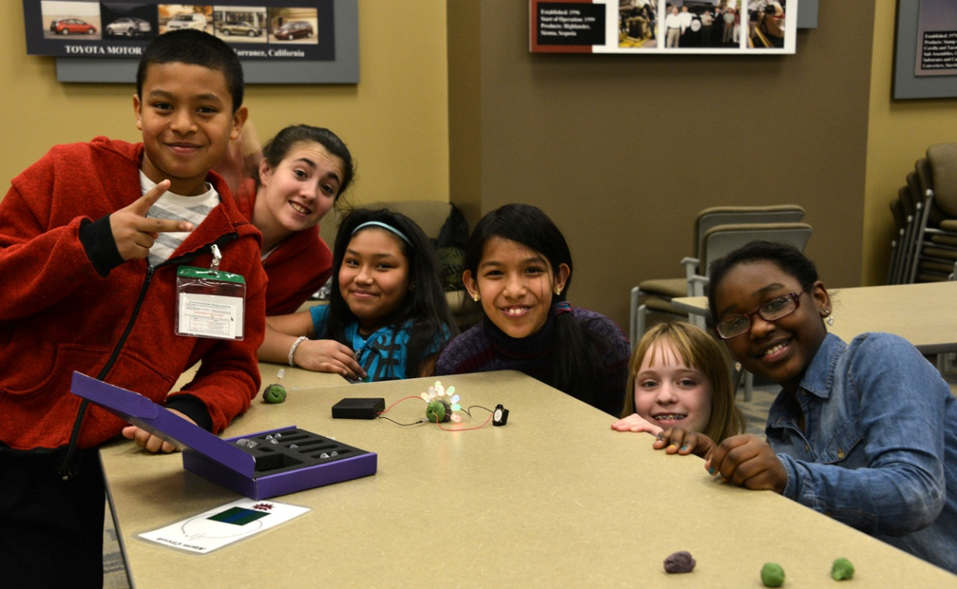

Slide 29
K-12: Pilot Site is Toyota Kentucky
“Career Pathway” Tours brings in 5th and 8th grade students for 3-part activity:
  Customized plant tour
  STEM activity (highly hands-on)
  Campus tour (highly hands-on)
Target deeper engagement with fewer schools. “Year-over-Year engagement
Over 1000 students will tour this year

Slide 30
K-12: Pilot Site is Toyota Kentucky
Phase 1: Tour development/trial
Phase 2: Grow tour, standardize work
Phase 3: Transfer “ownership” to External Affairs
Phase 4: Implement at other locations (next)
Phase 5: Assist growth throughout FAME
TRACK IMPACT

Slide 31
AMT Tool & Die Program
4th Track in the Advanced Manufacturing Career Pathways
Meets a critical worker shortage/critical business impact
European programs significantly ahead
Problem has been very difficult to solve
First students will enroll August, 2016

Slide 32
AMT Tool & Die
How Will It Work?
  Choose one U.S. school
  Develop school to be U.S. best, globally competitive
  Recruit locally, education “nationally” (at the school)
  AMT Model
  Develop full technician (Prof. Behaviors/MCE/T&D)
  Work/study. 3 years. Summers at home plant.
  Polish off at Toyota NAPSC.
  Program Leader: Denis Taylor

Slide 33
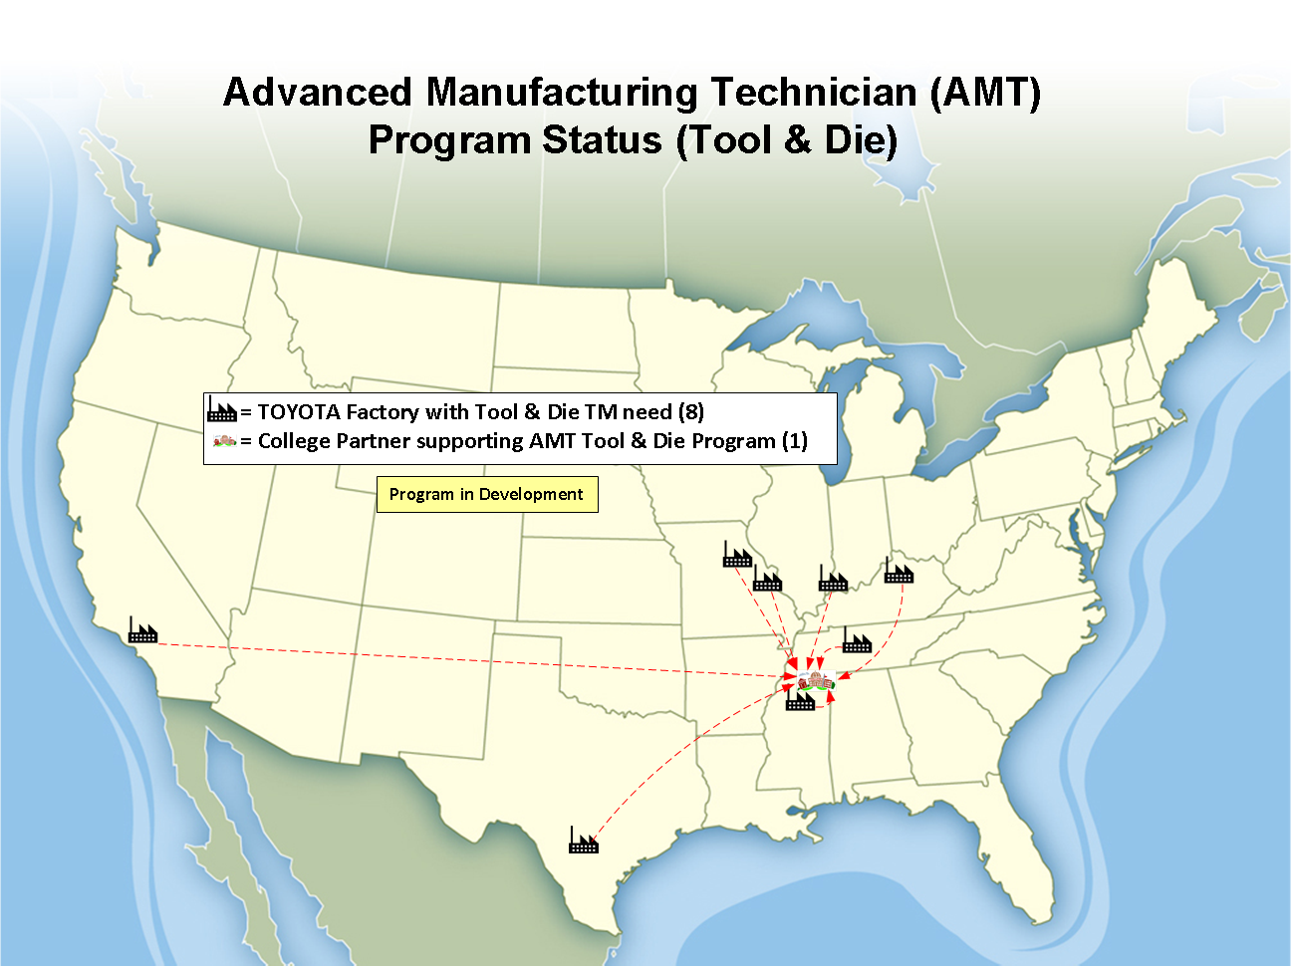

Slide 34
AMT Academy
PROBLEM: How to support AMT development beyond Toyota? Can’t directly teach and develop at boots on the ground level. Wish to be good corporate and societal citizen.
Two components
  1 week of “How to start and run an AMT Program”
  Teach 1st round of MCE’s (7 days worth)

Slide 35
AMT Academy
Offer annually on as-needed basis
To qualify for attendance new programs must come with both employers (program leaders/managers) and educators (program providers)
One program for all based on Toyota model
(Any change due to local program initiative)
Current programs can use to strengthen self

Slide 36
WV FAME
First meeting May 19, 2015
Launch multi-company effort
Will become model in WV for collaborative effort

