Slide 1
TMMMS Facilities AMT
Benefits of the AMT Program

Slide 2
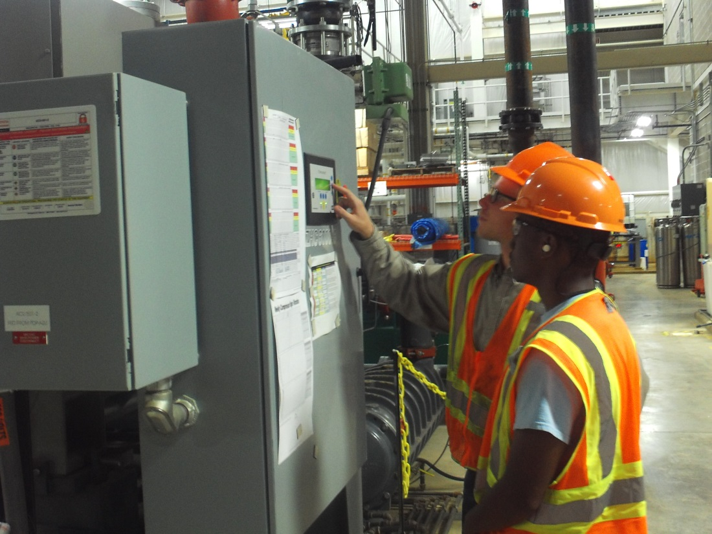
Program Benefits
Not only does the AMT program teach our future multi-skilled technicians Electrical, Fluid Power, Mechanical, and Fabrication skills; it gives the future technicians core exercises to relate their training to the real world experience. The program also places a strong focus on Professional Behavior Skills.

Slide 3
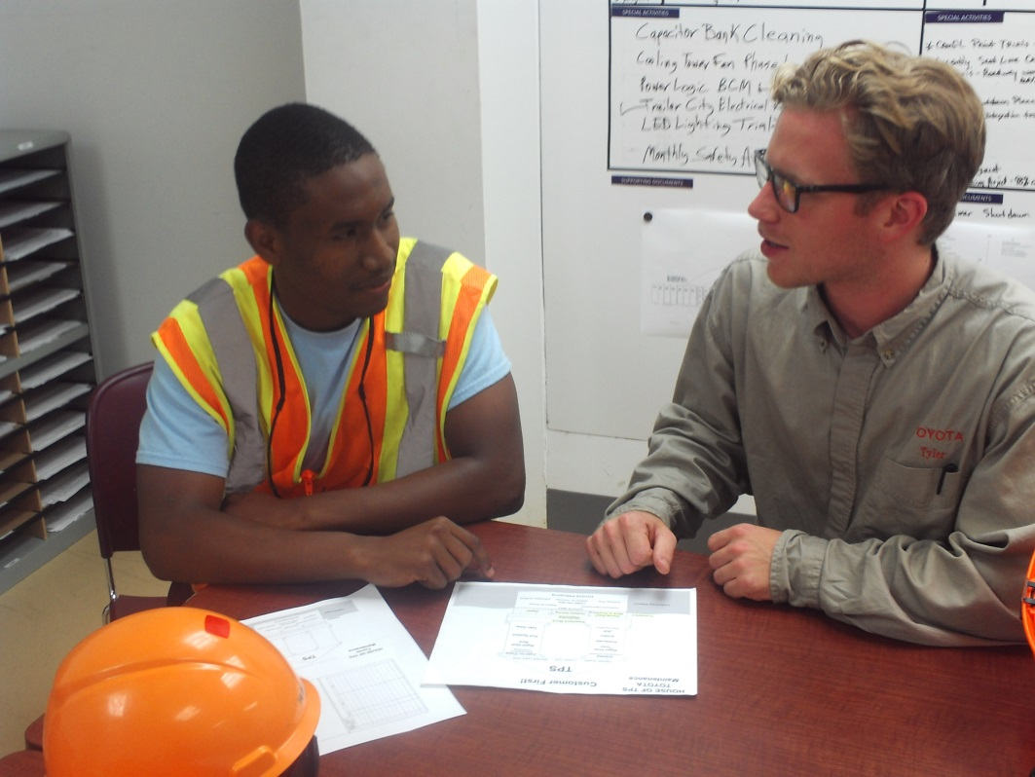
Professional Behavior Skills
While the AMTs are learning the behavior skills; it offers the continuous learning and refresher opportunities for the rest of facilities’ multi-skilled TMs. By strategically assigning the AMTs to TMs; we are able to improve AMTs technical skills and retain our focus on the professional behavior skills through shared learning.

Slide 4
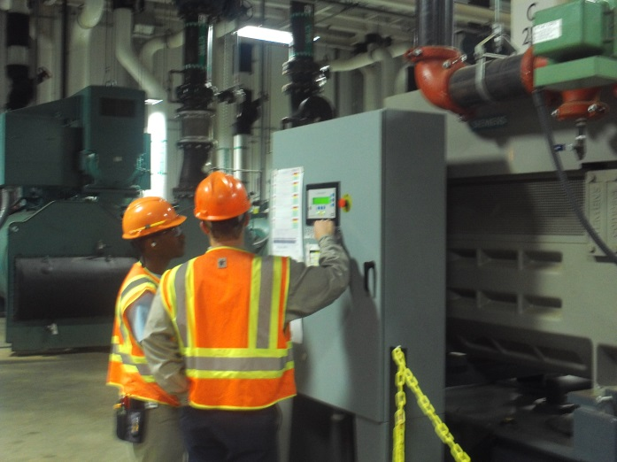
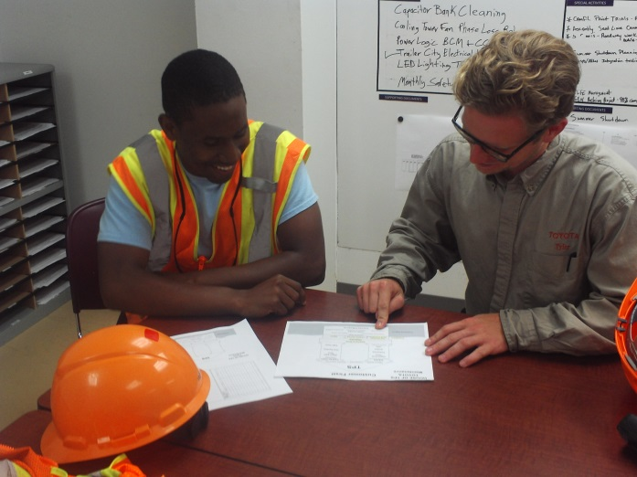
Shared Learning
Currently we are assigning past converted AMTs to the new AMTs going through the program. This process is offering a refresher opportunity while gaining the interest of our other TMs.
Our future goal will be for all our Facilities TMs go through an assignment to understand the AMT program and the expectation/direction of our company’s goals.

Slide 5
Building our future

