Slide 1
KYT Card system
Hunter Pack
&
Bryant England

Slide 2
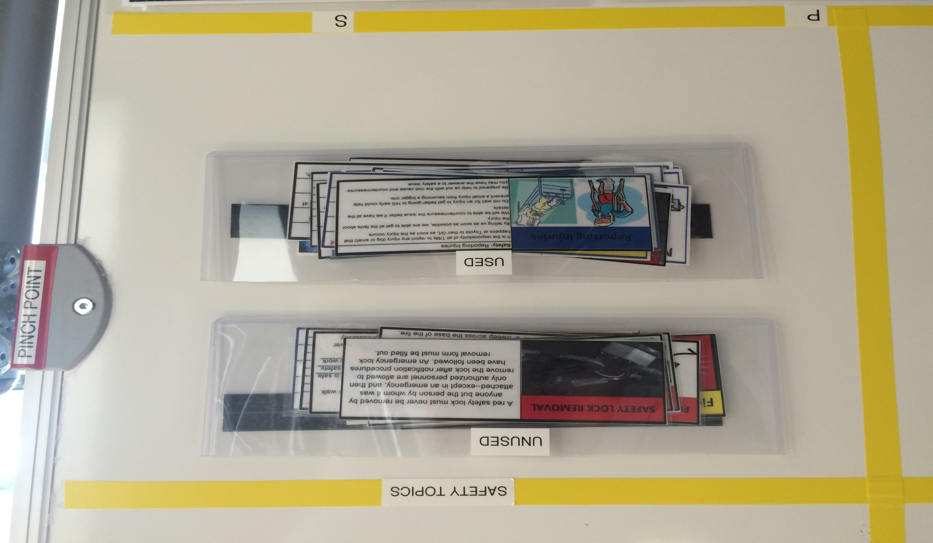
How the Safety KYT Board Works
There are holders for used and un-used safety key points.
Notes:
Each day someone picks a safety KTY card out of the UNUSED pouch. That is what the group will discuss for the safety topic.

Slide 3
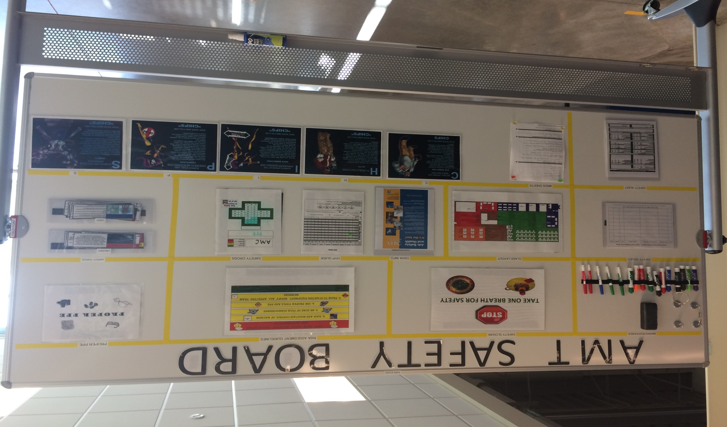
How the Safety KYT Board Works
Each day a different person gives the safety talk. A pin represents who’s day it is.
PIN
Notes:
A different person gives the safety kyt each day. If the pin is on your name it is your turn, after you have been; the pin should be moved down one slot.

Slide 4
Examples of a Safety KYT
Each card has a different safety topic.
Notes:
Each card has a different safety topic. Each topic has a list of safety items that can be discussed.

Slide 5
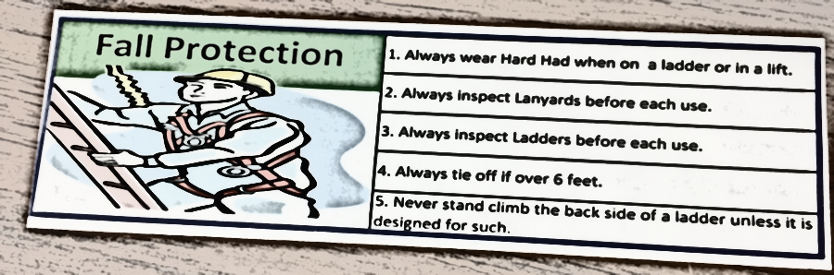
Fall Protection KYT Example
Notes:
This is an in depth example of a Safety KYT. We will walk through each thing the card says.

Slide 6

Fall Protection
Always wear Hard Hat when on a ladder or in a lift.
Notes:
Hard hat is to be worn at all times while in a lift. The hard hat is to protect your head form falling items or to keep you from bumping your head while in a lift or on a ladder.

Slide 7
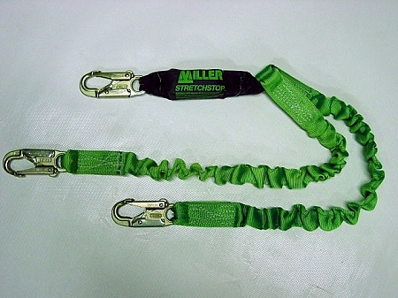
Fall Protection
Always inspect lanyards before each use
Check clasps
Check for tears
Notes:
If clasps are not functioning properly, or if a tear is found in fabric; lanyards should be disposed of properly.

Slide 8
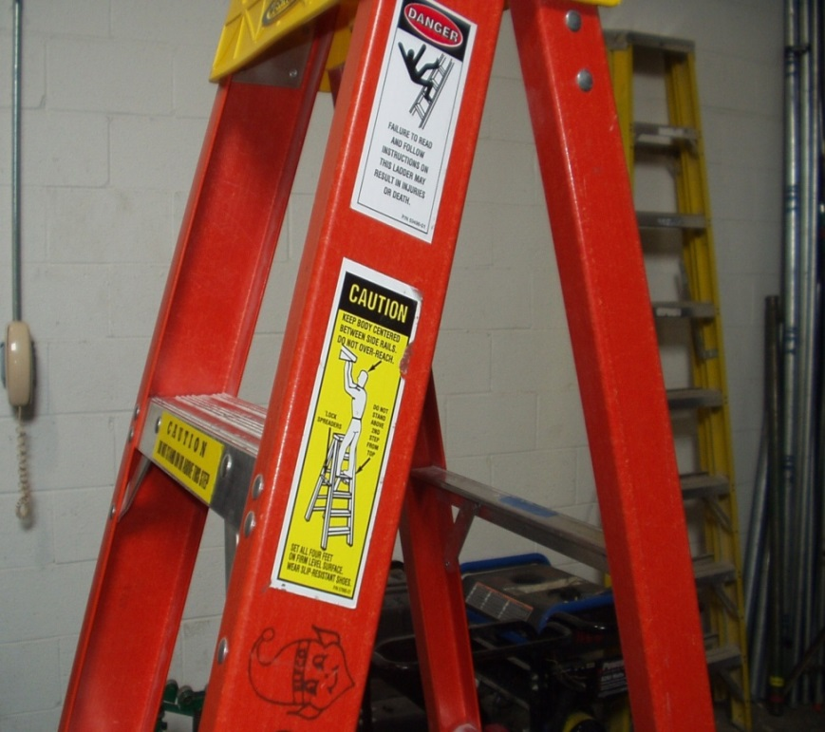
Fall Protection
Always inspect ladders before each use.
Check weight limit
Inspect for cracks
Notes:
Check for cracks, weight limit, check feet of ladder, check steps, look for any broken items.

Slide 9
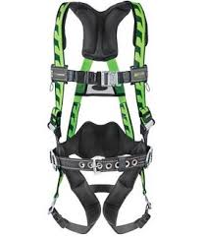
Fall Protection
Always tie off over six feet
Inspect function of buckles
Inspect straps for tears
Notes:
If you are over six feet or in a lift, the harness should be worn.
If buckles are not functioning properly, or if there are any tears in the straps; the harness should be disposed of properly.

Slide 10
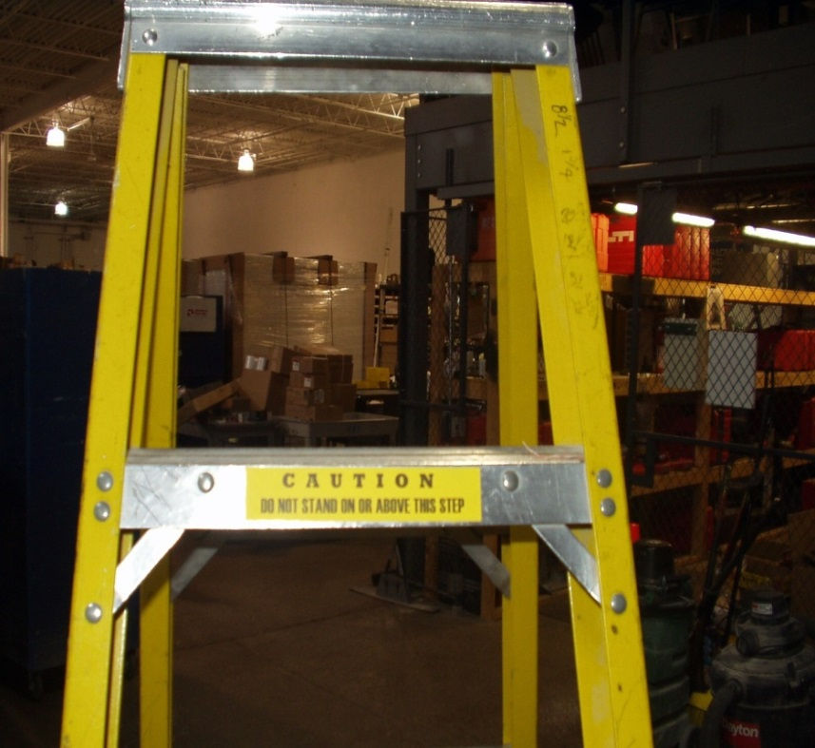
Fall Protection
Never climb the back side of a ladder unless it is designed for such.
Notes:
Certain ladders are designed to be climbed on both sides. If it is not designed for such, only climb on the approved side.

Slide 11
Life lesson…
Fall Protection Safety
Notes:
After each KYT, we give a life lesson. We tell about how this card has effected our life in someway.

Slide 12
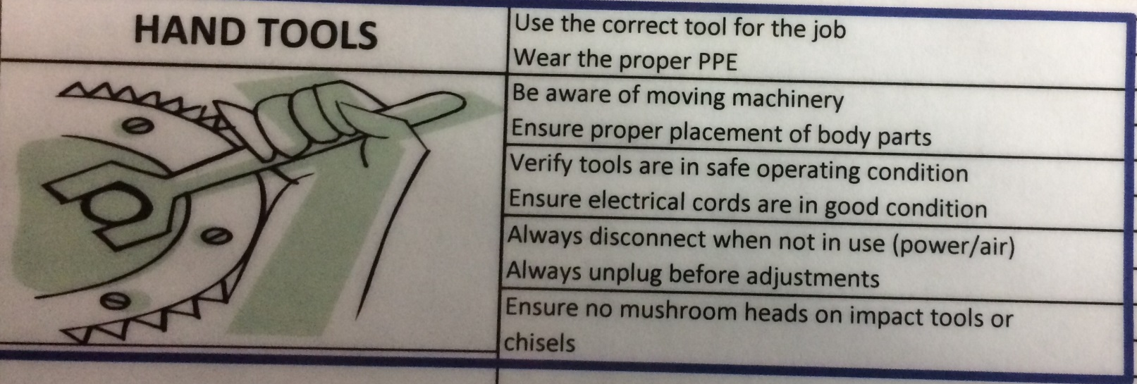
Hand Tool Safety KYT Example
Notes:
This is the example of the hand tool safety card. As you can see the card has a list of items to be discussed.

Slide 13
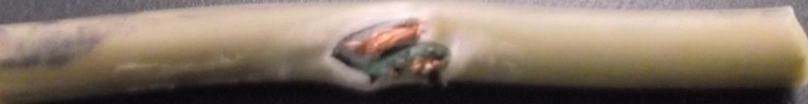
Hand Tool Safety KYT
Verify tools are in safe operating condition.
Ensure electrical cords are in good condition.
Check for breaks in cords.
Notes:
Check for cracks or mushroom heads on tools before using them. If any defects are found dispose of the tool.
Always check for breaks or exposed wires in a cord, if you can see any problems in your extensions cord throw it away.
An extension cord that could short out can electrocute you or short out your equipment.

Slide 14
Hand Tool Safety KYT
Use the correct tool for the job.
Wear the proper PPE
Notes:
Always use the correct tool for the job, never try to use something that is wasn’t intended for. There is always time to go and get the right tool.
Make sure you have on the proper ppe for the job that you are doing. If you are drilling something out make sure you do not have gloves on.

Slide 15

Hand Tool Safety KYT
Beware of moving machinery.
Ensure proper placement of body parts.
Notes:
Always be aware of any moving parts on a piece of machinery; such as gears, cylinders, or chains.
Be sure to check the placement of any body parts to ensure you don’t get injured.

Slide 16
Hand Tool Safety KYT
Always disconnect air/power when not in use.
Always unplug air/power before making adjustments.
Notes:
Always disconnect air/power when you aren't using it. Do things like roll up your extension cords or air hoses.
Make sure to always unplug your air/power before make any adjustments. Such as changing out a grinding wheel on a grinder.

Slide 17
Life lesson…
Hand Tool Safety
Notes:
Life lesson is on using the correct tool for the job. Mom asked me to open green beans. Did not use a can opener. Used a steak knife. Cut hand.

Slide 18
QUESTIONS?

