Slide 1
The Toyota Way in Safety
Safe Work
Reliable Work
Skilled Work …….
“Safe work is the door to all work. Let us pass through this door.”
Safe Work
Reliable Work
Skilled Work
Eiji Toyoda
Toyota’s Basic Safety Principle
“Safety is management itself. It is everyone’s responsibility from top management to individual workers, to place safety first.”
Notes:
Ageee Toyoda a 98-99 yrs .. Boils down to him giving us Toyotas basic safety principle….
Read principle.
You are responsible for your safety… take responsibility for your actions.

Slide 2
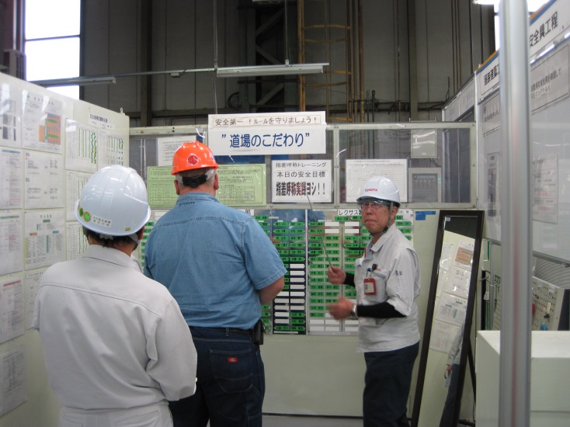
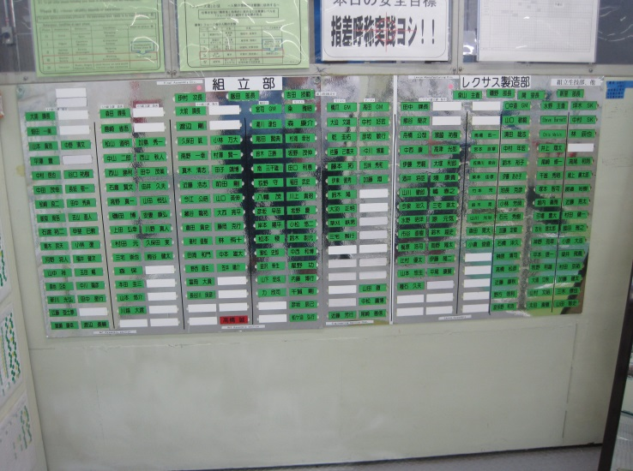
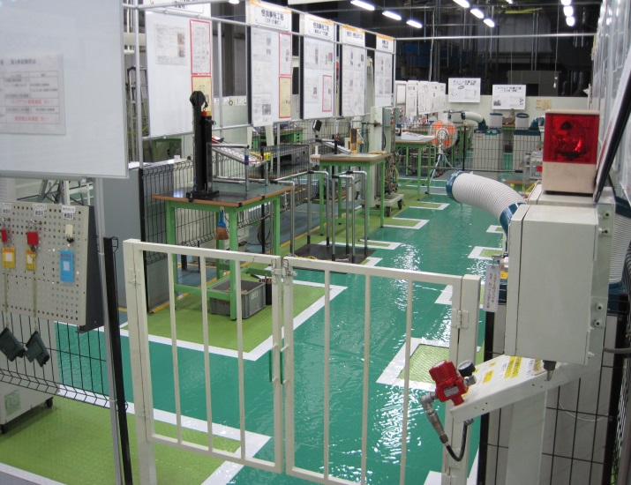
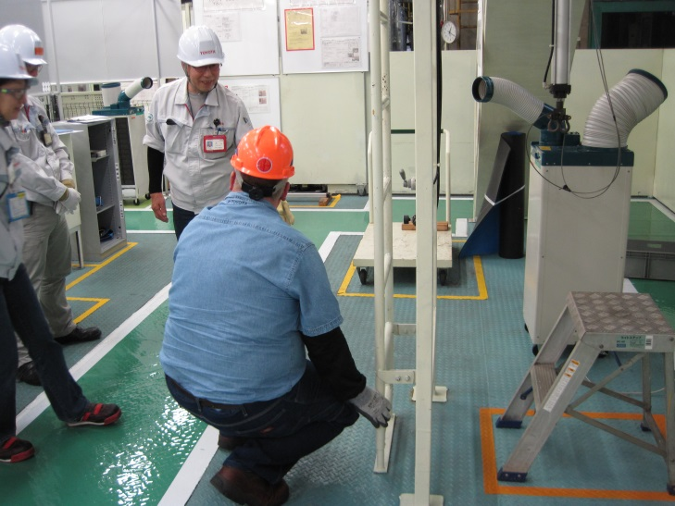
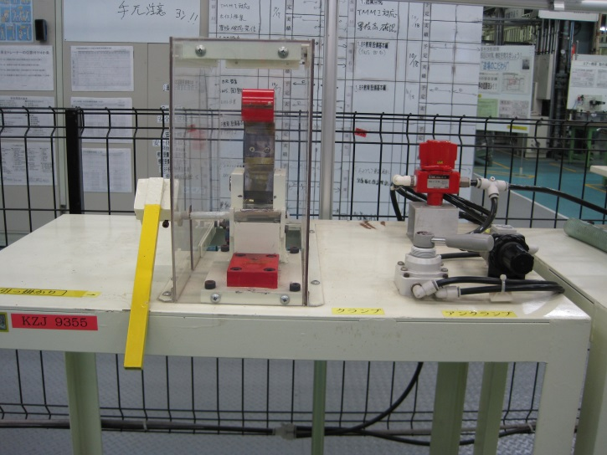
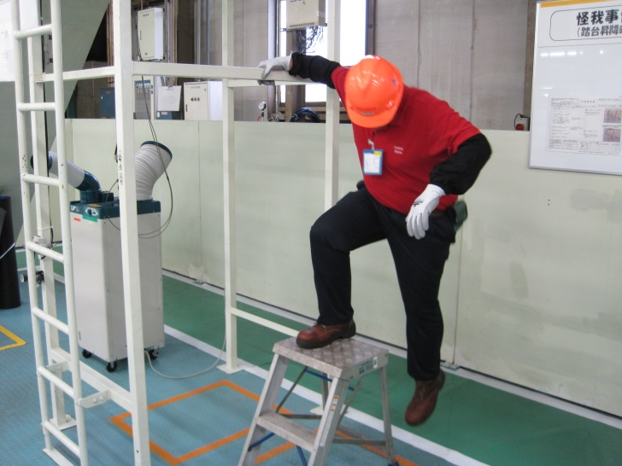
TAHARA Benchmarking
October 2013 our Training TL went to Japan to benchmark their Safety Dojo. He went through train the trainer sessions in the Tahara Safety Dojo. He received certification to train in the Safety Dojo at Tahara. After returning to TMMI he designed the Safety Dojo at TMMI.
Notes:
Ageee Toyoda a 98-99 yrs .. Boils down to him giving us Toyotas basic safety principle….
Read principle.
You are responsible for your safety… take responsibility for your actions.

Slide 3
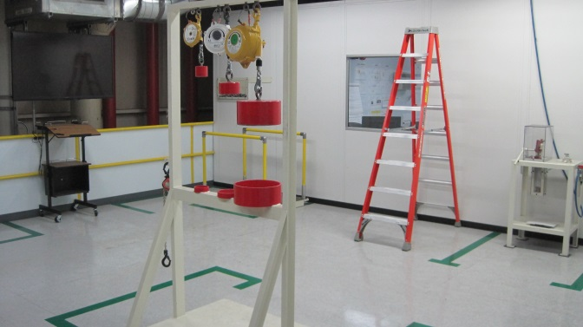
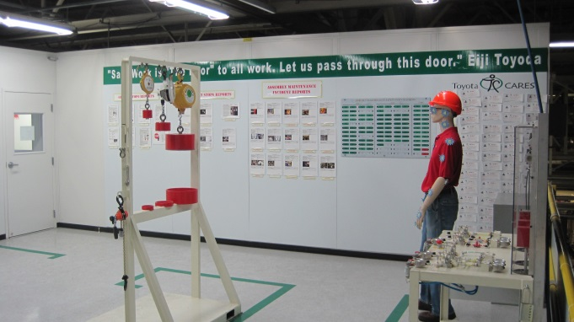
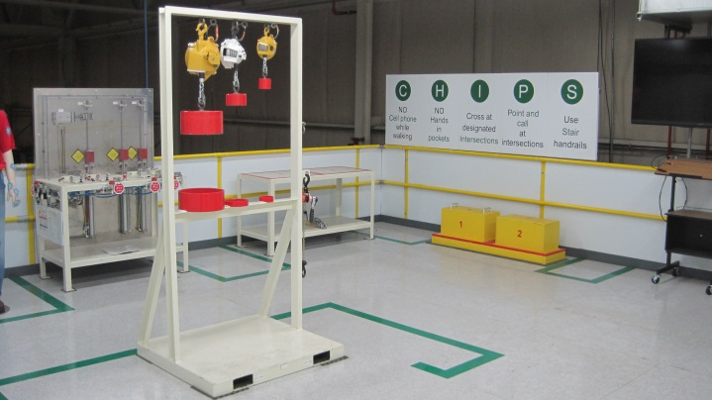
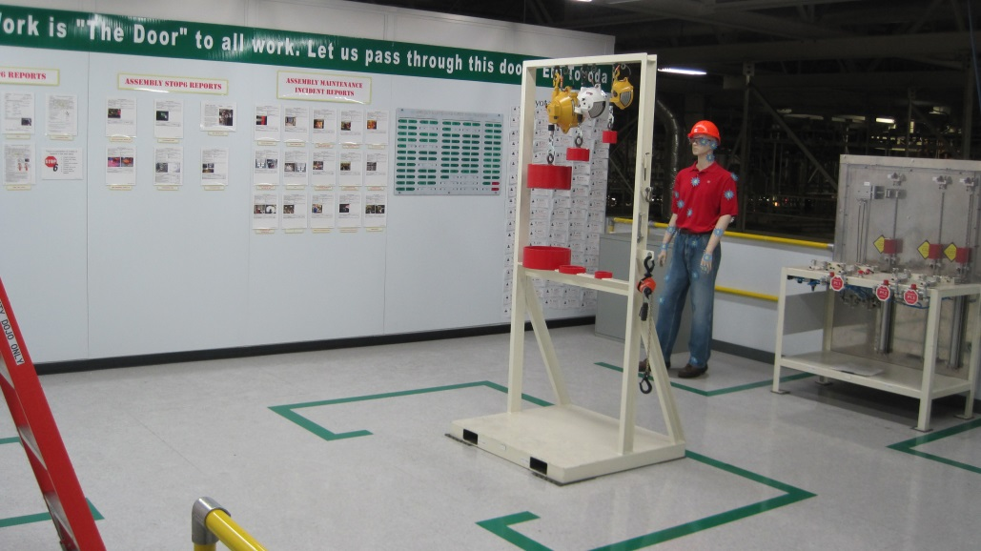
TMMI ASSEMBLY MAINTENANCE SAFETY DOJO
Finished construction of the Safety Dojo in November of 2014.
Notes:
Ageee Toyoda a 98-99 yrs .. Boils down to him giving us Toyotas basic safety principle….
Read principle.
You are responsible for your safety… take responsibility for your actions.

Slide 4
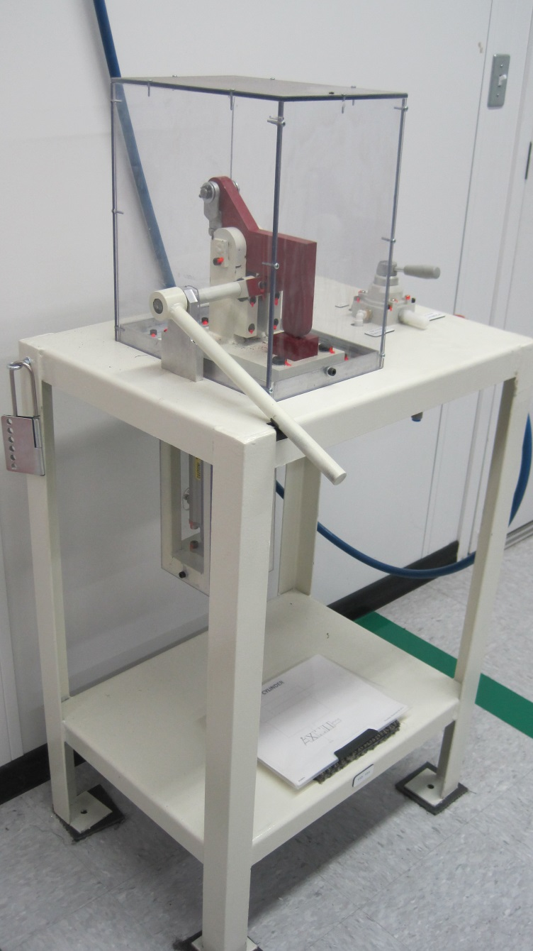
SAFETY DOJO STATION #1
CLAMP CYLINDER
This station simulates the force that can be generated from a pneumatic clamp device. It also simulates the stored energy that can be present in a pneumatic system even after the main air disconnect has been locked out.
Notes:
Ageee Toyoda a 98-99 yrs .. Boils down to him giving us Toyotas basic safety principle….
Read principle.
You are responsible for your safety… take responsibility for your actions.

Slide 5
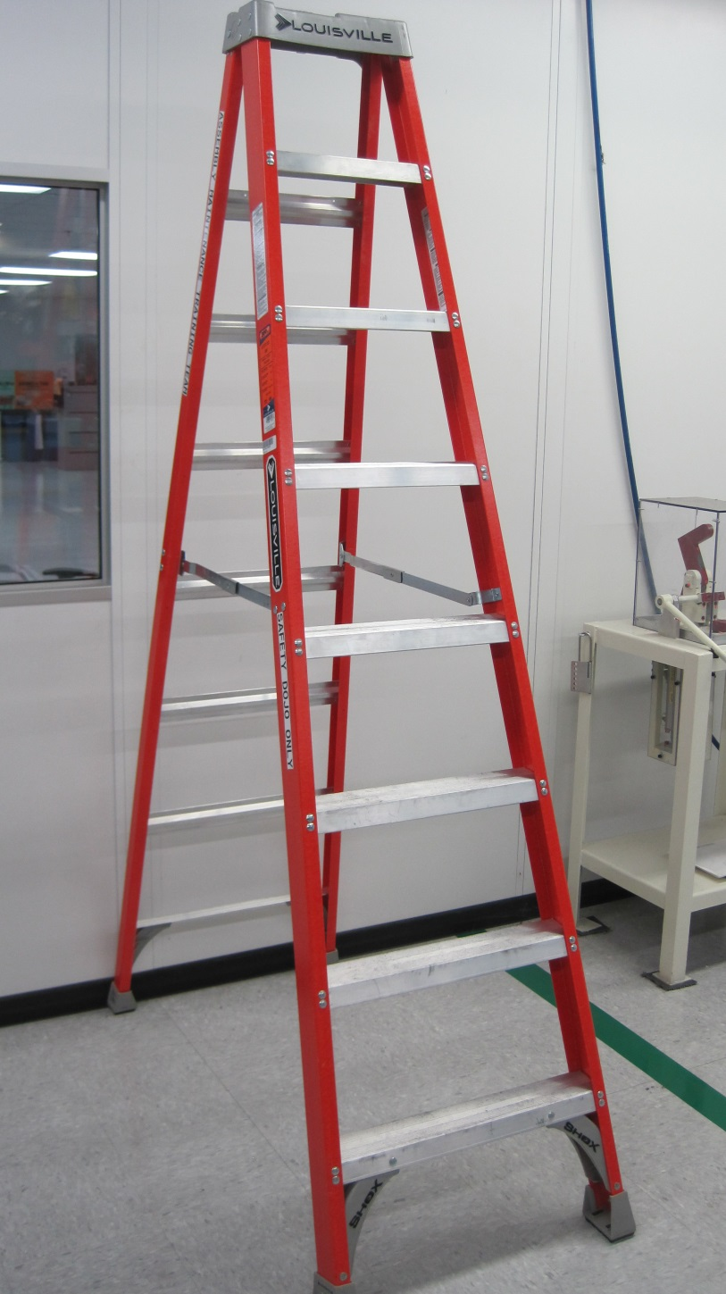
SAFETY DOJO STATION #2
LADDER SAFETY
This station reviews the hazards associated with ladder use in industry as well as in the home. Statistics of ladder related injuries and fatalities are discussed and training in proper ladder use is given.
Notes:
Ageee Toyoda a 98-99 yrs .. Boils down to him giving us Toyotas basic safety principle….
Read principle.
You are responsible for your safety… take responsibility for your actions.

Slide 6
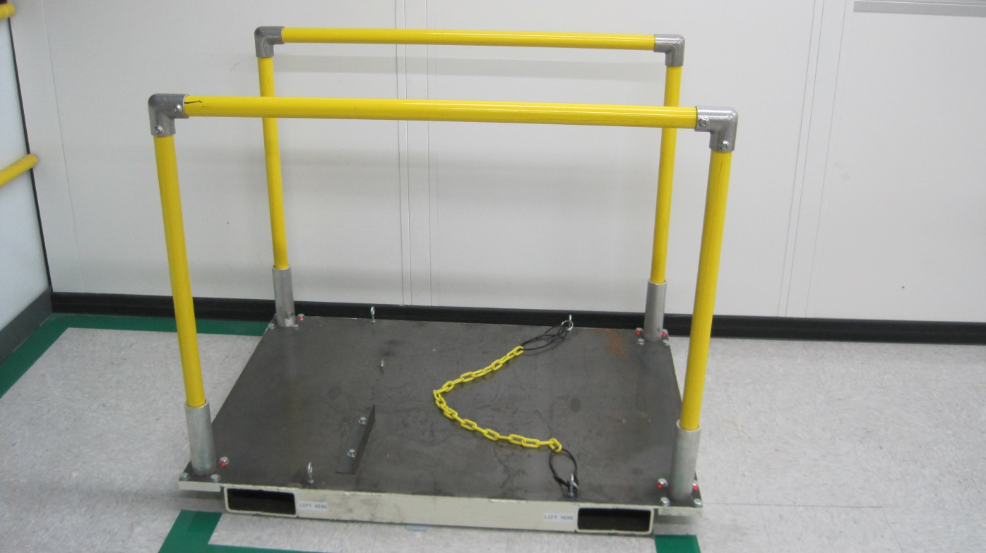
SAFETY DOJO STATION #3
SLIPS, TRIPS, & FALLS
This station reviews the hazards associated with slips, trips, and falls in the workplace. The station gives the team member a realistic simulation of slips and trips from commonly found items on the work floor.
Notes:
Ageee Toyoda a 98-99 yrs .. Boils down to him giving us Toyotas basic safety principle….
Read principle.
You are responsible for your safety… take responsibility for your actions.

Slide 7
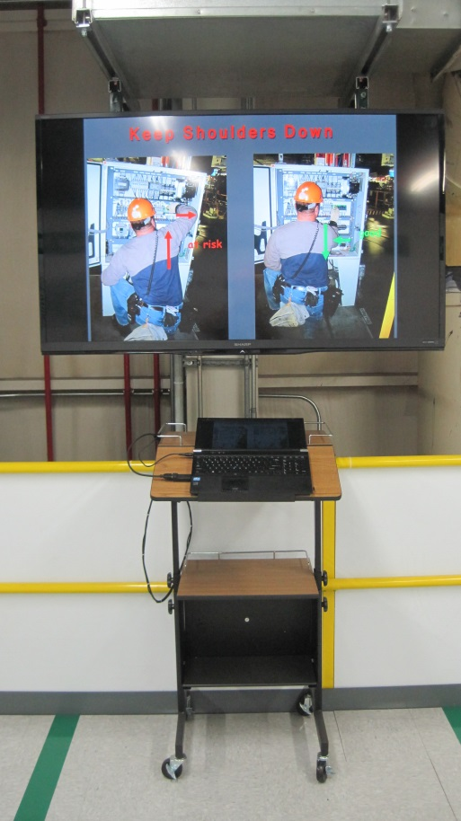
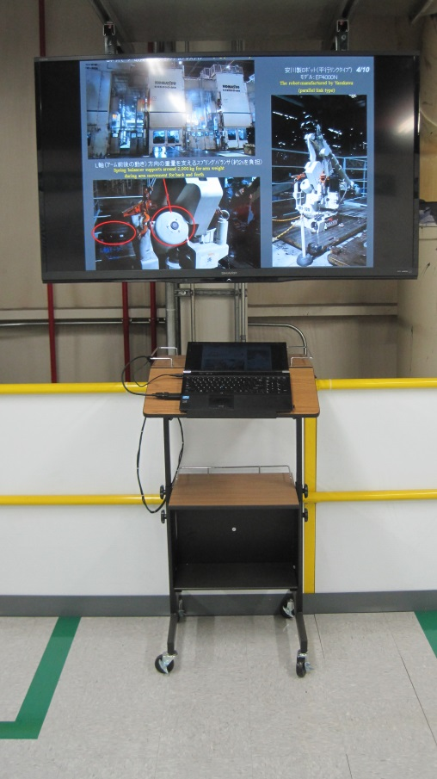
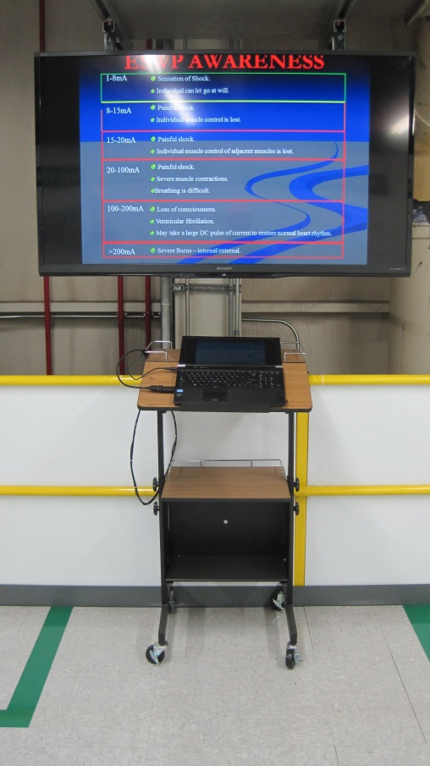
SAFETY DOJO STATION #4
POWERPOINT PRESENTATION
This station is used in conjunction with the other stations to enhance the training with statistics, videos, and data. This station is also used to cover robot safety and proper ergonomics in the workplace.
Notes:
Ageee Toyoda a 98-99 yrs .. Boils down to him giving us Toyotas basic safety principle….
Read principle.
You are responsible for your safety… take responsibility for your actions.

Slide 8
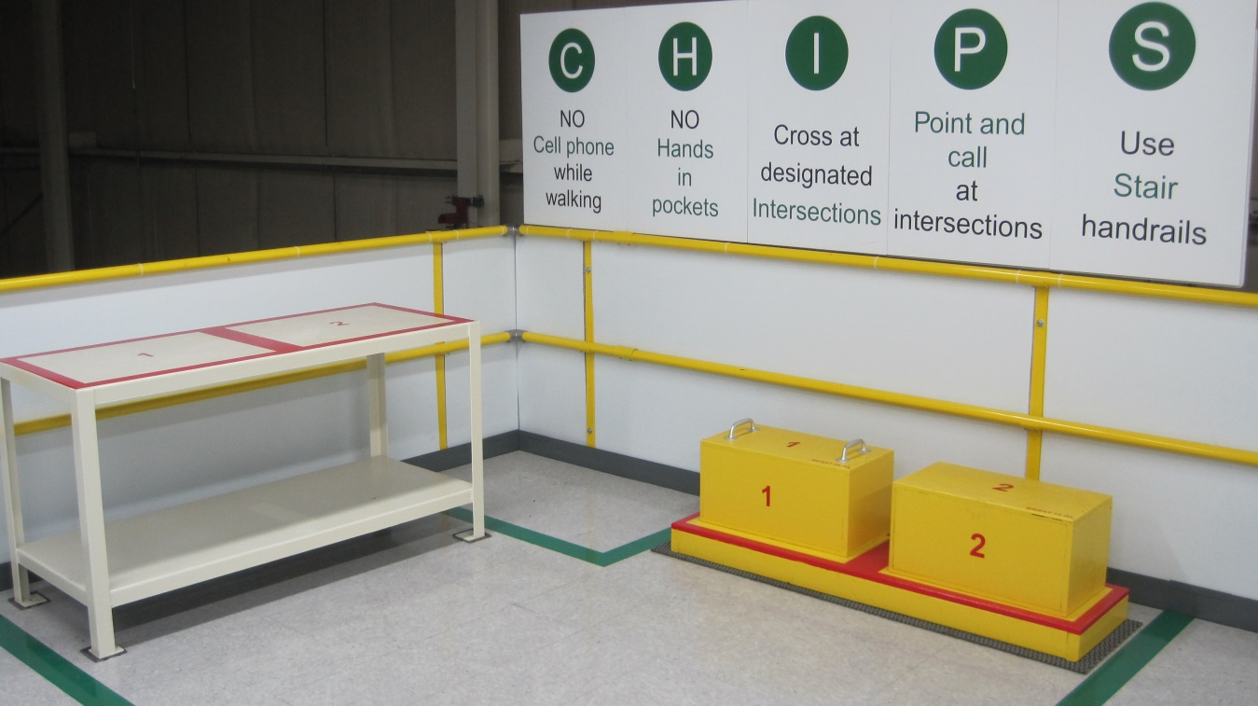
SAFETY DOJO STATION #5
PROPER LIFTING
This station is used to evaluate the way a team member lifts a load from ground level and repositions it on a table. Feedback and training is given to help the team member pick up the boxes and put them on the table in a safe way.
Notes:
Ageee Toyoda a 98-99 yrs .. Boils down to him giving us Toyotas basic safety principle….
Read principle.
You are responsible for your safety… take responsibility for your actions.

Slide 9
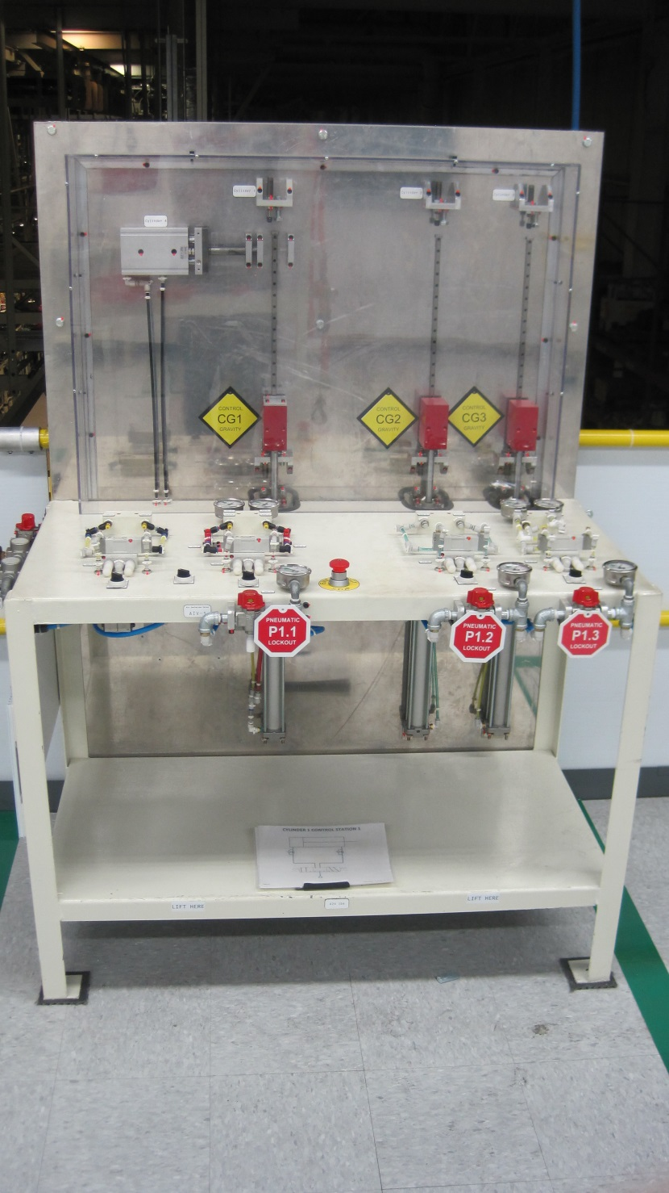
SAFETY DOJO STATION #6
CYLINDER/VALVE
This station incorporates a variety of different valve types and cylinders to demonstrate the possibility of store energy in a pneumatic system. The station also covers safety placarding and proper lockout.
Notes:
Ageee Toyoda a 98-99 yrs .. Boils down to him giving us Toyotas basic safety principle….
Read principle.
You are responsible for your safety… take responsibility for your actions.

Slide 10
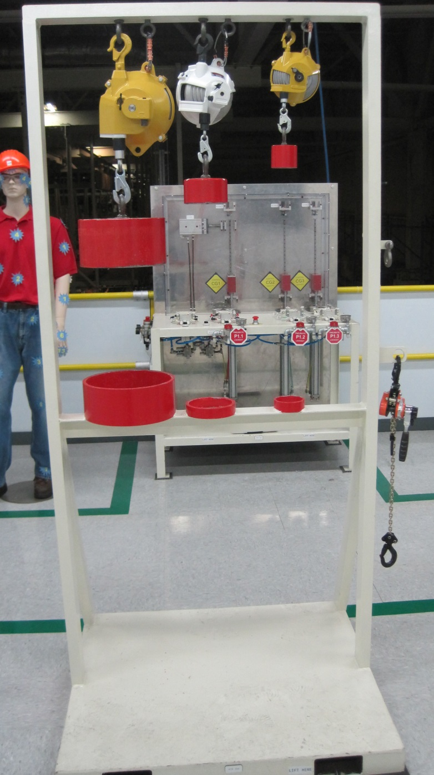
SAFETY DOJO STATION #7
SPRING BALANCER
This station demonstrates the use of and the safety precautions that need to be followed with the use of spring balancers. Training is given on the proper way to replace spring balancers as well as the adjustment of spring balancers.
Notes:
Ageee Toyoda a 98-99 yrs .. Boils down to him giving us Toyotas basic safety principle….
Read principle.
You are responsible for your safety… take responsibility for your actions.

Slide 11
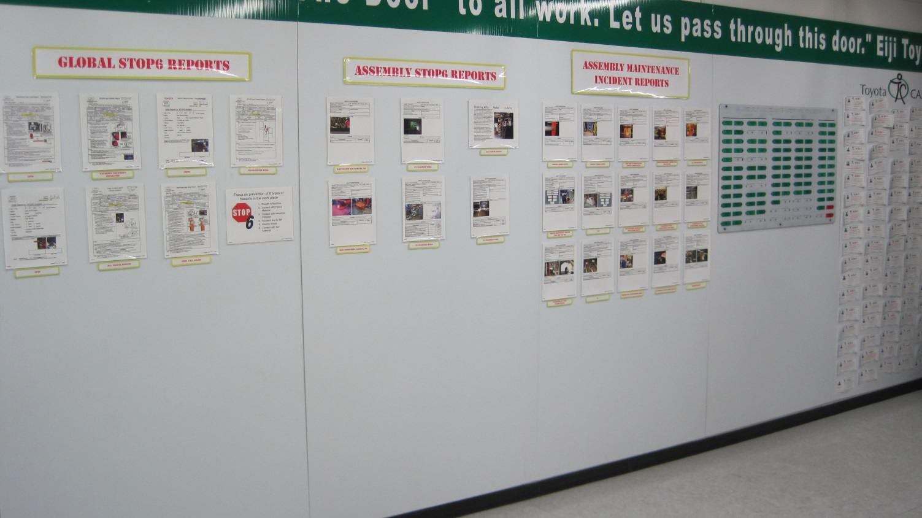
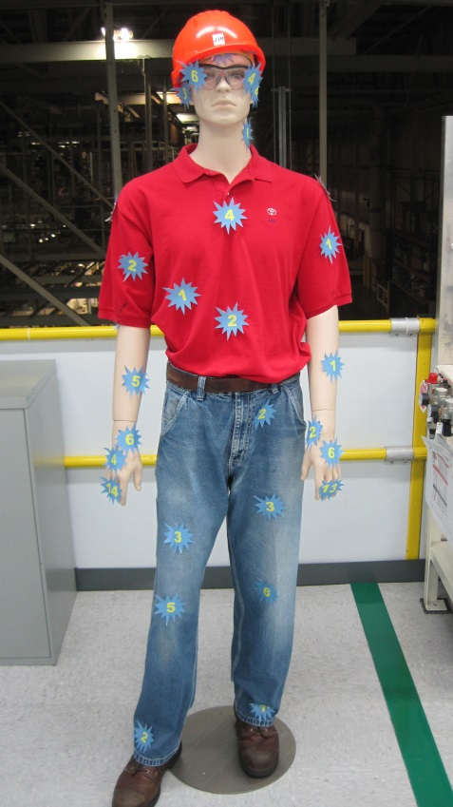
SAFETY DOJO DOCUMENTATION
The Documentation board consist of a variety of safety incidences that have occurred both in the TMMI plant and within other Toyota facilities. Training includes discussions on the incidents that happened and what Toyota procedures and policies are in effect that can prevent those incidents from happening. The safety incidents include global, TMMI assembly specific, and assembly maintenance only. “Safety Jim” is used to show the total number and location of all assembly maintenance injuries that have occurred since February 2003.
Notes:
Ageee Toyoda a 98-99 yrs .. Boils down to him giving us Toyotas basic safety principle….
Read principle.
You are responsible for your safety… take responsibility for your actions.

Slide 12
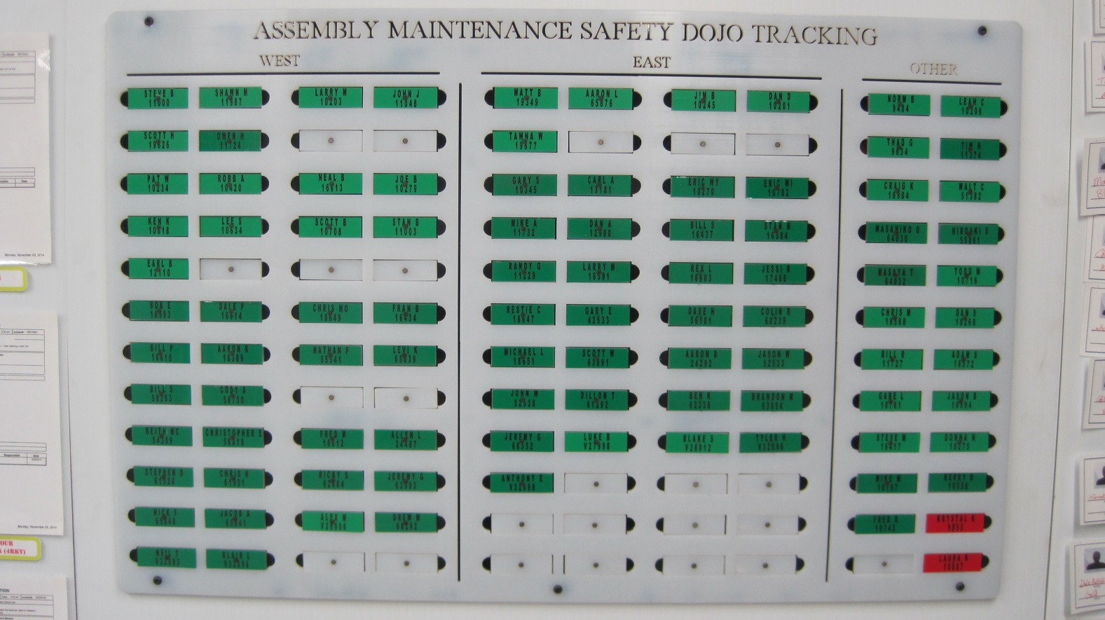
SAFETY DOJO TRACKING BOARD
The tracking boards allows a quick and easy reference to safety dojo completion. All Assembly AMTs have completed the safety dojo training.
Notes:
Ageee Toyoda a 98-99 yrs .. Boils down to him giving us Toyotas basic safety principle….
Read principle.
You are responsible for your safety… take responsibility for your actions.

Slide 13
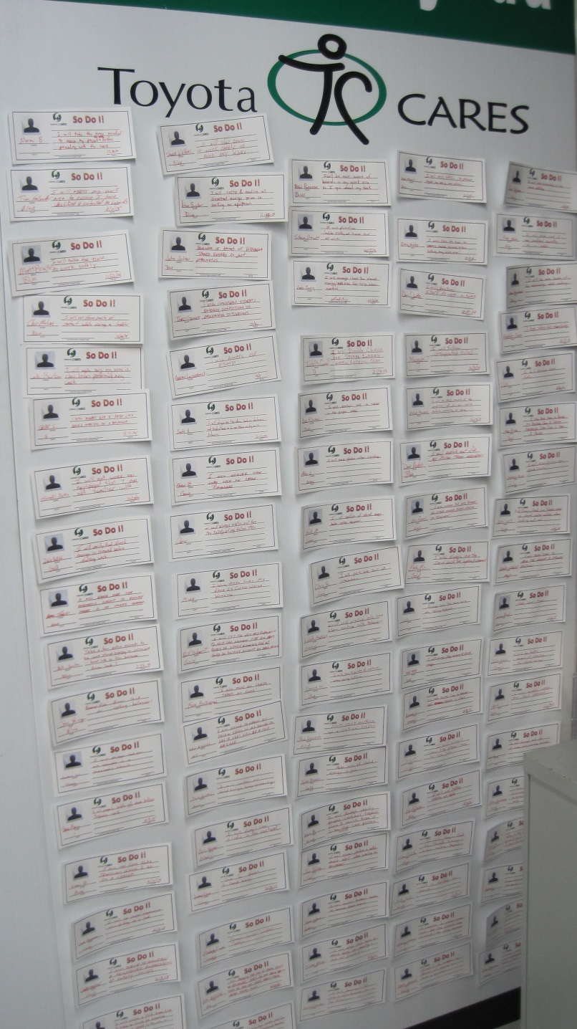
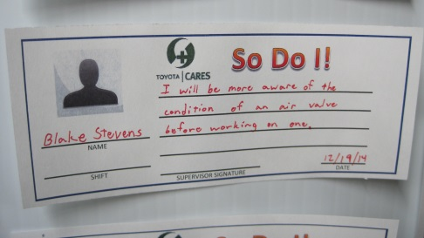
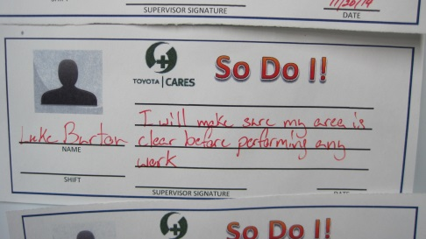
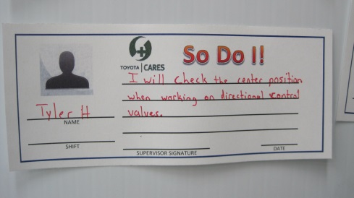
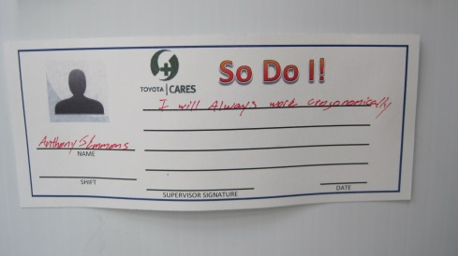
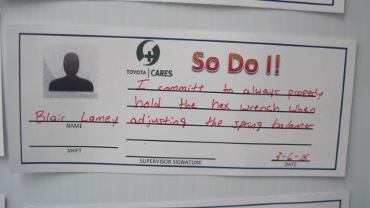
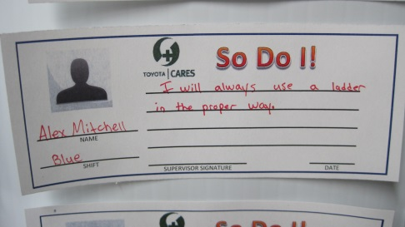
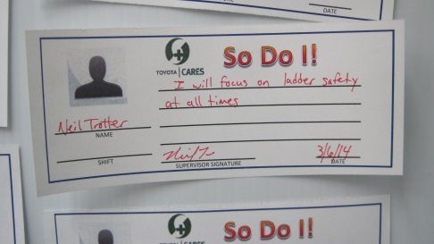
SAFETY DOJO SAFETY COMMITMENT BOARD
The safety commitment board has postings from every team member that has completed the safety dojo training. The postings consist of safety policies or procedures that the team members are “committing” to use while on the floor or at home. Below are our AMT’s commitments:
Notes:
Ageee Toyoda a 98-99 yrs .. Boils down to him giving us Toyotas basic safety principle….
Read principle.
You are responsible for your safety… take responsibility for your actions.

