Slide 1
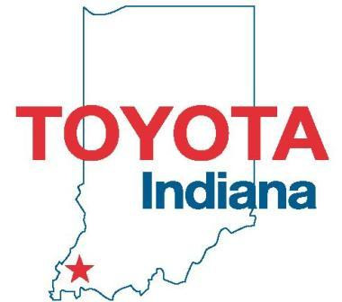
TMMI: Advanced Manufacturing Technician Program (AMT)
Notes:
Introduce self and personal safety commitment.

Slide 2
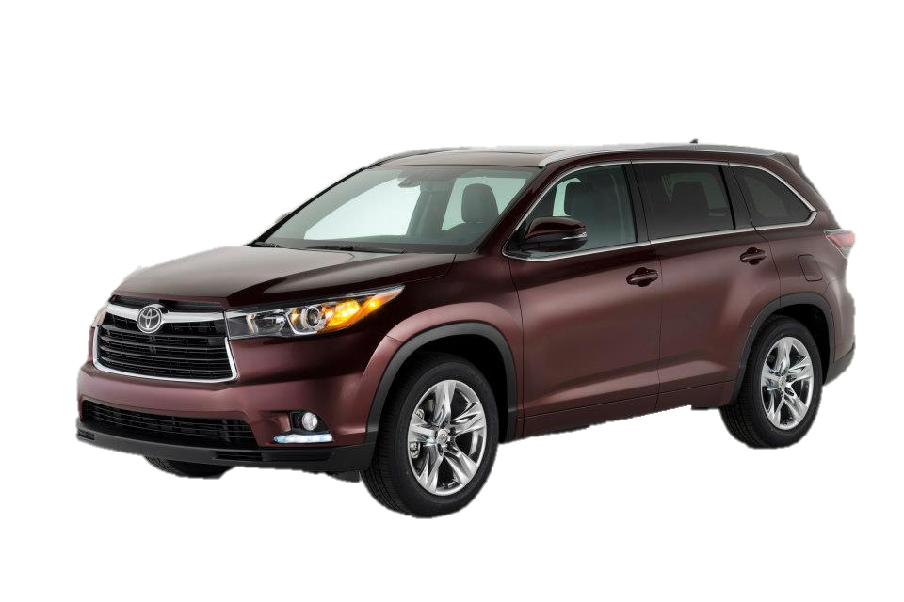
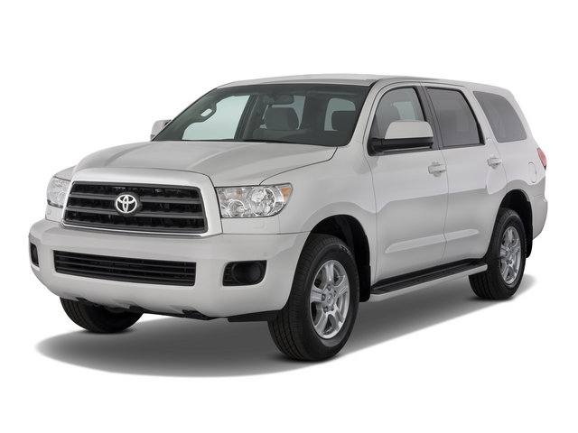
Location
INDIANA
Toyota Motor Manufacturing Indiana, Inc.
HIGHLANDER
West Plant
SEQUOIA
West Plant
SIENNA
East Plant
Notes:
TMMI is located in the state of Indiana, known as the “crossroads of America.” We manufacture the Sienna, Highlander and Sequoia. We export the Sienna to South Korea and the Sequoia to the Middle East.
Late 2013, we began production of the all-new third generation Highlander (shown on this slide). This includes hybrid versions, along with exports to the Russian and Australian regions. We now export our vehicles to 20 countries.
The frame-based Sequoia & the uni-body Highlander are built on the same assembly line, which is unique in automotive manufacturing.
In 2013, we built nearly 300,000 vehicles, and the projected volume for 2014 was for over 351,000 vehicles. (349,524 were made)
Our highest production year since 1999 was 2004 with 374,000 vehicles produced.
(Click)

Slide 3
Toyota Motor Manufacturing, Indiana Established 1996 Over 4,500 Team Members and over 900 Variable Workforce Members Products: Sienna, Sequoia and Highlander Located in Princeton, Ind., about 20 miles north of Evansville, Ind.
East Assembly
Stamping
East & West Body Weld
East & West Paint
Plastics
West Assembly
Administration
Notes:
This is an aerial view of TMMI.
We currently employ over 4,500 Team Members and over 900 Variable Workforce Members, in our 4 million square foot plant.
(Click)

Slide 4
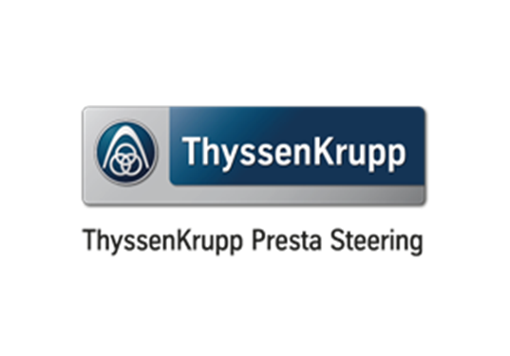
Notes:
Vincennes University in collaboration with TMMI, ThyssenKrupp, and Toyota Boshoku America sponsor the AMT Program.

Slide 5
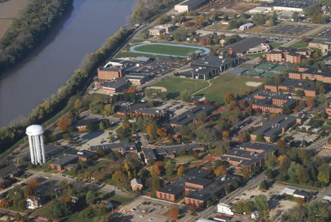
Vincennes University History
One of the first two-year colleges in America, Vincennes University is also Indiana's oldest college.
Notes:
This is an aerial view of the University Campus.
<Click>
This area is the location of the Technology Building.
<Click>
Today, the University is a model comprehensive two-year "university" offering more than 150 associate degree programs and options, and seven baccalaureate degrees in specialized areas.
Through its dual enrollment program and its unique early college program, the university assists high school students in transitioning into higher education when the student is ready.

Slide 6
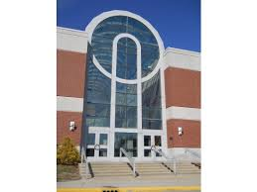
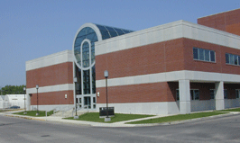
Vincennes University has had a distinguished history, rich with the traditions of many firsts. In the Vincennes University catalog of 1899, the statement appeared that, "Vincennes University is in fact a junior college offering the first two years of the regular college programs." By that statement, Vincennes University claims to be one of the first colleges to develop and recognize the junior college concept in higher education.

Slide 7
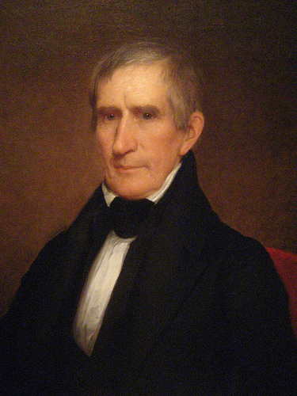
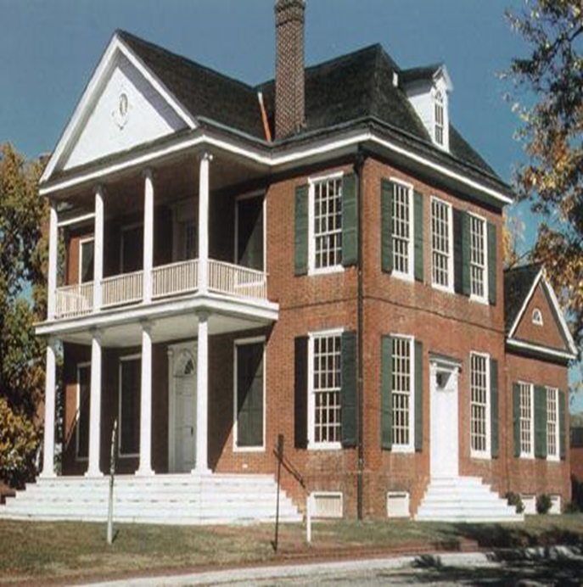
William Henry Harrison, first governor of the Indiana Territory, and later (1841) President of the United States, was the founder of the college and the first chairman of the Board of Trustees of the University.
Notes:
Wm. Henry Harrison’s house still stands today, as seen here, in Vincennes on the Campus of the University.

Slide 8
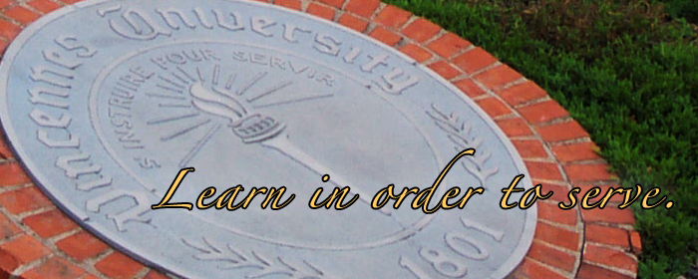
For the past two centuries, for today, and into the future Vincennes University students and graduates strive to make that goal a reality in their lives.
Notes:
The University's motto as translated from the official seal is, "Learn in Order to Serve."

Slide 9
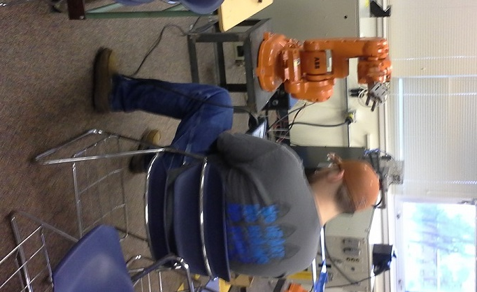
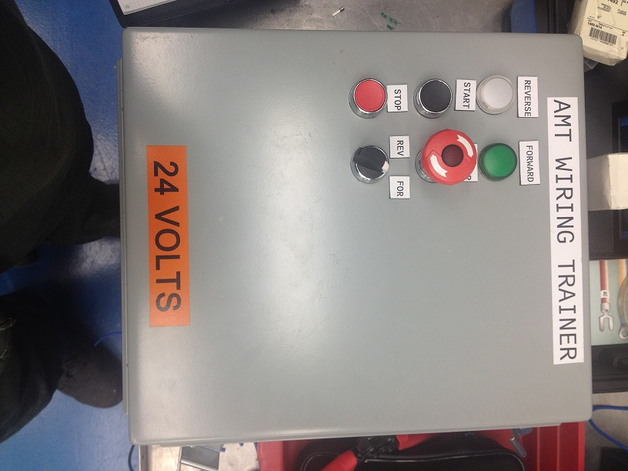
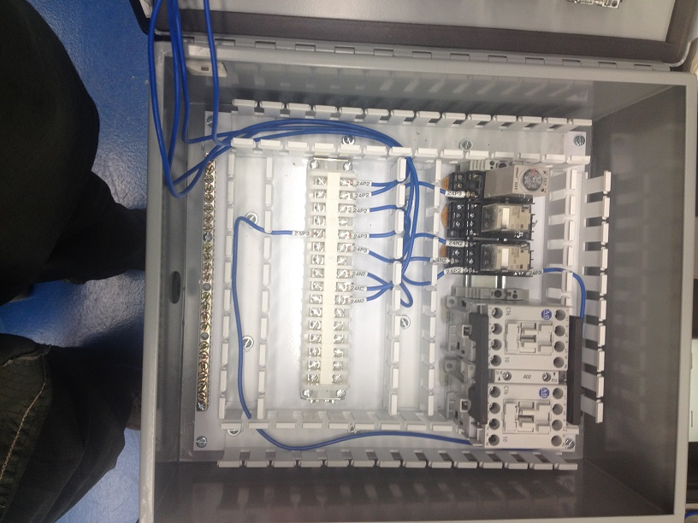
Computer Integrated Manufacturing/Robotics
Robotics Program started in Fall of 1983.
Notes:
This curriculum prepares graduates for employment in different industries as a Maintenance Technician, Instrumentation Technician, Renewable Energy Technician, Engineering Technician, Industrial Programmer, Field Service Engineer, Industrial Controls Technician, System Integration Technician, in automated manufacturing.

Slide 10
Graduates are prepared to install, program, interface, service, troubleshoot, and implement automated equipment, and robotic systems for various applications.
Graduates are well prepared in electronics, robotic systems, programmable logic controllers (PLCs), instrumentation, process control, hydraulics and pneumatics, mechanical drive systems, industrial networking, and industrial control circuits.
Job placement is 100%.
Demand exceeds the number of Graduates.

Slide 11
Robotics Classroom at VU
Notes:
This is a picture of our robotics classroom. In here we work with Motoman robots (seen in the background) and practice programming techniques. We also began working with visual basic on the computers in this room.

Slide 12
VU students utilize Motoman, ABB, Panasonic, IBM, and Kawasaki Robots in the classroom.

Slide 13
Notes:
This is a picture of our class upon starting the program in June 2013.

Slide 15
TMMI AMT Program
Program starts late June each year.
Students start out in Production; work full time June to Aug., part time Aug. to Jan.
Students enter Maintenance in Jan., stay in maintenance 4 semesters part time.
Normal Student Schedule:
Work: Mon. and Fri.
School: Tues., Wed., Thurs.

Slide 16
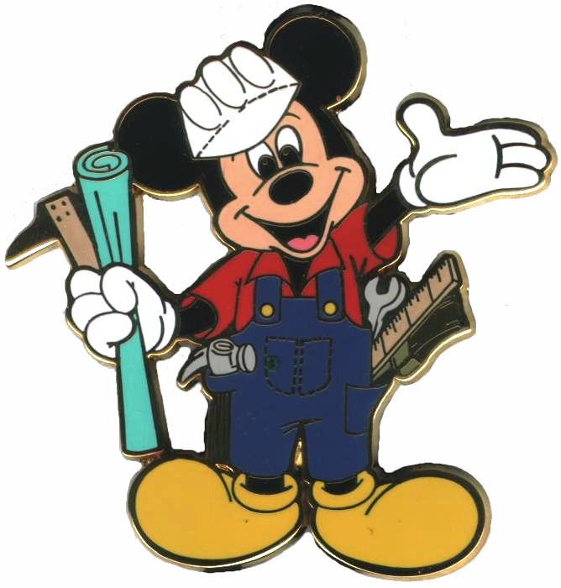
Program Kaizens
First group of students progressed to working Wed. & Thurs.
Second group took over the original schedule.
As the third group of students enters in June 2015 the work schedules will be rotated once again.
Group 1 & 2 worked and attended school in the summer following our 2nd semester.
Whereas, group 3 will work full time that summer and complete their schooling during the following summer.
Notes:
First group is US!
The program is continually evolving. The first group progressed from working Mon. and Fri to Wed. And Thurs. so as the 2nd group could assume the Mon and Fri schedule.
As the 3rd class begins the students will once again be rotated as to accommodate needs.

Slide 17
TMMI AMT Program
Degree Students Receive upon Completion:
Advanced Manufacturing Automation Technology: 2 year A.S. Degree
73 Credit Hour Curriculum
2013 AMT Class:
20 Students started in June 2013
75% directly out of high school
25% live on campus
Work in stamping, weld, paint, assembly, plastics
ThyssenKrupp Presta has additional 4 students in program
2014 AMT Class:
15 Students started in June 2014
Work in all shops above plus facilities
ThyssenKrupp Presta has an additional 1 student and TBIN has 2 students in the program
Notes:
The three of us received our degree May 2, 2015.
Out of the 20 students that started June 2013 we lost 3.
75% of us started from High School.
25% of us live on Campus.
15 new Students began June 2014

Slide 18
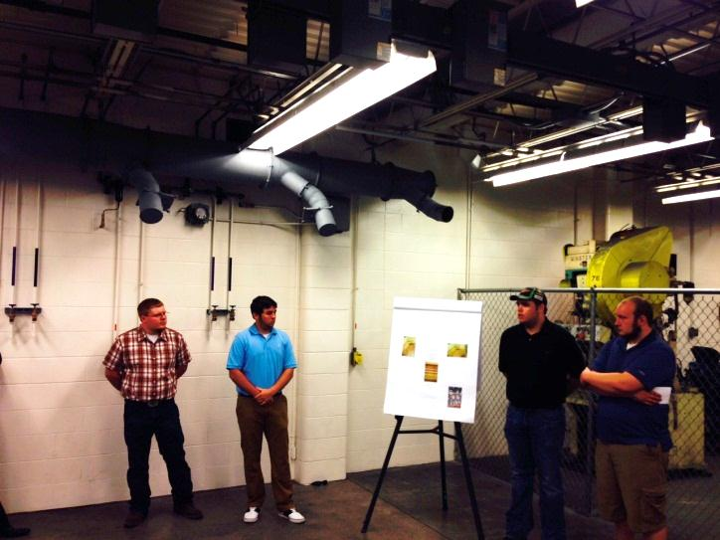
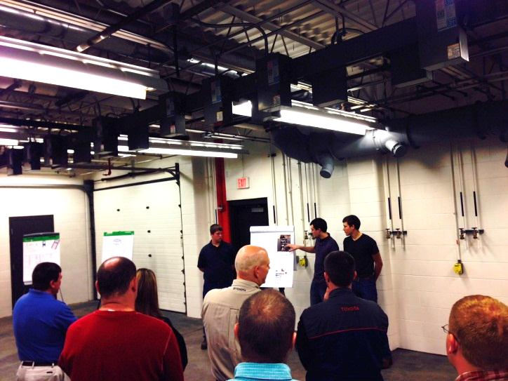
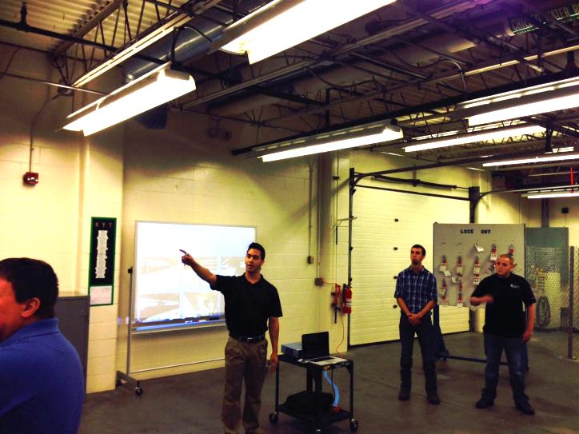
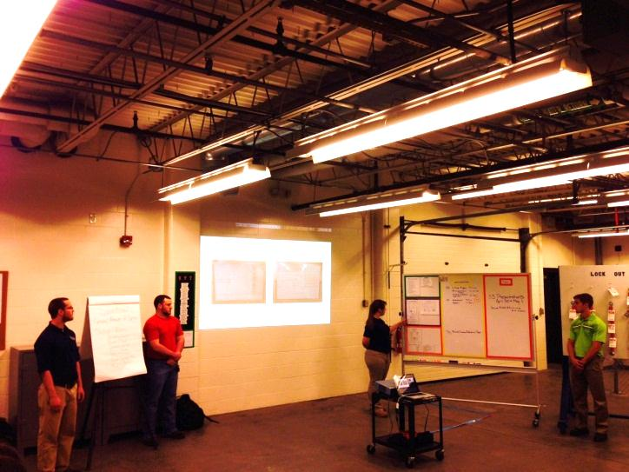
TMMI AMT Program
Students report out on 5S projects at VU in AMC area
Notes:
Part of our assignment is to report each semester on a project assigned to us by Toyota.
<click>
In these pictures we are reporting on our 5S projects.
<click?
We also reported on other MCE topics such as:
<Click>
Problem Solving, TPS and Safety Culture.
<click>

Slide 19
TMMI AMT Program
Questions?

