Slide 1
A Smarter Way to Hire the Right People

Slide 2
Companies need a trained and skilled workforce to fill current and projected vacancies due to growth and turnover
Schools need students in the programs they offer to fulfill the needs of partnered employees
Transitioning service members need to know what jobs are available, where they are located, what skills they need, and where to acquire those skills

Slide 3
fills employment gaps
Number of manufacturing jobs needed over the next decade: 3,400,000
…2,700,000 baby boomer retirements
…700,000 new jobs due to economic expansion
…only 1,400,000 likely to be filled
…leading to an expected 2,000,000 manufacturing jobs unfilled due to the skills gap
…86% of manufacturing executives say that access to talent is a factor contributing to the employment and skills gap
Number of currently serving U.S. military personnel: 2,100,000
…20,500 transition every month
…Transition out of the service from over 3,900 bases around the world
…Over 93% of enlisted personnel have a high school diploma or some college
...Over 80% move away from the base they transition from and select their location based on higher level education and employment opportunities
“The skills gap in U.S. manufacturing 2015 and beyond” Deloitte and The Manufacturing Institute, 2015
T3WDI White Paper, BMNT Partners, April 2015

Slide 4
A technology platform to help companies access and recruit transitioning service members into partnered education and skill providing pathways.

Slide 5
We help companies and schools by increasing the number of qualified applicants to partnered education and training programs…
Strategic recruitment
Global, anytime access to thousands of transitioning service members
Company and school branded content
Delivers applicants to company and school talent acquisition systems

Slide 6
We help service members by reducing the anxiety associated with transitioning to post-service employment…
Explore career opportunities with aligned educational pathways; see the purpose for going to school or entering a training program
Scan by location of interest to see positions, salaries, education pathways, and post education career options
Receive first hand information from recently transitioned veterans in both education pathways and companies
Information and contact months ahead of transition

Slide 7
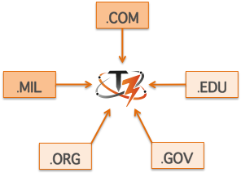
expands your talent pipeline
Integrate industry, military, academic, government, and non-profit partners
Conduct an assessment of overlapping interests
Connect across regions
.COM
.MIL
.EDU
.ORG
.GOV

Slide 8
finds the needles in the haystack
Companies describe their culture and job requirements
Transitioning service members explore opportunities
T3 screens interested service members
Company/school video / text content to T3
T3 generated cards
TSM generated Tier 1 profile
TSM generated selection
T3 generated ?s to TSM
TSM responses for Tier 2 profile
Hand off to Company / School
3
1
4
2
6
5
7
Interview, Enrollment, Onboarding within School and / or Company talent acquisition systems

Slide 9
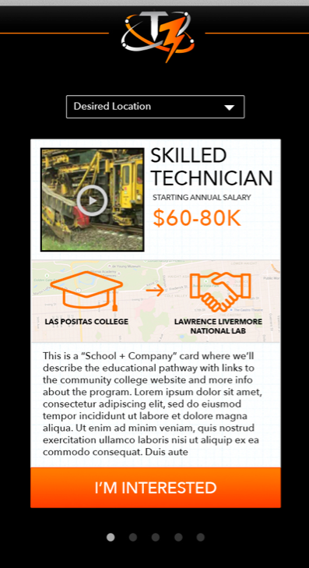

Slide 10
Contact me if you want to learn more
Brynt Parmeter
gparmeter@bmntpartners.com

