Slide 1
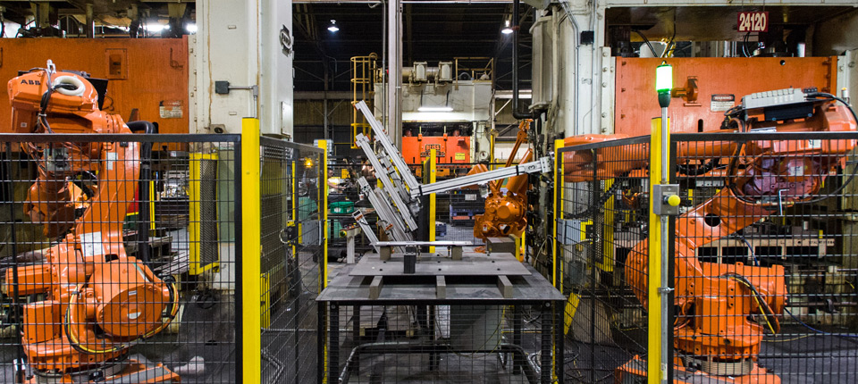
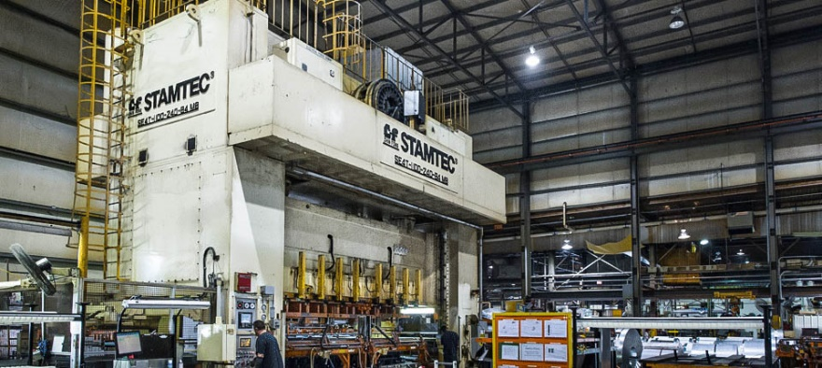
nth/works Goal
Create a sustainable world-class manufacturing company.

Slide 2
The Pre-Apprentice Solution
Welding & Automation
Tool & Die
Tool Engineering
CNC Machining
Quality
Started in 2012 with 5 students
Paid Training ($10 – 2012; $9 – 2011)
Rotating Focus Areas:
The Goals:
Elevate manufacturing as career
for new generation
Help fill the skilled trades gap
Students Graduate with skills for workforce

Slide 3
Learnings
Negatives:
Parent/Teacher/Counselor/Society Mantra
“You HAVE to go to college!”
STEM is weak
nth/works resources squandered
“Just a Job” Mentality

Slide 4
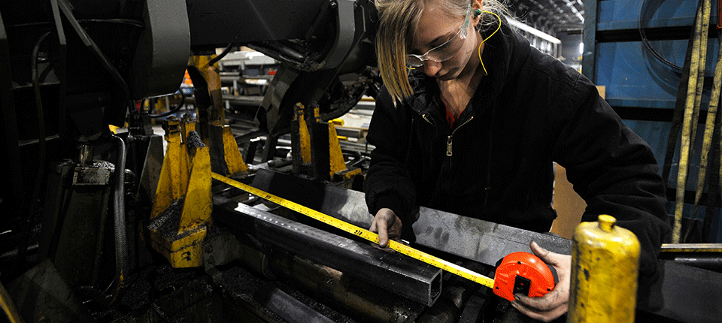
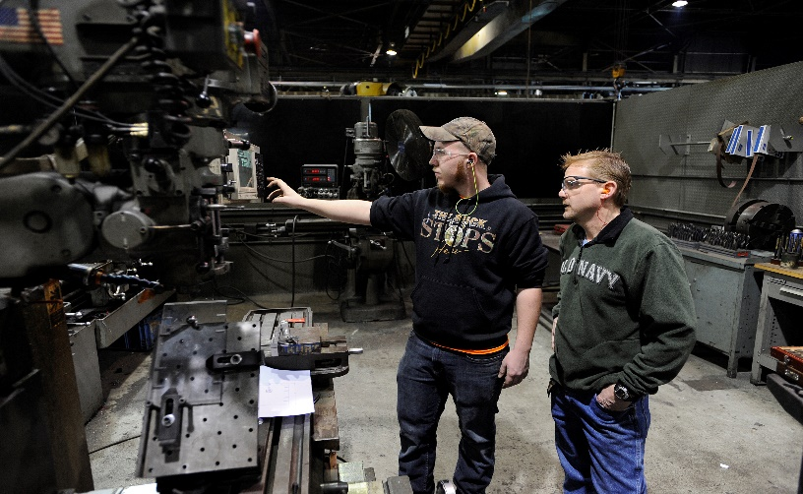
Learnings
Positives:
JCPS A++
Our Skilled Trades are willing to teach
Word of Mouth Outreach
Presence in High School
Total Hires +/- 20
Positive feedback for mentors

