Slide 1
AMT Problem Solving

Slide 2
Classroom Instruction
Students attend 8 hr workshop on Problem Solving
Students choose a problem in classroom to solve
Student then breaks down the steps of the problem
Instructors and AMT Leader mentor and coach students
Students visualizes problem on white boards
Students presents problem solving boards to manufacturers
This should also be happening on the manufacturing floor

Slide 3
Classroom instuction

Slide 4
AMT Leader coached TBP principles one on one with students

Slide 5
Students prepared their Problem Report on Board

Slide 6
Some benefits of using the white board: •Makes activity easy for other to see •Easy to make changes

Slide 7
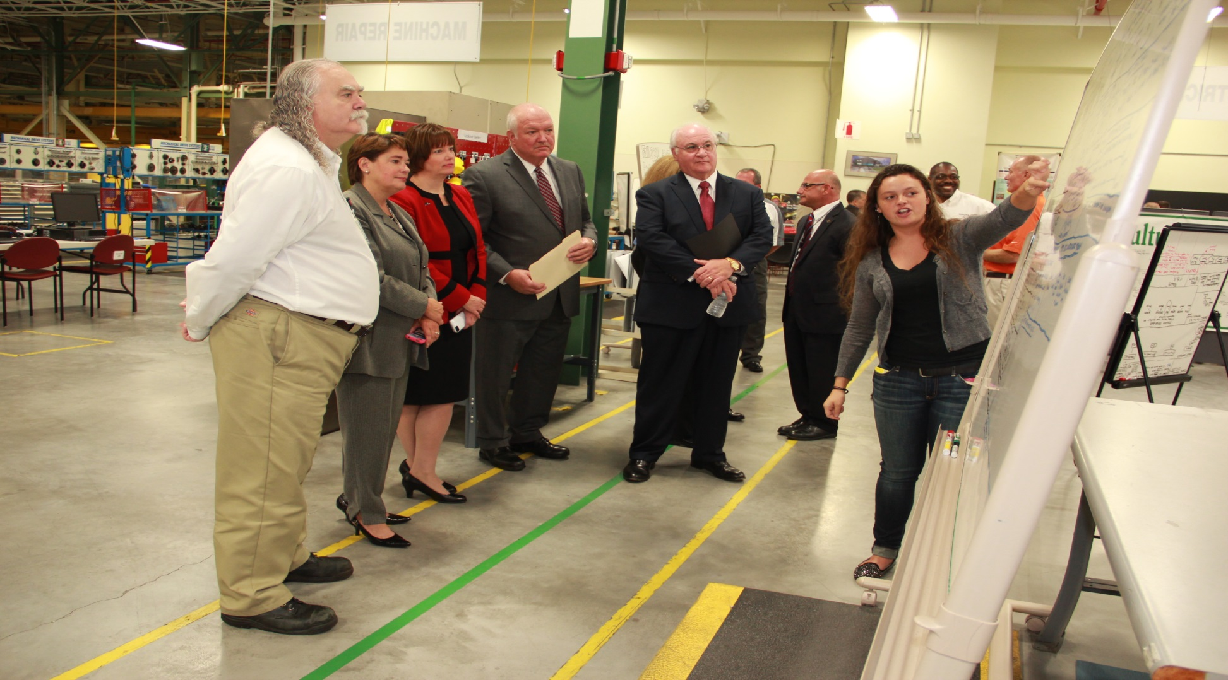
More benefits of using the white board:
•Keeps the activity fresh when in view daily
•Helps show a better picture of the program to visitors
•Helps recruit new companies because they can see student activities

Slide 8
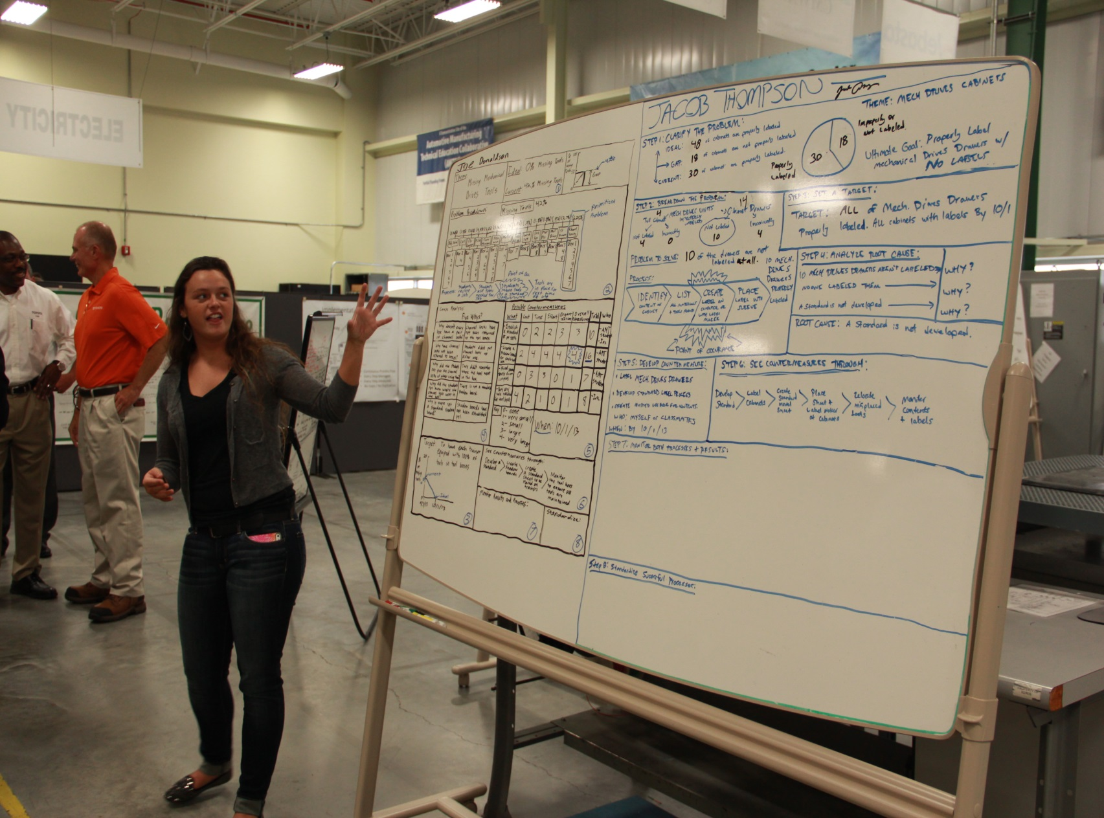
More benefits of using the white board:
•Develops Public Speaking skills and presentation skills.

Slide 9
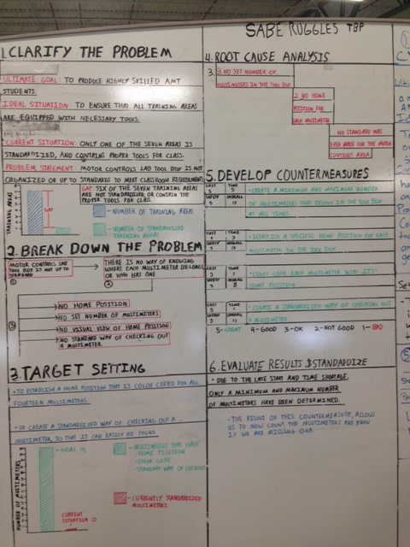
Other benefits of using the white board:
•Save a good “example” to serve as a guide for students when preparing their own project boards.

Slide 10
Questions?

