Slide 1
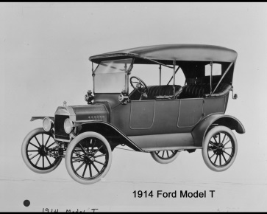
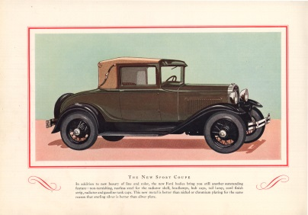
The Renaissance of American Manufacturing
1900
1920
1940
1960
1980
Today
Where are the people to make it happen?
Huge Challenge…Huge Opportunity

Slide 2
Huge Shortage of Skilled Trades
Is there anyone in the audience who doesn’t believe the shortage of skilled manufacturing people is real?
The “shortage story” is old news.
The bigger question is how did we get here and how do we recover?
Manufacturers and Academics.
Why do we have such a shortage of manufacturing talent?

Slide 3
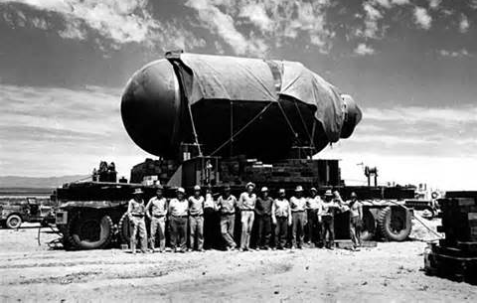
Manufacturing History Starting with World War II
American Mobilization of the entire workforce
Rosie the Riveter
Higgins Industries grew from a small business to providing 8,865 of the Navy’s 14,072 vessels in 1943.
The average Ford car had 15,000 parts and the B-24 Liberator long-range bomber had 1,550,000 parts. One B-24 off the line at Ford Motor Company ‘s Willow Run plant every 63 minutes.
The Manhattan Project began with a $6,000 budget and by the end of the war employed 130,000 workers and had spent $2.2 billion.
The “Greatest Generation” Delivered

Slide 4
The End of World War II
Sailor and girl in Times
Square

Slide 5
Who Were the Best Manufacturers in 1947?
Wrong question.
Who were the only significant manufacturers in 1947?
Every other country’s manufacturing facilities had been destroyed.
Americans manufactured products and shipped them all over the world. For twenty years, we had no competition.
We thought we were fabulous manufacturers.

Slide 6
American Manufacturing Reality
Our arrogance closed our eyes to the emergence of manufacturing excellence coming from Japan and Germany.
U. S. Management and Labor fought constantly.
Remember what we said in the 60’s and 70’s about the new cars from Japan and Germany?

Slide 7
Japanese Share of U.S. Auto Market
American Auto Makers
Japanese Auto Makers

Slide 8
Historical Market Share vs. Arrogance

Slide 9
Video Clip #1
Flint Factory Closing

Slide 11
Political Support for Manufacturing
In the middle of this gutting of the manufacturing sector, where were our politicians?
Cheap consumer goods for everyone vs. protection for the manufacturing sector.
Free Trade Policy. Unfortunately not a Fair, Free Trade Policy.
Service Industry. Information Industry.
“Manufacturing is dead. The end of the Industrial Revolution.”

Slide 12
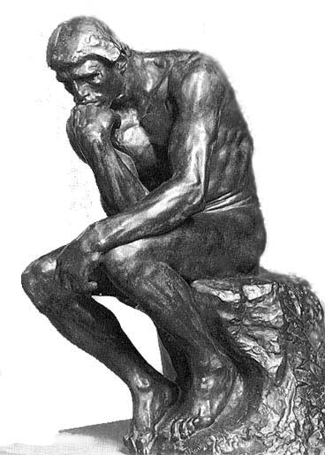
Here’s what our intellectual elites had to say about the issue.

Slide 13
Rise of the Service Economy and the Information Age
“Potato chips, computer chips, what’s the difference? A hundred dollars of one or a hundred dollars of the other is still a hundred dollars.”
Michael Boskin, Chairman, Council of Economic Advisors 1992

Slide 14
Rise of the Service Economy and the Information Age
“When a fast-food restaurant sells a hamburger, is it providing a service or combining inputs to manufacture a product?...the distinction is blurry.”
Dr. N. Gregory Mankiw, Chairman, Council of Economic Advisors. 2004

Slide 15
Video Clip #2
Taco Bell

Slide 16
Rise of the Service Economy and the Information Age
“A successful argument for a government manufacturing policy has to go beyond the feeling that it’s better to produce “real things” than services. American consumers value health care and haircuts as much as washing machines and hair dryers.”
Christina Romer, 4 February 2012 NYT, former Chairwoman of President Obama’s Council of Economic Advisors.

Slide 17
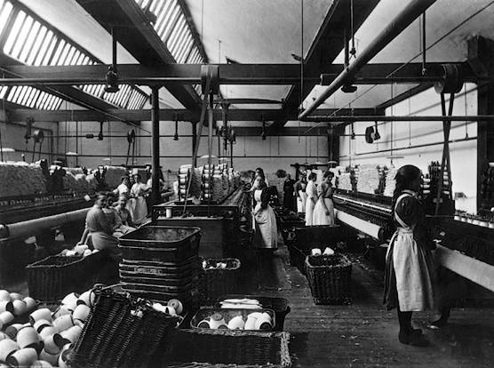
Here’s the context for the decision for your son or daughter to go into manufacturing.

Slide 18
1990-2010 Decisions, Decisions….
If you’re a talented student thinking about your future, is manufacturing top of mind?
If you’re the parent of a talented student, are you advising them to go into manufacturing?
If you’re the high school guidance counselor, are you advising any of your talented kids to go into manufacturing?
Combine this with the American mantra of “If you want to be successful, you have to go to a four year college.”
The answer to all three questions is a resounding NO!

Slide 19
So What?
That was then, this is now.
America can’t have a manufacturing revival without people to make it happen – all the people.
Everyone in a manufacturing facility has to contribute.
The good old days of “Tom says…..” doesn’t work.

Slide 20
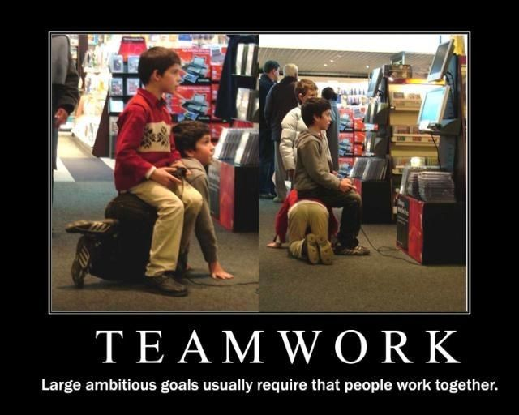
Soft Skills Essential
Teamwork
Problem solving
Attitude
The sum of the individual team members capabilities = the strength of the team.
What’s the strength of our human capital to join today’s team?

Slide 21
The 2012 PISA assessment showed US 15-year-olds scoring below average in math and science (compared to students from 64 other countries and systems)
2013 Program for International Student Assessment results from nces.ed.gov

Slide 22
….and outscored by key economic competitors
23rd in Reading Literacy | 34th in Mathematics Literacy | 27th in Science Literacy
Shanghai, Hong Kong, Singapore, Japan, Republic of Korea, Finland, Ireland, Chinese Taipei, Canada, Poland, Estonia, Liechtenstein, New Zealand, Australia, Netherlands, Belgium, Switzerland, Macao-China, Germany, Vietnam*, France*, Norway*, United Kingdom* | Shanghai, Singapore, Hong Kong, Chinese Taipei, Republic of Korea, Japan, Liechtenstein, Switzerland, Netherlands, Estonia, Finland, Canada, Poland, Belgium, Germany, Vietnam, Austria, Australia, Ireland, Slovenia, Denmark, New Zealand, Czech Republic, France, United Kingdom, Iceland, Latvia, Luxembourg, Norway*, Portugal*, Italy*, Spain*, Russian Federation*, Slovak Republic* | Shanghai, Hong Kong, Singapore, Japan, Finland, Estonia, Republic of Korea, Vietnam, Poland, Canada, Liechtenstein, Germany, Chinese Taipei, Netherlands, Ireland, Australia, Macao-China, New Zealand, Switzerland, Slovenia, United Kingdom, Czech Republic, Austria*, Belgium*, Latvia*, France*, Denmark*
* Marks a score difference that is not statistically significant

Slide 23
Educational Testing Service Study
ETS Research Forum: America’s Skills Challenge: Millennials and the Future
Literacy
Numeracy
Problem solving in technology rich environments
22 Participating countries

Slide 24
ETS Study Con’t
How do the average scores of U.S. millennials compare with those in other participating countries?
Literacy – Only Spain and Italy had lower scores.
Numeracy – US tied for last with Spain and Italy
PS-TRE – US tied for last along with Slovak Republic, Ireland and Poland

Slide 25
ETS Study Con’t
How do millennials with different levels of educational attainment perform over time and in relation to their peers internationally?
Since 2003 the percentage of US millennials scoring below level 3 (Minimum) in numeracy increased at all levels of education attainment.
U.S. millennials with a 4 year bachelor’s degree scored 20th out of 22.
Millennials with a master’s or research degree scored 19th out of 22.

Slide 26
Manufacturer’s Challenge #1
Changing the perception of manufacturing. No longer dirty, dark and dangerous.
Manufacturing today is sophisticated and high tech.
Manufacturers need to engage the academic community differently than we have historically.
For talented young adults, this is an opportunity of a lifetime.

Slide 27
Manufacturer’s Challenge #2
Finding young adults:
With brains and a decent education
Who are drug free
Who have a desire to work as part of a team
Who are not entitled
In other words, “Hey Dude” doesn’t get it.

Slide 28
Manufacturers and Educators Must Join Together
Most manufacturers have turned their backs on the labor shortage issue preferring to hire from others.
We need to challenge educators to think differently about how to educate kids so they’re work or college ready when they graduate high school.
Approximately 25% of the $1.2 Trillion in college debt is remedial education to get students ready to start college.
The AMT model is outstanding and will serve as an example for other industries.
Ford’s Next Generation Learning is another “mold-breaking” model with great success.
What are some of the potential obstacles of manufacturers working effectively with educators?

Slide 29
Educators and Manufacturers Different Perspectives?
Tangibility and Political Behavior
Cost Management
The Urgency Quotient

Slide 30
Tangibility Continuum
Tangible
Intangible
Farmer
Rabbi or Priest

Slide 31
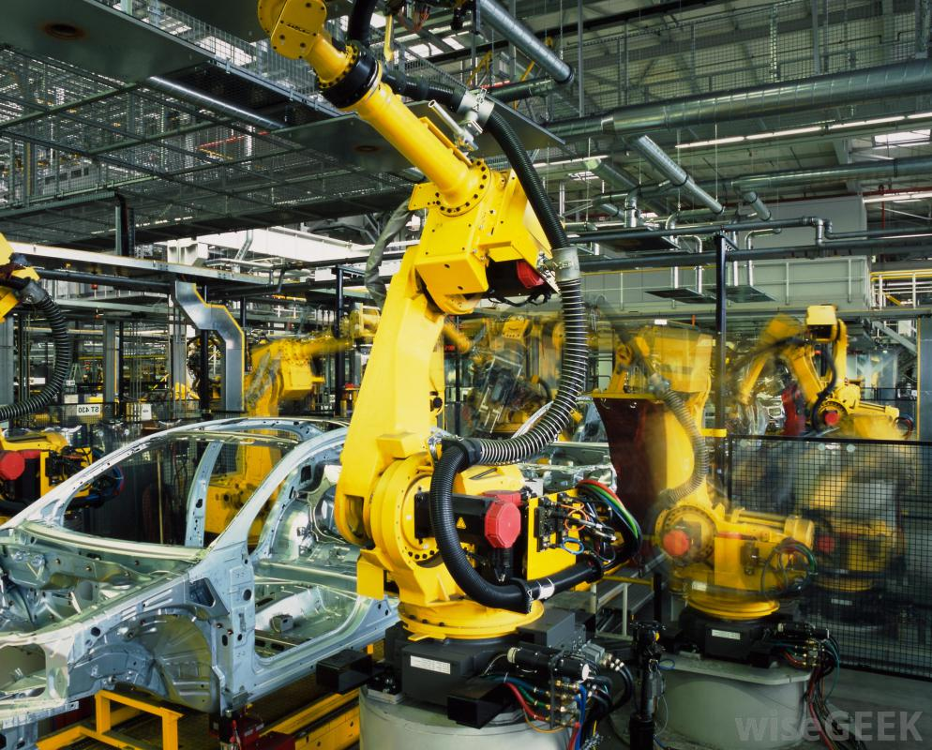
Tangibility Continuum
Tangible
Intangible
Manufacturer
College Professor

Slide 32
Intangibility and Political Behavior
Political
Political Behavior
Apolitical
Tangible
Intangible
Tangibility

Slide 33
Educators and Manufacturers Different Perspectives?
Tangibility and Political Behavior
Cost Management
The Urgency Quotient

Slide 35
The Cost of a College Education
Annual Growth Rate 5.8%

Slide 36
Urgency Quotients
Group Discussion about the cost per hour of shutting down Toyota, GE, Siemens or Ford.

Slide 37
Summary
It took 30 to 40 years to dig this hole. It’s going to take awhile to recover.
From a manufacturer’s perspective, the education model has to evolve to deliver graduates who can quickly add value to the organization and later become the next generation of manufacturing leaders.
The soft skills are essential.
Educators and manufacturers need to work together as partners recognizing we have different skill sets.
Manufacturing will be an extraordinary opportunity over the next 30 or 40 years.
Kids and their parents are beginning to get it.

