Slide 1
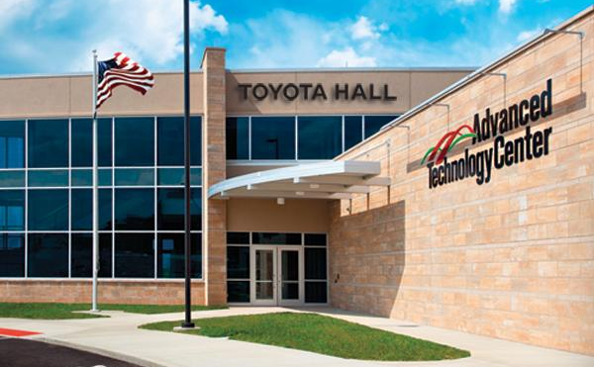
ADVANCED MANUFACTURING
CENTER
Norm Mortensen
Dean of Technology
BridgeValley CTC

Slide 2
ADVANCED MFG CENTER
SAFETY COMMITMENT
Making sure that Dennis recites his safety commitment …

Slide 3
ADVANCED MFG CENTER
Tour of the Advanced Manufacturing Center
Student hosted tour of the AMC.
Split into six groups. Your numbers are not a raffle. (Sorry!)
Each group will start in the area identified by your number. (Map to come!)
Transitions to the next area will be announced via the public address system.

Slide 4
ADVANCED MFG CENTER
Tour of the Advanced Manufacturing Center
A pair of freshmen AMT students will conduct the tours groups.
The sophomore students will present each area.

Slide 5
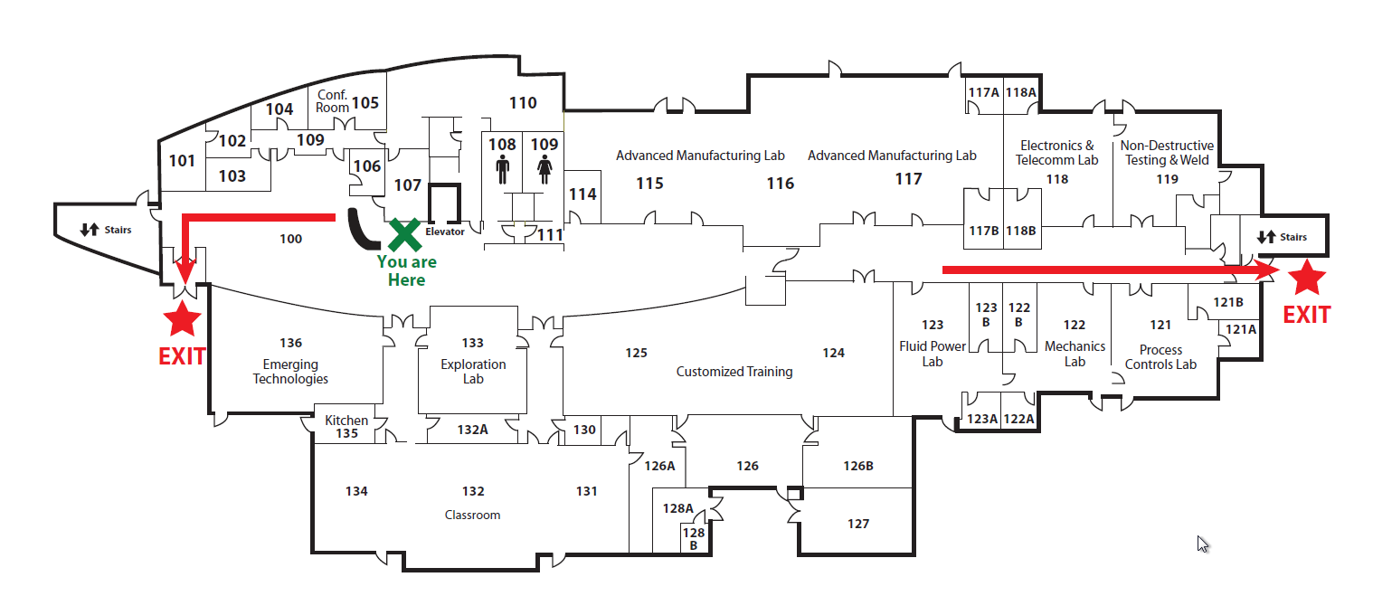
ADVANCED MFG CENTER
2
3
4
1
6
5
YOU ARE HERE

Slide 6
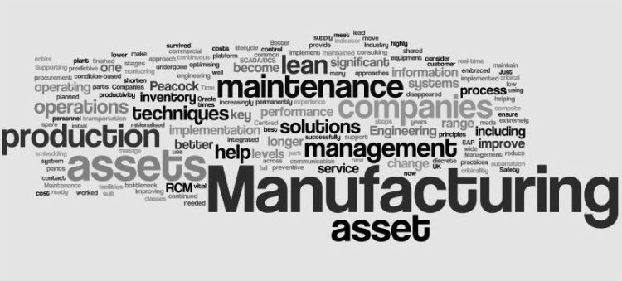
ADVANCED MFG CENTER

