Slide 1
Second Annual AMT Conference
Manufacturing Qualification System
(MQS)
Presented by
John McBride II

Slide 2

This system was designed and built by a Toyota Team Leader (TL).
It was built to keep up with the skill set and training needs at each plant.
- Shows skill gap Target training needs.

Slide 3

When the system is used properly it is a great tool for the maintenance Group Leader (GL), Assistant Manager (AM) and the Manager.
It is also a great tool for the training department to see skill gaps of their Team Members (TM’s).

Slide 4
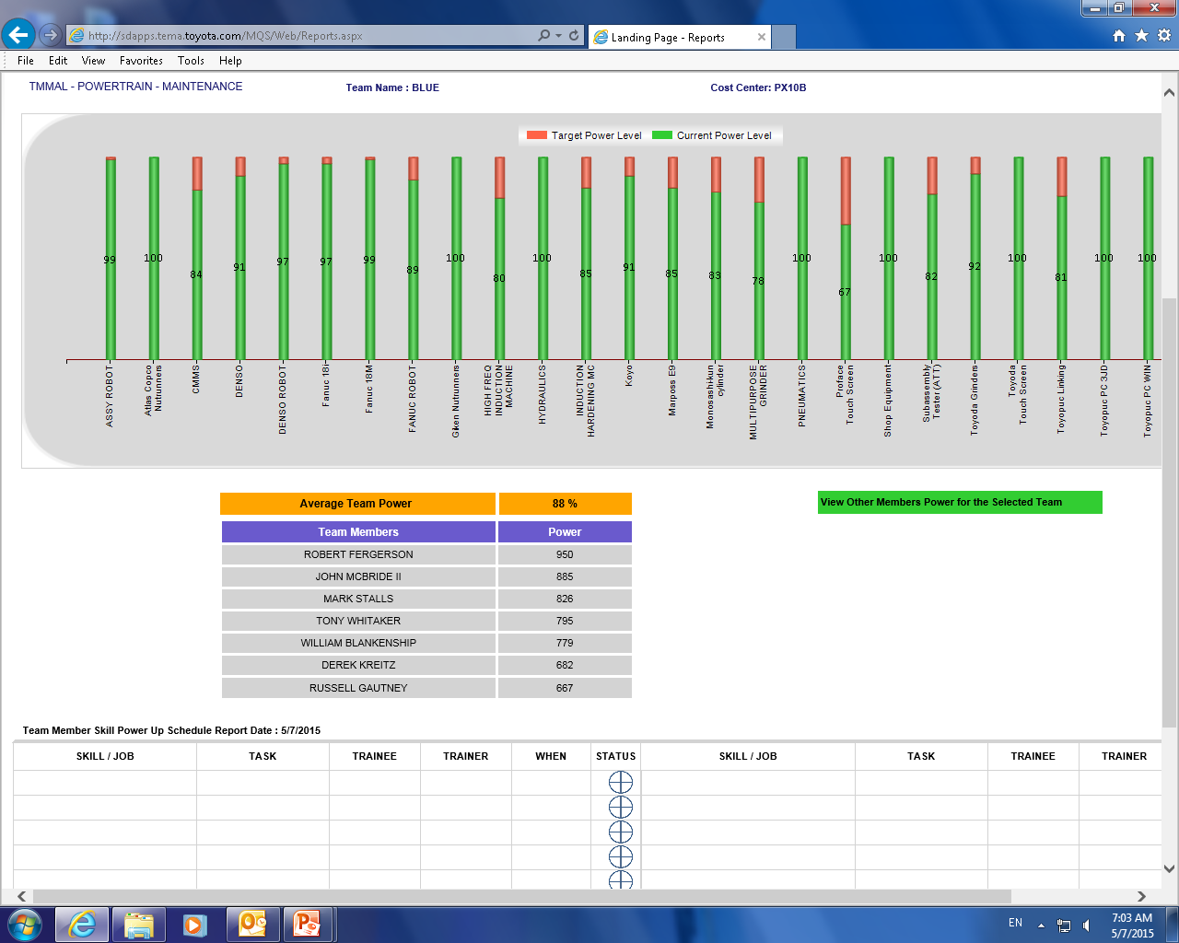
This is just one of the reports used for tracking.
Team Proficiency Level
Equipment
Individual Proficiency Level

Slide 5
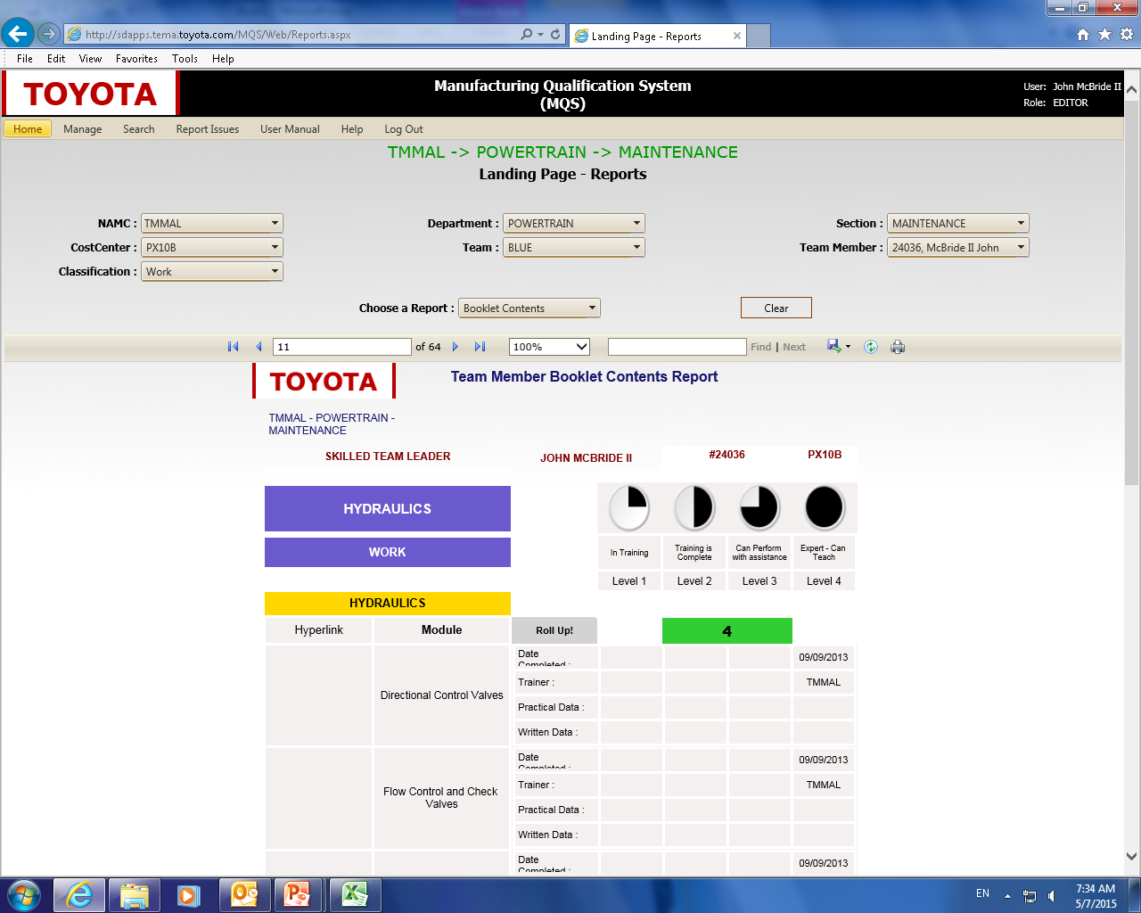
Let’s talk for a just a minute about scoring:
  Level 1 → In Training
  Level 2 → Training Complete
  Level 3 → Can Perform Task with No Assistance
  Level 4 → Expert – Can Teach
Overall course score
Date level attained on module

Slide 6
We also use MQS for tracking what the students learn at school.
It is our way to make sure they grasp what they are learning at school.

Slide 7

It is also our way of making sure that they understand how each element fits in real life, on the job situations.

Slide 8
This is where the mentors are a large part of the process.
The students have to explain or demonstrate each of the elements in the MQS booklet.

Slide 9

THIS IS A GREAT TOOL!!!
This is a great tool for keeping up with how your AMT's are grasping what the instructors are teaching them.

Slide 10

It is also a great way for all of us to keep track of their work ethic also.
It is the AMT’s book and their responsibility to complete.

Slide 11

The AMT’s are very good about asking, if they do not completely understand an assignment.

Slide 12

The first semester we had to set aside one day to work with the AMT’s in order to get their books completed.
None of the AMT’s had completed their book. 100%.

Slide 13
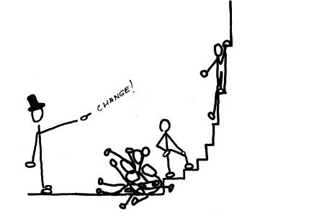
This was our first group to go through the books.
We had one of our very smart electrical TM’s help them.
This was a learning point for the first semester with the books.

Slide 14

Yes, they have books at work they have to complete also.

Slide 15
I talked with the instructor at the college and he gave me the plan of instruction for each class they take during the program.

Slide 16

Due to time constraints the first semester, we used the booklet that was already done in the MQS system.

Slide 17

The second semester booklet was complete but needed a few changes.
For the third semester, we used the plan of instruction and made the books.

Slide 18
The books are full of simple questions about what they have learned each semester.

Slide 19
The AMT’s have to explain to the mentors the answers to the questions in the books.

Slide 20
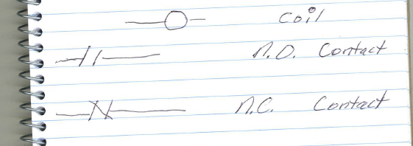
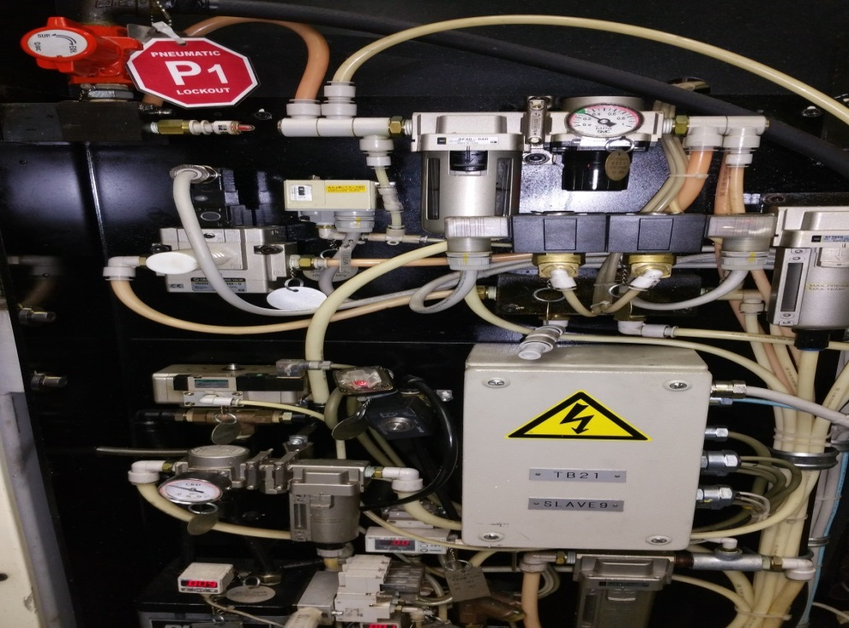
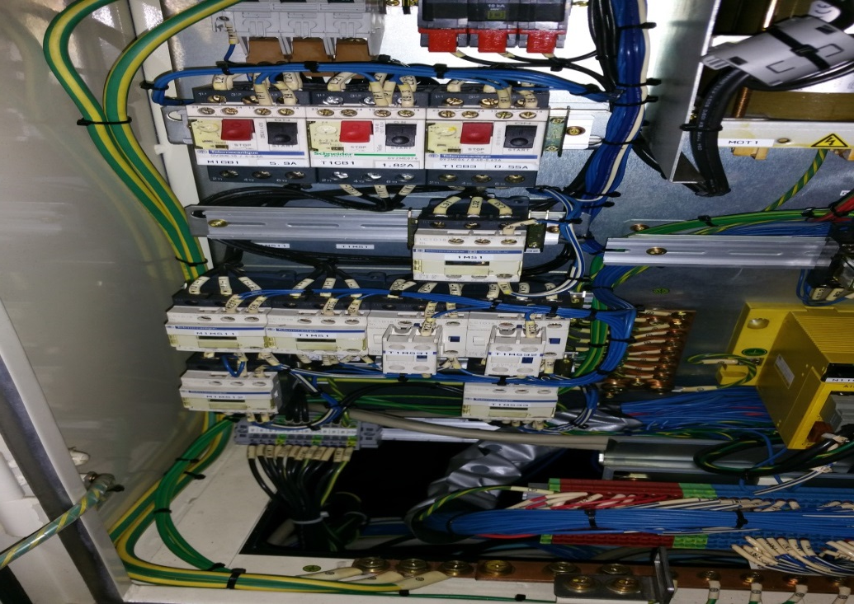
Some of the questions require the student to draw something.
Show mentor the item on a machine.
Gauge
Breaker
Cut off valve
Ground

Slide 21
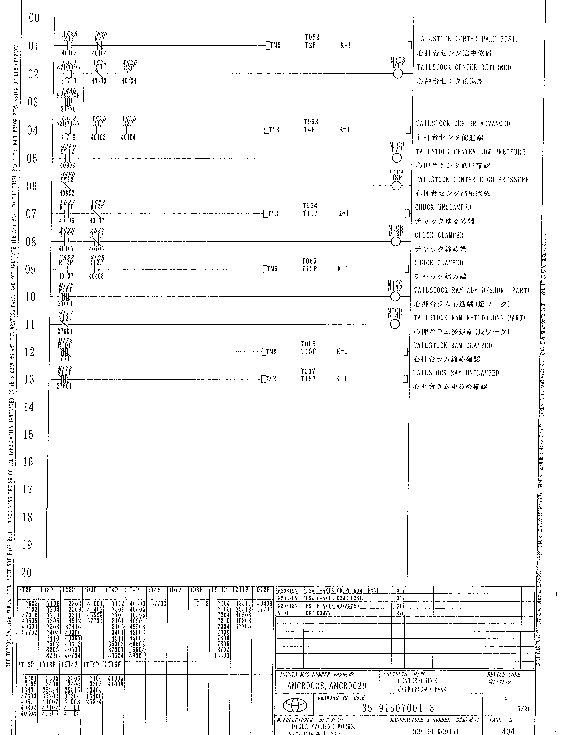
Show mentor an item in the logic.
This contact is used in another device code
N.O. contact
N.C. contact
Coil
Timer

Slide 22
We also have them do (CBT) Computer Based Training. We pick the training that is relevant to the classes they are taking that semester.

Slide 23

The AMT’s also have to complete some other online classes from the Simutech software.
We input the scores from the books into MQS at least once a month.

Slide 24

Regarding the grading, it is done a little different for the AMT’s than for the regular TM’s.

Slide 25

If an AMT can explain it to their mentor with no problems, they get a 3. The mentors at TMMAL will not sign off on an element until the AMT can explain it with no help.

Slide 26




NOW LETS LOOK AT THE BOOKS
 |  | 50250170-TMMAL Maintenance Work Foundation
 |  | WORK |  |  | In Training | Training is Complete | Can Perform with assistance |  | Expert - Can Teach
 |  |  |  |  | Level 1 | Level 2 | Level 3 |  | Level 4
 |  | Semester 3 Basic Programming
 |  | Hyperlink | Module | Roll Up! |  | 0
 |  |  | Describe the rules that govern a ladder diagram. | Date Completed :
 |  |  |  | Trainer :
 |  |  |  | Practical Data :
 |  |  |  | Written Data :
 |  |  | Describe the use of various elements of the instruction set. | Date Completed :
 |  |  |  | Trainer :
 |  |  |  | Practical Data :
 |  |  |  | Written Data :
 |  |  | Draw a coil. | Date Completed :
 |  |  |  | Trainer :
 |  |  |  | Practical Data :
 |  |  |  | Written Data :
 |  |  | Draw a contact. | Date Completed :
 |  |  |  | Trainer :
 |  |  |  | Practical Data :
 |  |  |  | Written Data :

Slide 27
 | Describe how to use count down functions. | Date Completed :
 |  | Trainer :
 |  | Practical Data :
 |  | Written Data :
 | Describe how to use count up functions. | Date Completed :
 |  | Trainer :
 |  | Practical Data :
 |  | Written Data :
 | Describe the terms associated with PLC counter functions. | Date Completed :
 |  | Trainer :
 |  | Practical Data :
 |  | Written Data :
 | Explain how to reset counters. | Date Completed :
 |  | Trainer :
 |  | Practical Data :
 |  | Written Data :

Slide 28

Every question is one that a skilled TM needs to know and understand.

Slide 29

There are no trick questions in the books.
The book’s purpose is only to confirm the knowledge and understanding that the AMT’s have gained.

Slide 30

TMMAL offers this booklet to everyone in the AL FAME.

Slide 31

We want to make sure that ALL AMT’s are given the same opportunity to have their skills tested / verified.

Slide 32

For now, MQS is proprietary, and we cannot share it. So we have put the booklets in excel format so that everyone can get a copy of the materials.

Slide 33
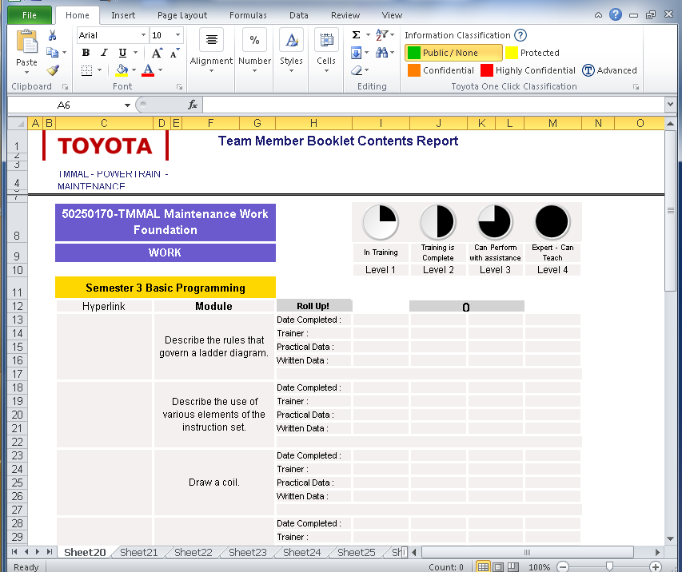

Slide 34

THIS CONCLUDES THE MQS PRESENTATION
QUESTIONS?

